Slide 1
Eagle Technology Proteus MMX
Harry Kohal, VP Business Development
07-Dec-2011
COBie CMMS/CAFM Challenge
1

Slide 2
product description
Proteus MMX is a web-based, multi-enterprise solution for asset life-cycle management. Hosting a top level down architecture, the major functions are separated into modules for ease of use and understanding; yet integrated to provide maximum utilization and optimization. Proteus MMX integrates asset management, maintenance management, inventory, labor and purchasing functions for improved scheduling, cost reduction, resource planning and more.
07-Dec-2011
COBie CMMS/CAFM Challenge
2

Slide 3
product features
• Web-based - no software to install!
• World wide access
• Customizable & robust
• Automated work order generation
• Automatically print, email, or send work orders to a mobile device
• Multi-location management
• Multi-cycle scheduling
• Powerful report generator with over 120 reports and graphs
• Multiple languages and currencies
• Integrate with BMS/BAS systems
• View drawings, videos, user manuals, maintenance instructions, etc.
• Fixed or mobile asset tracking with RFID
• Many more options to choose from
07-Dec-2011
COBie CMMS/CAFM Challenge
3

Slide 4
user base
users
user count:
facility count:
public sector:
private sector:
customers
name:
name:
name:
100 users
50 facilities
30% (Airports, Universities, etc.)
70% (Manufacturing, Office Buildings, etc.)
Woodbine Entertainment Group
Ottawa Airport
Princess Noura University (Saudi Arabia)
07-Dec-2011
COBie CMMS/CAFM Challenge
4

Slide 5
tested product
product name:
product version:
PC or Cloud:
website:
Proteus MMX
2.1
PC / Cloud
http://www.eaglecmms.com
07-Dec-2011
COBie CMMS/CAFM Challenge
5

Slide 6
challenge scope
information | COBie.Sheet | Imported
spaces and equipment | Space, Type, Component | 
PM schedules | Job | 
safety procedures | Job | 
systems | System | 
system procedures | Job | 
materials, tools, training | Resource | 
associated documents | Document | 
replacement parts | Spare | 
space and equipment properties | Attribute | 
space zones | Zone | 
07-Dec-2011
COBie CMMS/CAFM Challenge
6

Slide 7
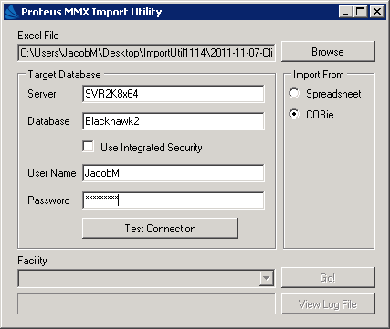
configuration
As a consumer of the COBie Standard, Eagle Technology, Inc. (Eagle) provides a capability to import COBie data into a SQL database accessed by Eagle’s maintenance/asset management solution, Proteus MMX.
Prerequisites:
New/Blank/Empty Proteus MMX database
COBie XML document
Proteus MMX installation
It should be noted the import tool is designed to be utilized in conjunction with a new database, the initial step in the CMMS implementation process. Proteus MMX must be installed and configured. The COBie XML document should be saved as a Microsoft Excel document (2003 or 2007). The COBie Conversion Tool will retrieve the data and populate the Proteus MMX database.
07-Dec-2011
COBie CMMS/CAFM Challenge
7

Slide 8
process
The process of COBie consumption is quite simple.
Prerequisites:
New/Blank/Empty Proteus MMX database
COBie XLS document
Proteus MMX installation
One the above items have been gathered, a Technical Support Specialist from Eagle Technology will utilize the Proteus MMX Import Utility to import the data in the system.
The import time for the sample Clinic XLS document is approximately three (3) minutes.
07-Dec-2011
COBie CMMS/CAFM Challenge
8

Slide 9
COBie savings – single project
Eagle Technology does not currently have any applications of COBie consumption in the current market.
back of napkin estimate of:
Savings to load data - $30,000
savings per PM - $50
savings per service order - $50
Total $ FM office savings - $75,000 - $100,000
07-Dec-2011
COBie CMMS/CAFM Challenge
9

Slide 10
COBie savings – facility portfolio
Eagle Technology does not currently have any applications of COBie consumption in the current market.
back of napkin estimate of:
Savings to load data – 85%
savings per PM – 50%
savings per service order – 50%
Total $ FM office savings - $75,000 – $100,000 per building
07-Dec-2011
COBie CMMS/CAFM Challenge
10

Slide 11
contacts
COBie support
name:
phone:
email:
web:
marketing POC
name:
phone:
email:
Matthew Wagner
(262) 241-3845
MatthewW@eaglecmms.com
http://www.eaglecmms.com
Jennifer Bublitz
(262) 241-3845
JenniferB@eaglecmms.com
07-Dec-2011
COBie CMMS/CAFM Challenge
11

Slide 12
COBie import demo
07-Dec-2011
COBie CMMS/CAFM Challenge
12

