Slide 1
IBM Maximo Asset Management
Doug Wood, Architect Tivoli CTO’s Office
21-Dec-11
COBie CMMS/CAFM Challenge
1

Slide 2
Maximo Asset Management
Asset Management
Facilities, Operations, IT, Fleet
Assets, Locations, Failure Reporting, Condition Monitoring, Meters
Work Management
Preventive, Corrective, Projects, Emergency, Safety Plans
Work Hierarchies, Planning, Status, Assignments, Actual Metrics
Procurement Management
PR’s, PO’s, Receipts, Invoices
Materials Management
Items, Storerooms, Inventory, Reorder, Issues, Returns
Contract Management
Master, Purchase, Warranty, Lease/Rental, Labor Rate
Service Management
Self Service Requests & Status
Platform for asset owners, asset managers and service providers
Next Generation Architecture
J2EE Platform
Standards-based
Service Oriented Architecture (SOA)
ASSET
WORK
Management
PROCUREMENT
SERVICE
CONTRACT
MATERIALS
Management
MAXIMO ASSET MANAGEMENT
07-Dec-2011
COBie CMMS/CAFM Challenge
2

Slide 3
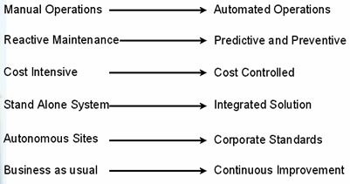
Maximo Capabilities
Documented maintenance plans through knowledge based solution leads to timely problem identification and resolution
Increase wrench time through the use of advanced scheduling tools
Clear tracking of responsibilities and asset maintenance strategy leading to reduced asset downtime
Decreased capital investment through Improved asset useful life by identification of manufacturer related issues and accurate warranty tracking
Manage contractors/vendors and service providers increasing the quality of services rendered
Stock management for critical spares, linking to maintenance schedules, leading to reduced carrying costs
Mobile devices support real-time access to assigned work and asset details for improved resolution times
Facilities service desk to publish available services and provide increased customer satisfaction
Benefits:
Improved warehouse productivity
Support for Sarbanes-Oxley compliance
Improved regulatory/safety compliance
More accurate data for improved decision making
Improved work planning/coordination
Sales growth through improved service
07-Dec-2011
COBie CMMS/CAFM Challenge
3

Slide 4
Who uses Maximo? Asset Intensive Organizations
11 of the 12 largest PHARMACEUTICALS companies in the world are using Maximo
7 of the 10 largest AUTOMOTIVE companies in the world are using Maximo
8 of the 10 largest OIL & GAS companies in the world are using Maximo
11 of the 20 largest diversified UTILTY companies are using Maximo
11 of the 12 major AEROSPACE & DEFENSE companies in the world are using Maximo
9 of the 15 busiest AIRPORTS in the world are using Maximo
6 of the 10 largest ENERGY companies in the world are using Maximo
May 2010
07-Dec-2011
COBie CMMS/CAFM Challenge
4

Slide 5
tested product
product name:
product version:
PC or Cloud:
website:
Maximo Enterprise Asset Management
7.5.0 test, 7.1.1.8+ supported
Cloud
http://www-01.ibm.com/software/tivoli/products/maximo-asset-mgmt/
21-Dec-11
COBie CMMS/CAFM Challenge
5

Slide 6
challenge scope
information | COBie.Sheet | Imported
spaces and equipment | Space, Type, Component | 
PM schedules | Job | 
safety procedures | Job | 
systems | System | 
system procedures | Job | 
materials, tools, training (Tools Only) | Resource | 
associated documents | Document | 
replacement parts | Spare | 
space and equipment properties | Attribute | 
space zones | Zone | 
Not tested, but support validate, merge, update and export or all of the above
21-Dec-11
COBie CMMS/CAFM Challenge
6

Slide 7
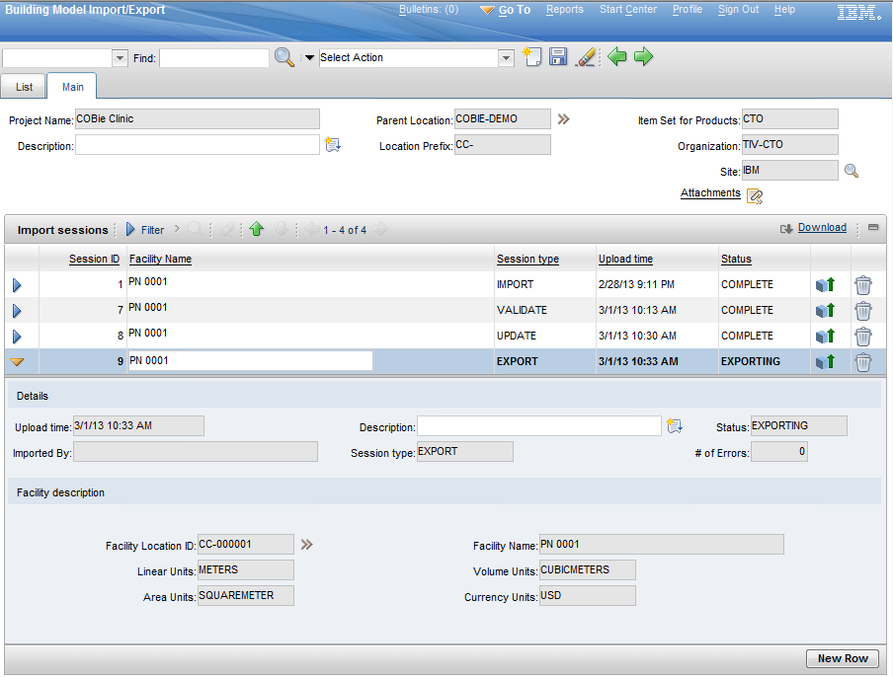
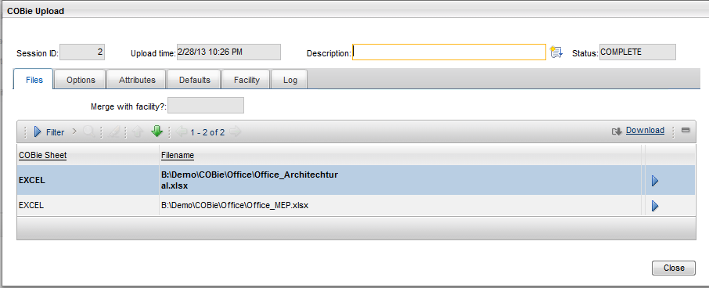
COBie Data exchange application
Session based import/Export/Update/Validate utility that provides audit trail of imports
Import from native Excel format and CSV format
Browser based import completely driven by Maximo user
(No IT involvement required)

Slide 8
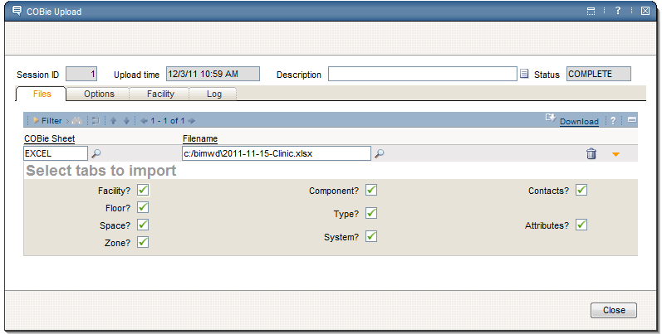
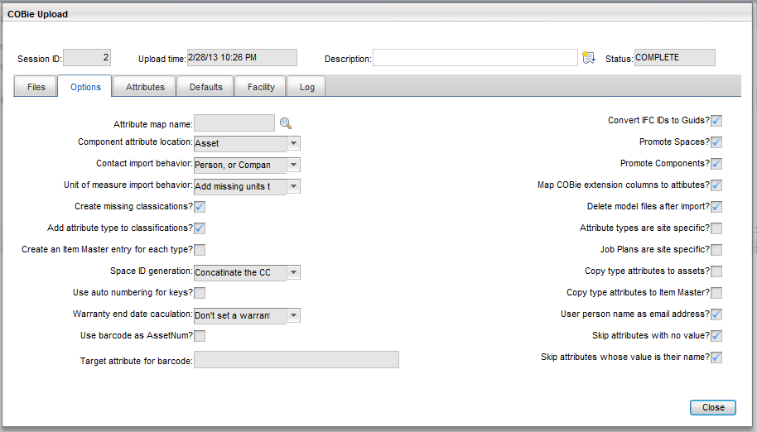
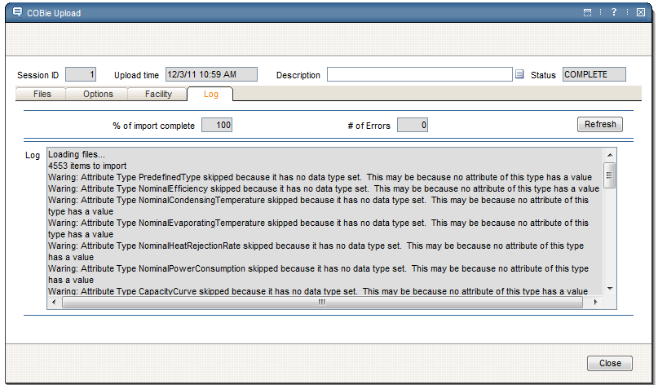
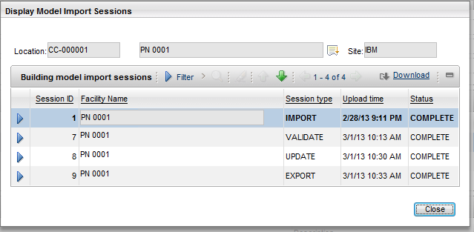
COBie import
Import from native Excel format and CSV format
Many Import configuration options to deal with import data quality and custom configurations
Full log of import session
View import history for any asset or location

Slide 9
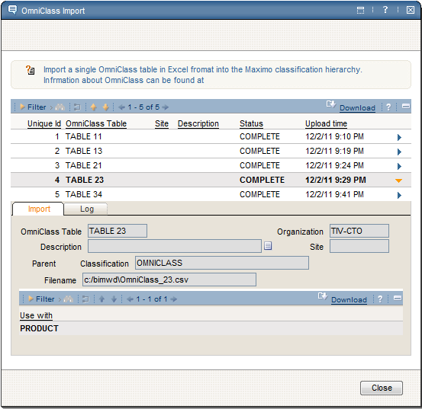
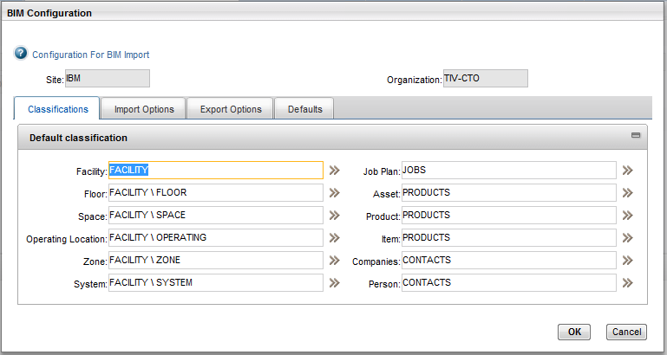
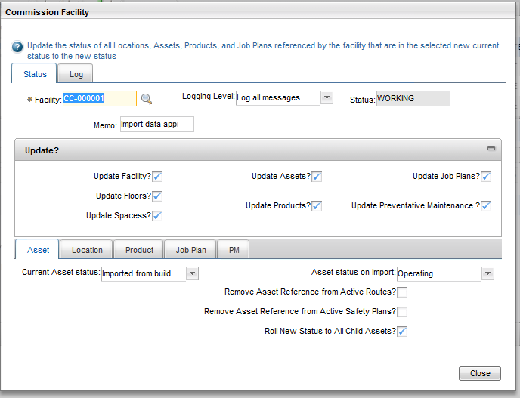
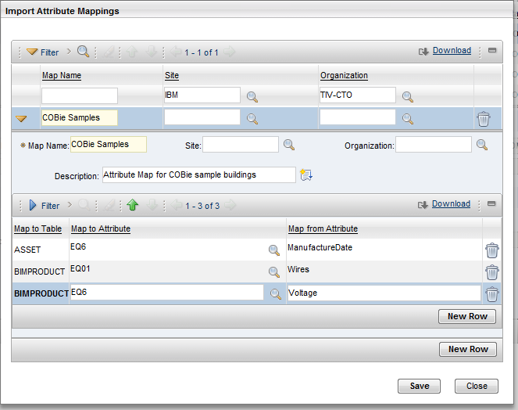
OmniClass Import and Building Commission Application
OmniClass import utility
Default Classification provides a fallback for uncategorized COBie data
User configurable mapping of import data
Bulk status update utility to move imported data into production

Slide 10
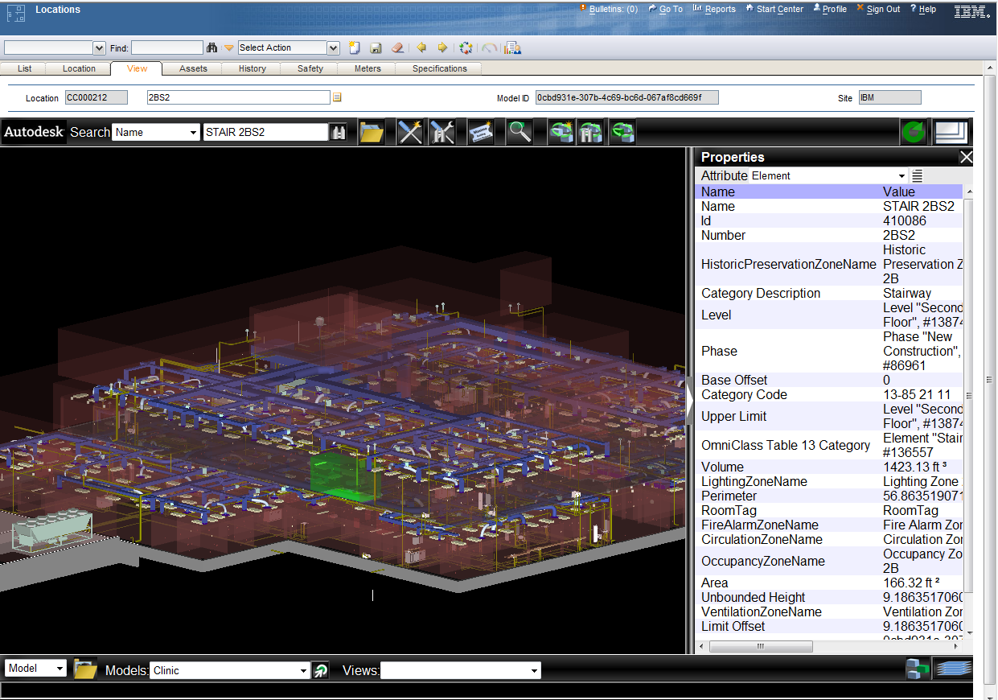
process
Assets with open work order, service requests, or preventive maintenance due can be highlighted in the model
Current Maximo record tracks model selection
IFC GUID Binds Maximo records to import source
Simple search of key model properties
COBie Systems and Zone are imported as Maximo Systems and can be viewed and edited
Work orders can be created for the asset selected in the model
Property Sheets for all model properties
Model selection and focus track Maximo selected asset or location
Predefined views may be associated with the model
Selection sets hide or display model elements
07-Dec-2011
COBie CMMS/CAFM Challenge
10

Slide 11
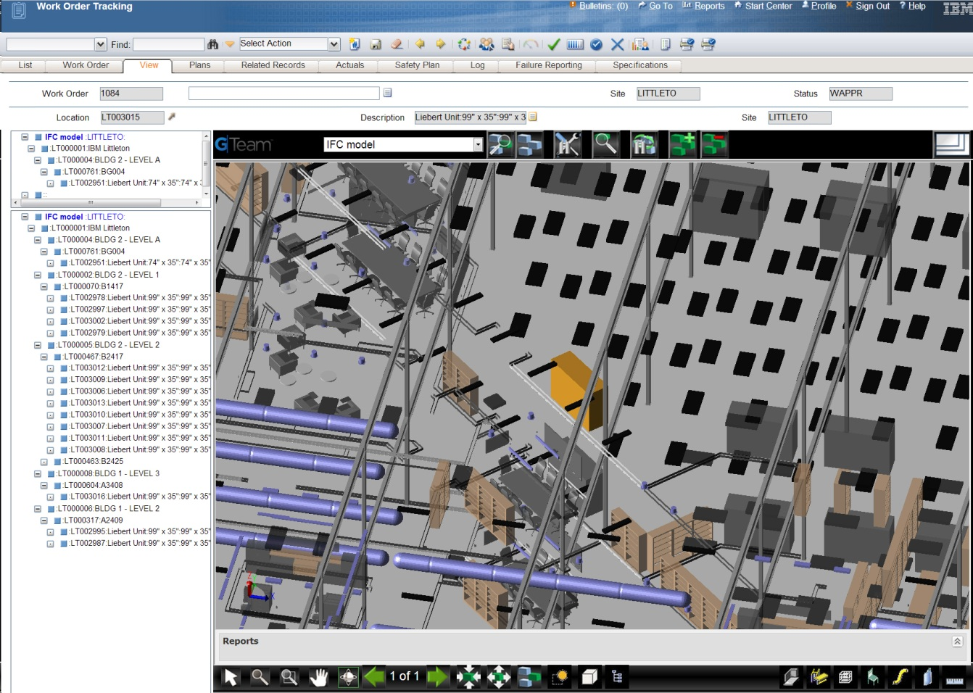
Work order viewer integration
Selecting the facility to display in the viewer
Many ways to search and create a selection list
Add or remove selection list from work order
Tree has list of all assets and locations associates with the work order and shows path to top
Selecting an item in the tree displays and highlights it in the viewer

Slide 12
contacts
COBie support
name:
email:
marketing POC
name:
phone:
email:
Doug Wood
Doug.wood@us.ibm.com
Kim Woodbury
(978) 899-2644
Kim Woodbury/Bedford/IBM
07-Dec-2011
COBie CMMS/CAFM Challenge
12

