Slide 1
dRofus Inc dRofus
Ole Kristian Kvarsvik, Head of business & technology
Company
logo
10-Jan-13
2013 Building Programming information exchange Demo
1

Slide 2
product description
Client requirement management
Areas/space planning and administration
Room data sheet planning
FF & E planning
Data sync and validation design model ↔ program
Client and end user involvement
Purchase of (moveable) FF&E
Log. Tracking of all changes in the project
TIDA - Separate module for complete FM documentation and punch lists.
Not yet for the international market
dRofus® is a unique, cloud based tool for planning, program validation and data management. dRofus is a collaboration tool and a project can have “unlimited” number of users (without additional cost).
dRofus® handles all building types, including large projects where several design models needs to be synchronized to a central database.
dRofus® has a strong connection to the Autodesk® Revit® suite and extensive support for IFC.
dRofus® has a built in (ifc) EDM ModelServer from Jotne EPM Technology.
10-Jan-13
2013 Building Programming information exchange Demo
2

Slide 3
product features
COBie/BPie
dRofus can export COBie/BPie compliant ifc files
dRofus supports import of ifc design files and can syncronize/enhance design files with BPie data through design development
The standard requirements model (BPie) enables full scale validation through model checking (against req.).
Result: What you order is what you get (at handover)
dRofus® is built for (client) requirement management throughout the project. The key to enable comparison between program requirement and the design solution (BIM) is either through plug-in access or through OpenBIM comparison.
Plug-in:
Requirements and planned FF&E available in design interface
Continuously synchronizing data between requirements and design
OpenBIM
Upload ifc to built in ModelServer
Compare
Update
10-Jan-13
2013 Building Programming information exchange Demo
3

Slide 4
user base (15th Dec. 2012)
8269 registered users
513 active projects (of 1029 total)
50% health, 15% education, 10% office, 10% cultural, 5% Airport, 10% other
70% health, 15% office, 15% other
Statsbygg (“GSA of Norway”)
HOK
Region Midt Jylland, Denmark
users
user count:
facility count:
public sector:
private sector:
customers
name:
name:
name:
10-Jan-13
2013 Building Programming information exchange Demo
4

Slide 5
tested product
product name:
product version:
PC or Cloud:
website:
dRofus
dRofus 1.5
Cloud
www.drofus.com
10-Jan-13
2013 Building Programming information exchange Demo
5

Slide 6
BPie demo scope
information | COBie.Sheet* | Exported
spaces | Space, Type | 
space properties | Attribute | 
Zones | Zone | 
Facility | Facility | 
Building story | Floor | 
Document | Document | 
* and supporting COBie sheets as required per standard.
10-Jan-13
2013 Building Programming information exchange Demo
6

Slide 7
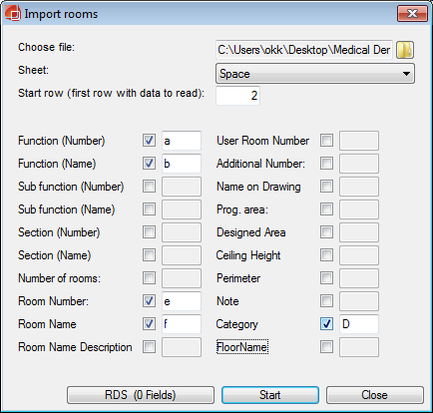
configuration - import
category
Room name
Departments
Room number
Import dialogue
Departments
Roomlist
10-Jan-13
10-Jan-13
2013 Building Programming information exchange Demo
7

Slide 8
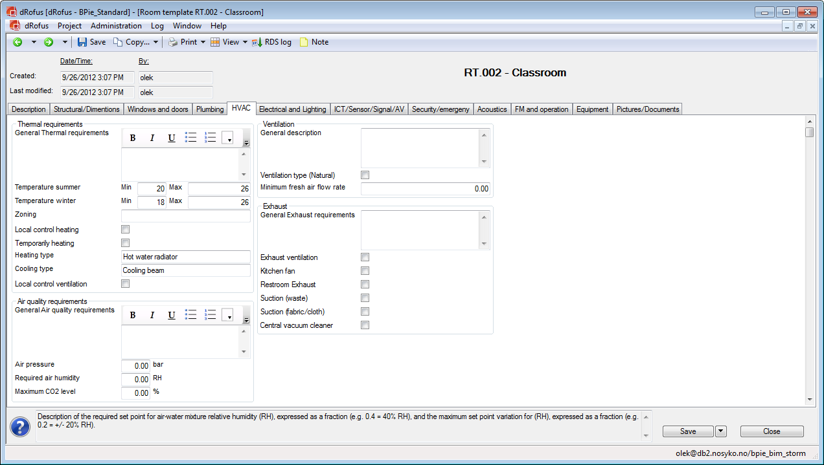
configuration – RDS from room templ.
Room Templates
(client or project specific)
Detailed RDS requirements
10-Jan-13
10-Jan-13
2013 Building Programming information exchange Demo
8

Slide 9
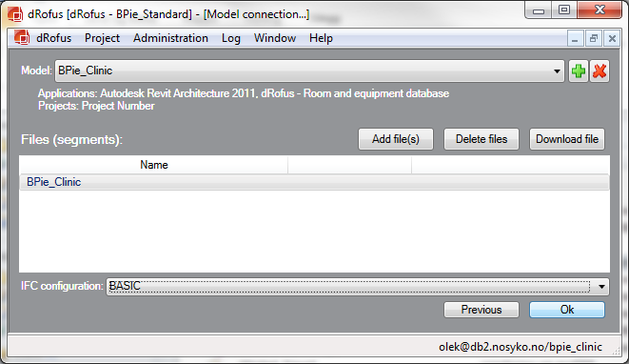
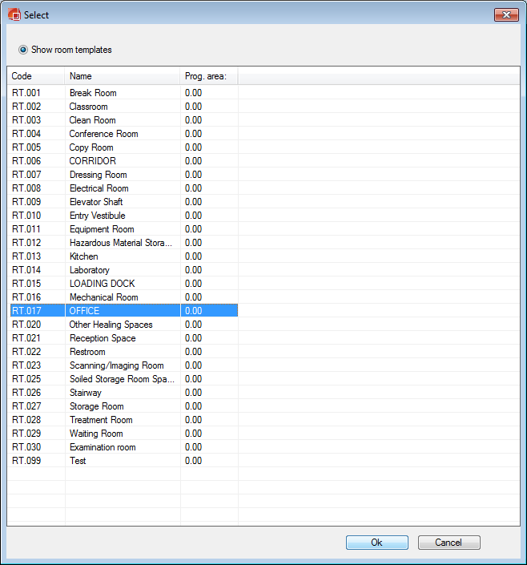
configuration – attach RDS (BPie)
A series of screen shots showing the generic steps needed to import and view COBie data
Connect to empty model
10-Jan-13
10-Jan-13
2013 Building Programming information exchange Demo
9

Slide 10
configuration
Syncronize to model
Check which data
to write to model
NB: COBie compliant
10-Jan-13
10-Jan-13
2013 Building Programming information exchange Demo
10

Slide 11
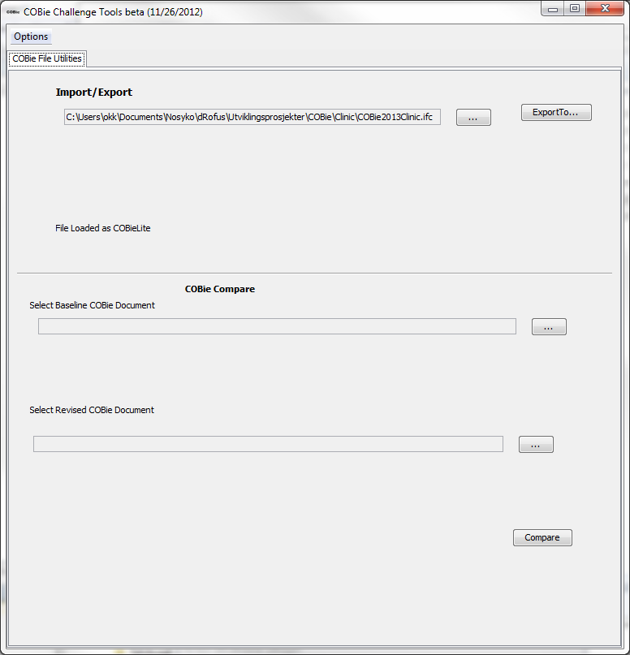
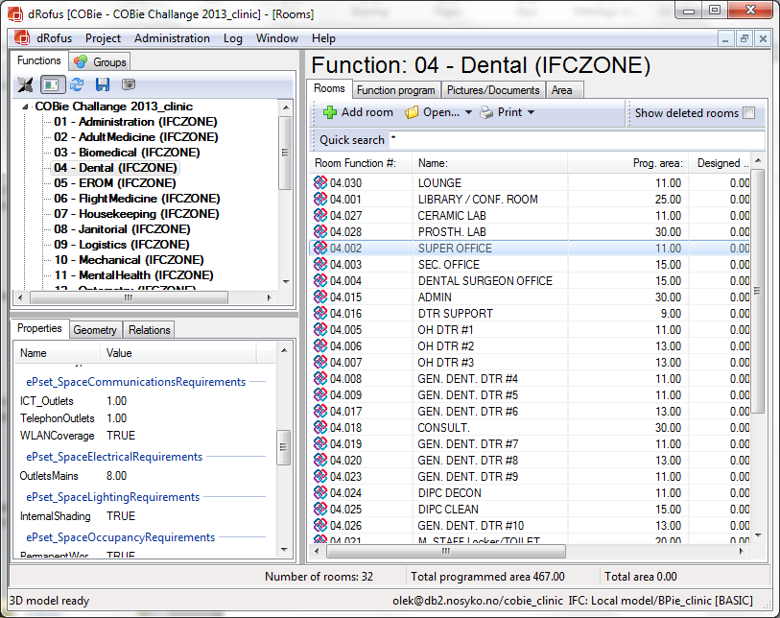
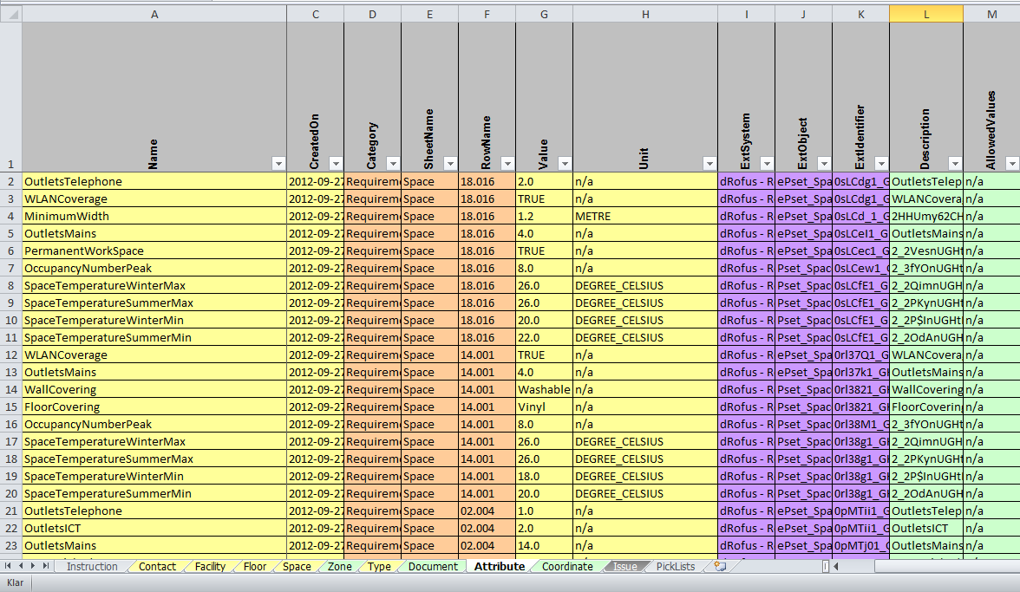
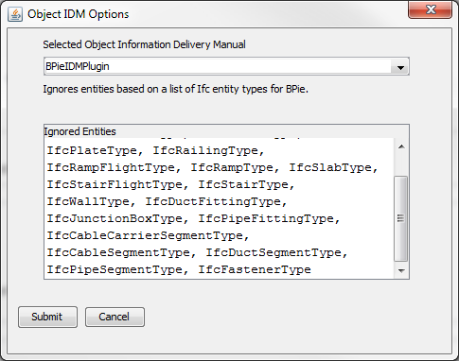
configuration
Save Ifc file
Ifc file according to BPie created, inclusive
Identification (contact)
Rooms, R.Types & RDS
Zones/dep.
Classification
10-Jan-13
10-Jan-13
2013 Building Programming information exchange Demo
11

Slide 12
process – through design development
10-Jan-13
2013 Building Programming information exchange Demo
12

Slide 13
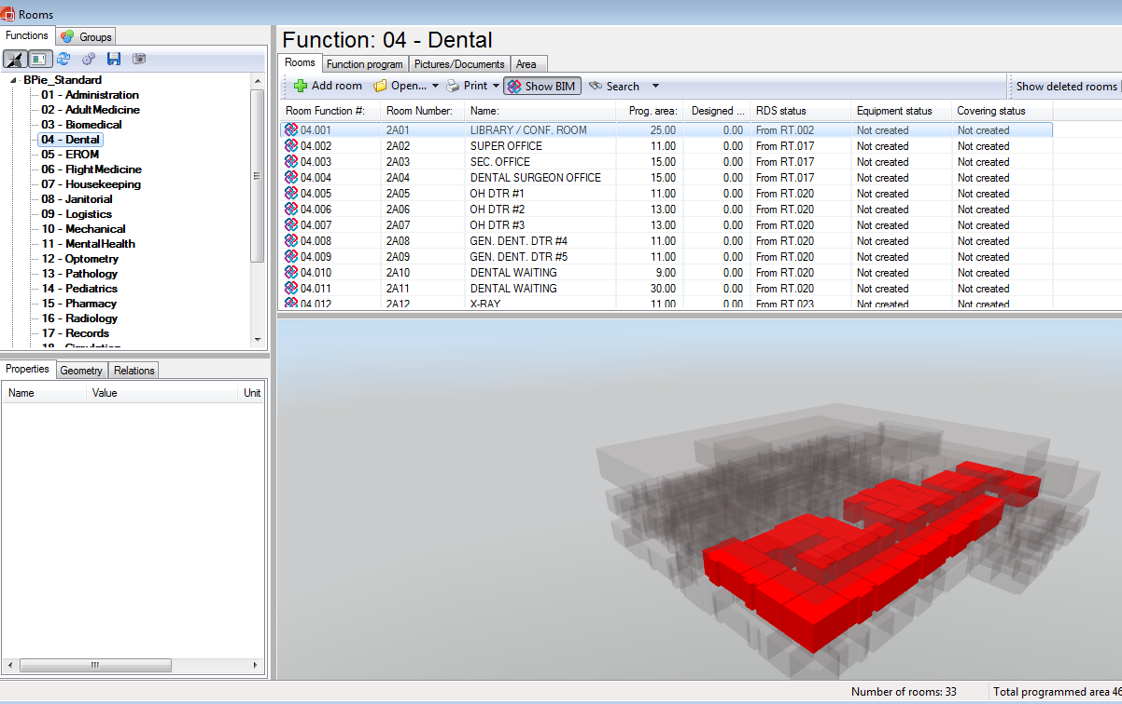
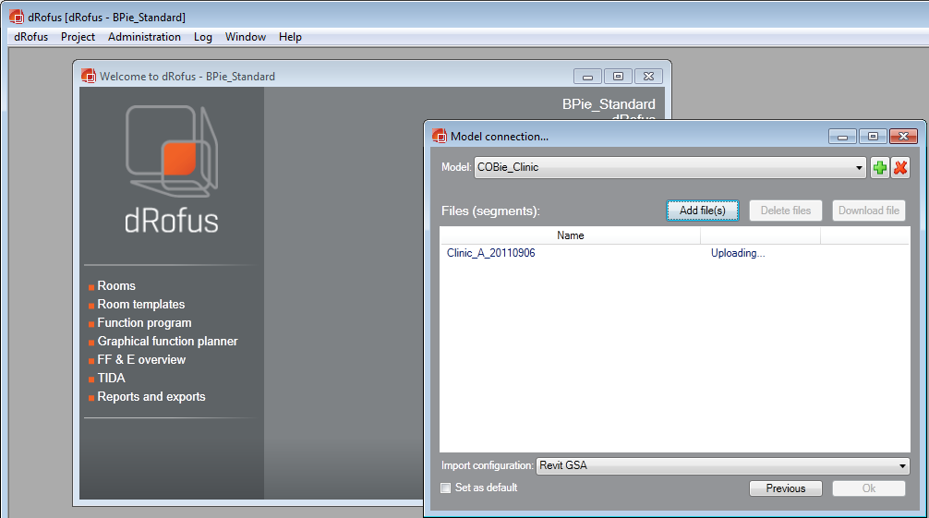
process – through design development
Upload COBie clinic (ifc) design file to ModelServer
10-Jan-13
2013 Building Programming information exchange Demo
13

Slide 14
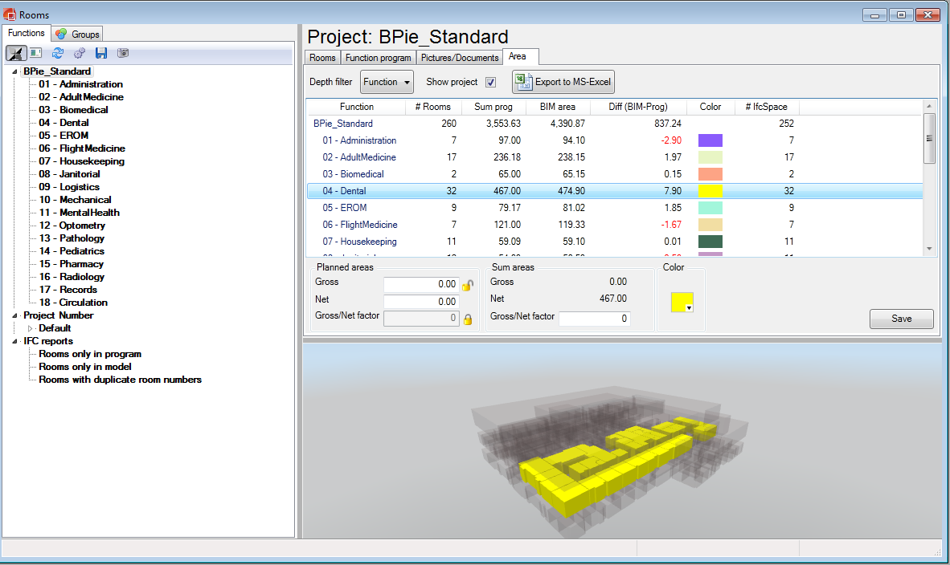
process – through design development
Comparison
Area validation
10-Jan-13
2013 Building Programming information exchange Demo
14

Slide 15
process – through design development
Syncronize updated BPie data back to design model
- Check «COBie compliant»
10-Jan-13
2013 Building Programming information exchange Demo
15

Slide 16
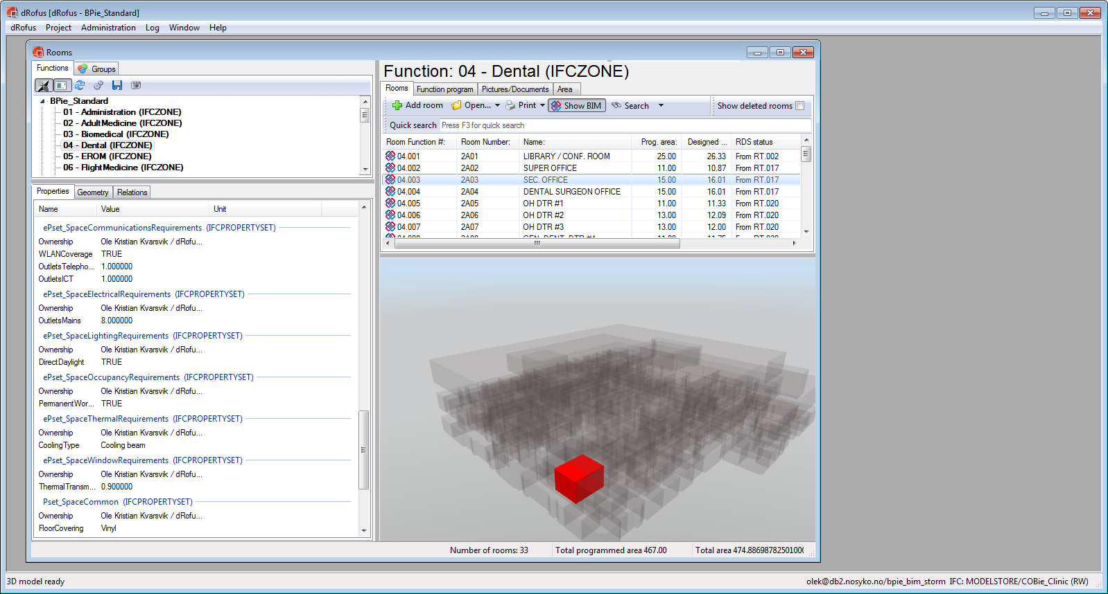
process – through design development
COBie/BPie properties in the IfcSpace object
Can be converted back to COBie spreadsheet format
10-Jan-13
2013 Building Programming information exchange Demo
16

Slide 17
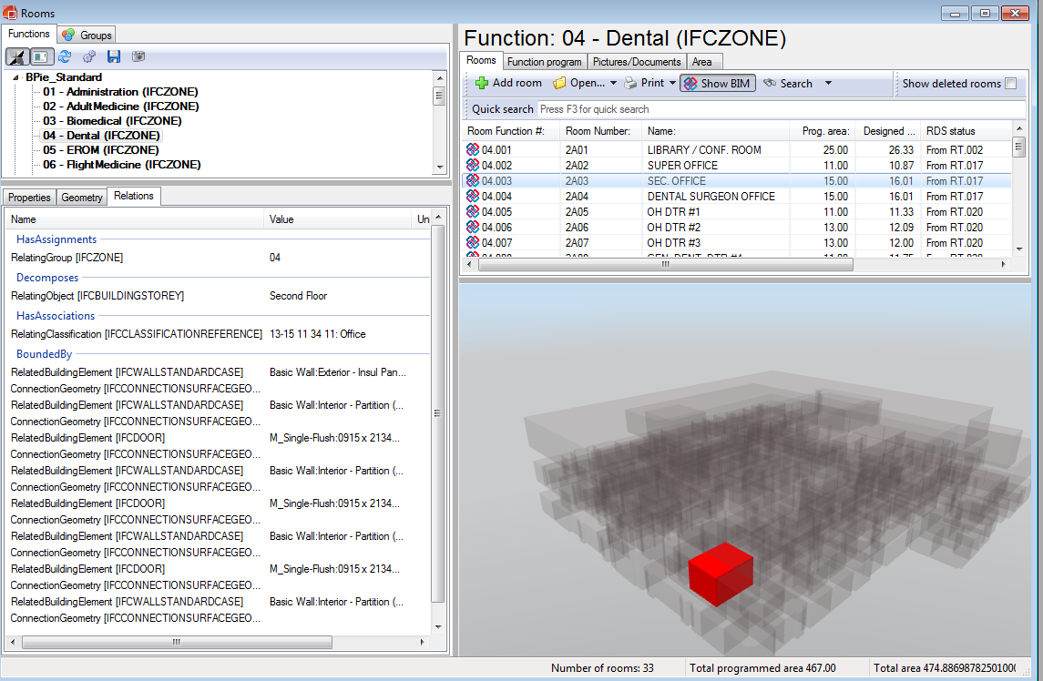
process – through design development
Omniclass classification reference
10-Jan-13
2013 Building Programming information exchange Demo
17

Slide 18
BPie savings – single project
building type
floors
total SF
equipment count
Hospital/Health facility
6-10 floors
1 000 000 SF
70 000 (approx 40 000 to be Modeled)
“back of napkin” savings:
in data capture from user criteria
in capture in planning workflow
in use downstream
other, etc…
Total $ expected savings on this project
Savings in time consumption and quality
QA & validation
Do it right the first time
Deviation handling
Area- and cost control
What you order is what you get
Information available for decision making
10-Jan-13
2013 Building Programming information exchange Demo
18

Slide 19
BPie savings – facility portfolio
building types
number of buildings
total SF
equipment count
Health, educational, office, cultural buildings (museums, concert halls, etc)
“back of napkin” savings:
in data capture from user criteria
in capture in planning workflow
in use downstream
other, etc…
Total $ expected savings on this project
As for one single project +
Quality of the handed over facilities!!!!
Reuse of data/knowledge
Requirements
Process
Implement best practice
10-Jan-13
2013 Building Programming information exchange Demo
19

Slide 20
contacts
COBie support
name:
phone:
email:
web:
marketing POC
name:
phone:
email:
Ole Kristian Kvarsvik
+47 22 33 15 70
okk@drofus.com
http://www.drofus.no/en/support-services.html
Rolf Jerving
+1 917.340.1303
rolf@drofus.com
10-Jan-13
2013 Building Programming information exchange Demo
20

