Slide 1
TMA Systems WebTMA
Kerry Joels, Government Affairs
Gary Cox, Professional Services Manager
07-Dec-2011
COBie CMMS/CAFM Challenge
1

Slide 2
product description
WebTMA is a true enterprise-wide web application (written and developed entirely in Microsoft .NET technology). With more than 1,400 clients, our CMMS solution effectively helps organizations better manage technicians' time, which in turn reduces overall costs.
WebTMA has a broad feature set that allows for multiple client locations while still accommodating the unique business needs for individual campus/business units.
The WebTMA solution has a significant amount of data loaded in the system, such as PM procedures, task codes, reports, etc. that enable clients to quickly recognize system operability. Furthermore, TMA offers numerous tools during system implementation, such as an implementation portal. Start the implementation process in a matter of days from purchase rather than weeks or months.
WebTMA is a robust, web-based CMMS solution, which can be provided either as a client-hosted solution or WebTMA as a service solution(SaaS). It provides the highest level of data integrity, maximum uptime, and advanced functionality along with a robust product feature set.
07-Dec-2011
COBie CMMS/CAFM Challenge
2

Slide 3
product features
Base Module
Work Order Management
Planned Maintenance Management
Equipment Management
Asset Management
Vehicle Maintenance Management
Building/Space Management
Basic Human Resource Management
Escalation and Notification
Optional Modules
Material Management Module
mobileTMA
Project Management Module
Facility Resource Scheduler
Time Manager Module
Fleet Management
Contract Management Module
Universal Financial Interface
Service Request Module
Utility Management
Failure Analysis/Risk Assessment
Approval/Authorization Routing
Training Management
Task Library (300 plus)
Linked Documents
Report Writer
Customer Surveys
Key Management
Executive Dashboard
Event Management
General Inspections
cellularTMA
CAFM (CAD Interface)
Custodial Management
Room Inspections
GIS Interface
WebTMA is offered as integrated software modules, which allows you to purchase only the functionality your organization needs. WebTMA manages everything from work orders to inventory control to planned maintenance. This flexibility makes WebTMA an invaluable asset for your organization.
07-Dec-2011
COBie CMMS/CAFM Challenge
3

Slide 4
user base
users
user count:
facility count:
public sector:
private sector:
customers
client:
client:
client:
1,400 accounts
45,000 facilities
(23% of users) major facility types
(77% of users) major facility types
Architect of the Capitol
Board of Governors of the Federal Reserve
American Airlines
07-Dec-2011
COBie CMMS/CAFM Challenge
4

Slide 5
tested product
product name:
product version:
PC or Cloud:
website:
WebTMA
4.3.5
PC
www.tmasystems.com
07-Dec-2011
COBie CMMS/CAFM Challenge
5

Slide 6
COBie Design/ Build Levels of Effort
Phase | Design | Build | Commission | Operate | Lfe Cycle
FM Data (% available) | 25%* | 60% | Confirmation | 15% | ??%
COBie process Cost distribution | 15% | 45%** | 25% | 15%
Traditional Model Cost distribution | 5% | 5% | 35% *** | 55% ****
* Supplies space definition and inititial system and attribute definition
** Sub-contractors enter SPie data
*** Commissioning verifies construction “as built”, but most data is delivered as cut sheets and physical drawings.
**** Depending on size of project, can range from several weeks of data entry to several person-years.
Equals about 85% of the cost of data acquisition for the FM system.
07-Dec-2011
COBie CMMS/CAFM Challenge
6

Slide 7
CMMS Data Management Cost Savings Factors (Proto-Metric Analysis)
10 – 20% Data Errors
Cost of BIM Data through COBie LCie Operations
Speed of New Construction to full operations
Cost of legacy updates to BIM
07-Dec-2011
COBie CMMS/CAFM Challenge
7

Slide 8
10 – 20% Data Errors
Current data has high error rate and requires verification
85% of data not available in convertible form at commissioning
Data entry and re-work currently require 1 person for a week or up to 3 to 12 people for possibly months. Even this requires re-work that is normally corrected over time
07-Dec-2011
COBie CMMS/CAFM Challenge
8

Slide 9
Cost of BIM Data through COBie LCie Operations
Maintenance of general data in BIM format not currently available
Building remodeling, modification, or repair not currently informed by FM data in an interoperable format
CMMS systems can automatically track BIM related changes and modifications, and automatically store “as maintained” data
LCie customized owner rules and requirements can be set during construction of the initial structure
07-Dec-2011
COBie CMMS/CAFM Challenge
9

Slide 10
Speed of New Construction to Full Operations
Redesign velocity is increased with a robust maintained BIM
Process informed by equipment condition, warranty, PM, and other data
Maintenance requirements for the improved space can be derived from the BIM/CMMS sandbox
Commissioning and new FM data loaded at building re-opening.
07-Dec-2011
COBie CMMS/CAFM Challenge
10

Slide 11
Cost of Legacy Structure Updates to BIM
Legacy buildings can be put into a BIM for improved LCie cost returns
Sample costs for a typical college campus building to create a Basic Revit model: $500 - $2500 per building
The model relevancy is reinforced by a COBie FM export into the BIM
No change in immediate operations and maintenance is required
Downstream savings result from necessary remodel/ repair situations
07-Dec-2011
COBie CMMS/CAFM Challenge
11

Slide 12
Life Cycle Cases
COBie interoperable exchanges over the lifetime of the structure in remodel, restoration, and replacement scenarios
07-Dec-2011
COBie CMMS/CAFM Challenge
12

Slide 13
COBie FM Export BIM Consequence
Phase | CMMS | Redesign/Restore | Construct | FM Data Update
Remodel | 30%* | 25%** | 35%** | 85% (New FM Data)
Addition | 30% | 25%*** | 35%*** | 85% (Total FM Data)
* BIM specific Data
** New BIM Data
*** New construction FM data
07-Dec-2011
COBie CMMS/CAFM Challenge
13

Slide 14
Cost Summary
Costs to be determined in current client projects and case studies. Percentages are approximate, but involve the amount of FM data and the responsibility for populating that data. Data accuracy is gained from adding checks by designers, engineers, sub-contractors, general contractors, commissioning agents, CMMS providers and FM owners. Data integrity statistics can be built quickly as projects multiply.
07-Dec-2011
COBie CMMS/CAFM Challenge
14

Slide 15
challenge scope
information | COBie.Sheet | Imported
spaces and equipment | Space, Type, Component | 
PM schedules | Job | 
safety procedures | Job | 
systems | System | 
system procedures | Job | 
materials, tools, training | Resource | 
associated documents | Document | 
replacement parts | Spare | 
space and equipment properties | Attribute | 
07-Dec-2011
COBie CMMS/CAFM Challenge
15

Slide 16
configuration
TMA Import Steps
1. Place copy of COBie xml file in the COBie directory and rename it to COBie2.xml.
2. Open COBie2.xml file and convert it to an .xlsx (Excel 2007) format and save.
3. Launch the TMA MS Access Import tool.
4. Select the facility and repair center and execute the import.
5. Login to the WebTMA application and assign user security rights to access imported records.
For configuration details with the WebTMA product, please reference the COBie link on the Building Smart Alliance website and open the TMA Configuration Guide.
07-Dec-2011
COBie CMMS/CAFM Challenge
16

Slide 17
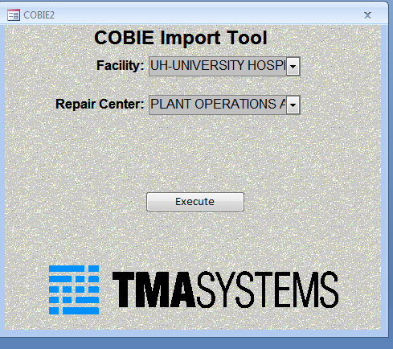
process
Choose a facility in which the building being imported will be linked, and associate a repair center/cost center for the building.
Select the Execute command to begin the import process from the COBie document.
07-Dec-2011
COBie CMMS/CAFM Challenge
17

Slide 18
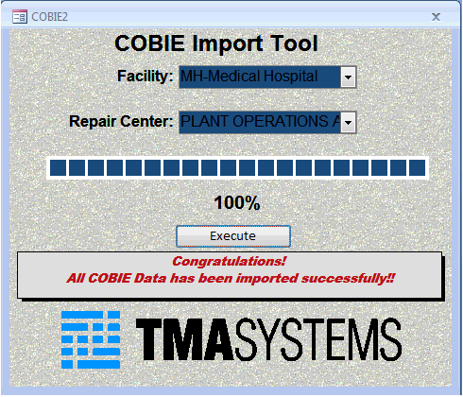
process
COBie import process is completed!

Slide 19
contacts
COBie support
name:
phone:
email:
web:
marketing POC
name:
phone:
email:
Ross Powell, Senior Account Executive
(800) 862-1130
ross.powell@tmasystems.com
www.tmasystems.com
Dustin Taylor, Vice President
(800) 862-1130
dustin.taylor@tmasystems.com
07-Dec-2011
COBie CMMS/CAFM Challenge
19

Slide 20
COBie Import Demo
07-Dec-2011
COBie CMMS/CAFM Challenge
20

