Slide 1
BIM Collaborations at the University of Wyoming
Keith E. Hedges, AIA NCARB
Department of Civil and Architectural Engineering, University of Wyoming, USA

Slide 2
Collaborations Between Industry University & Government

Slide 3
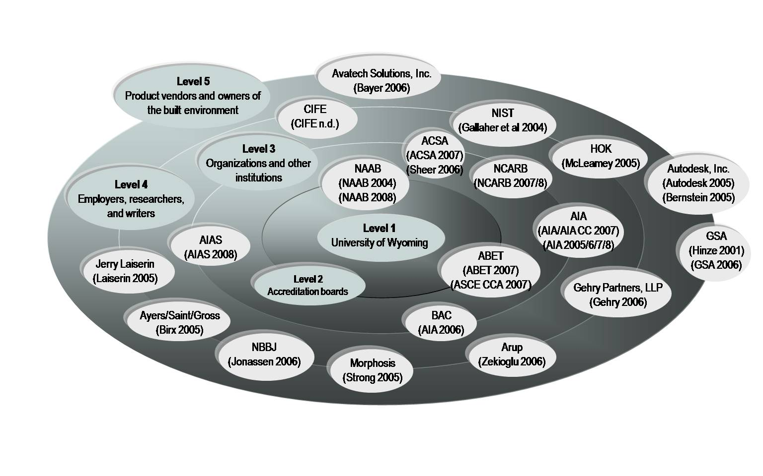
Collaborations Between Organizations and Accreditation Board Constituents
Theall, M. (2002). Evaluation and assessment: An institutional context. In R. M. Diamond (Ed.), Field Guide to Academic Leadership (pp. 225-240). San Francisco: Jossey-Bass.
Notes:
James O. Jonassen, FAIA (NBBJ)
“We need new business models that address optimum ways to deliver building projects in a digitally enabled, integrated way. This includes models which will accommodate a new set of relationships between the stakeholders in a project.”
James O. Jonassen, “Changing Business Models in BIM-Driven Integrated Practice.” AIA Report on Integrated Practice (June 2006) [article on-line]; available from http:// www.aia.org/SiteObjects/files/ 3_Jonassen.pdf.
Thom Mayne, FAIA (Morphosis)
“If you want to survive, you’re going to change; if you don’t, you’re going to perish. It’s as simple as that.”
Norman Strong, “Change is Now,” AIArchitect Best Practices, 12 Sept 2005
Atila Zekioglu, P.E., S.E. (Arup)
“By using the three-dimensional programs, the designers sought to resolve all of the geometrical problems during the design stage. With traditional two-dimensional drawings it can be all but impossible to anticipate areas of conflict.”
Atila Zekioglu, “Braced for the Future.” Civil Engineering 12 (December 2006) : 76, 38-45.

Slide 4
Collaborative Opportunities Between Architecture and Engineering Students
NAAB (Architecture)
Student Performance Criteria 7 (Collaborative Skills): Ability to recognize the varied talent found in interdisciplinary design project teams in professional practice and work in collaboration with other students as members of a design team [2004 NAAB Conditions].
ABET (Engineering)
AE students should have an “understanding of an architectural design . . . that will permit communication, and interaction, with other design professionals in the execution of building projects” [ABET, 2007a].
Architectural Design
“The AAC [AEI (Architectural Engineering Institute) Academic Council] believes it is a professional responsibility for architectural engineers to have a basic understanding of the design process of the architects involved in the execution of building projects” [AAC, 2007].
Multidisciplinary Teams
Engineering programs must demonstrate that students attain an ability to function on multidisciplinary teams [ABET, 2007b].
“(1) each team member serves in a well-defined role in the team;
(2) each team member brings a particular expertise to bear in solving the problem; and
(3) the scope of the problem is sufficiently broad that no one team member could successfully solve the problem alone” [ASCE CCA, 2007].
CE students should have “an understanding of professional practice issues . . . how the design professionals and the construction professions interact to construct a project” [ABET, 2007b].

Slide 5
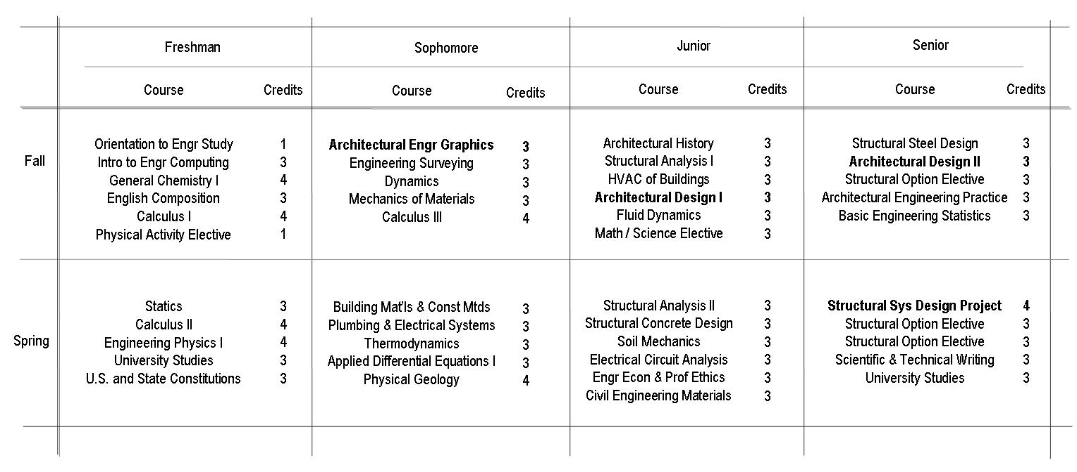
Articulating an Architectural Engineering Program
UW Structures Option
Fund.of Building Perf. 3

Slide 6
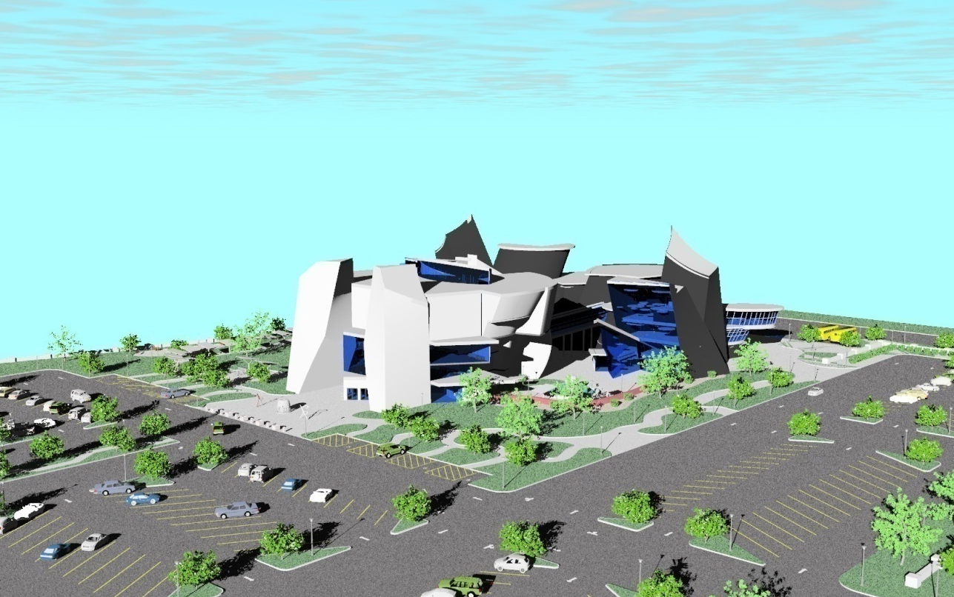
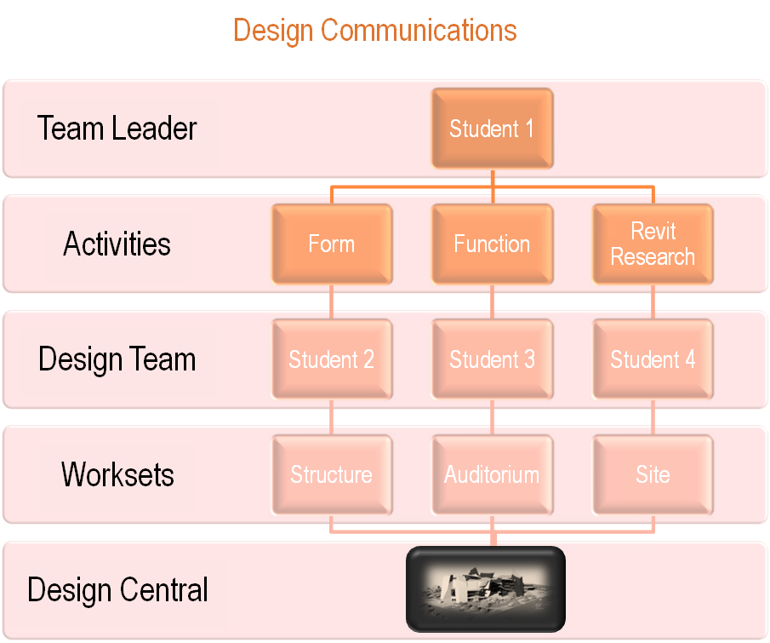
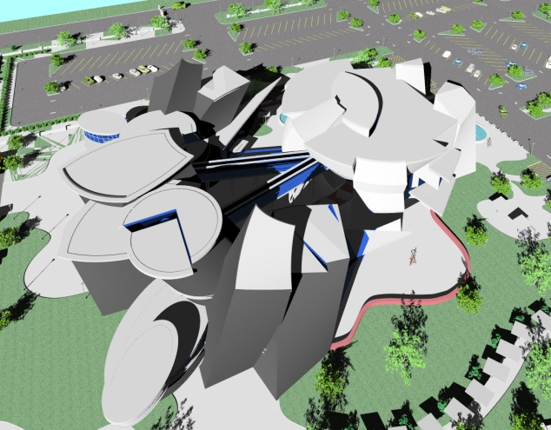
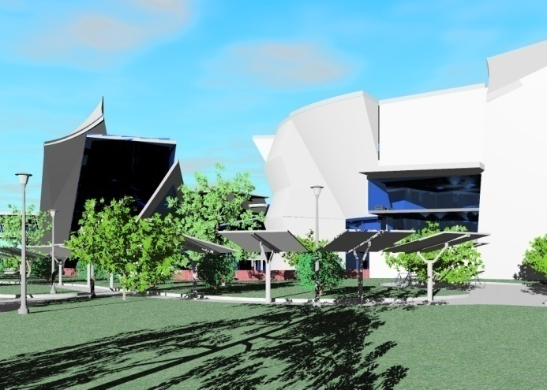
Local Collaboration in the Introductory Studio (2007)
excerpts from
Student Learning Journals
“This design would have given a structural engineer a real headache.”
“When we started the project, we all visualized something totally different. In order to accomplish our final project, we had to run with ideas that we all agreed on, compromise where we conflicted, and discard without hard feelings”.

Slide 7
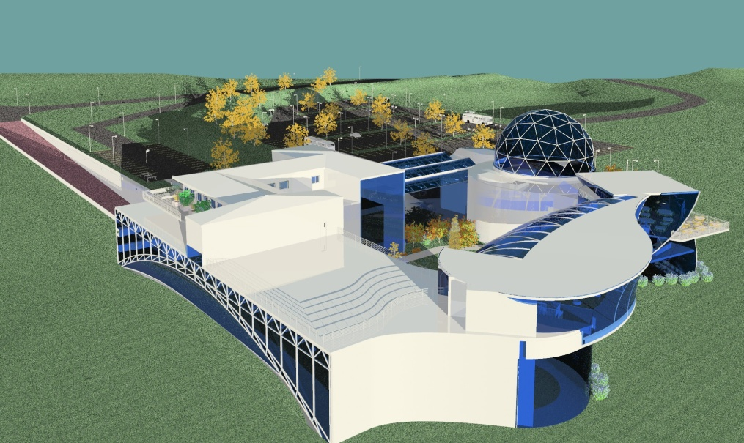
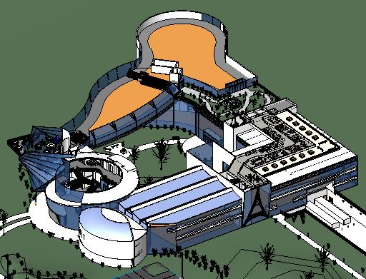
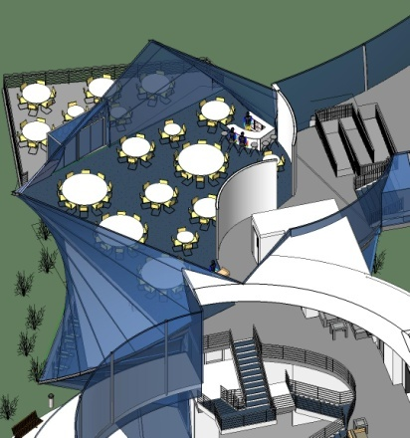
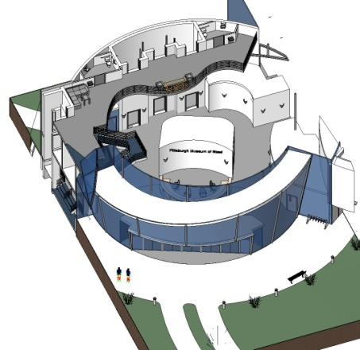
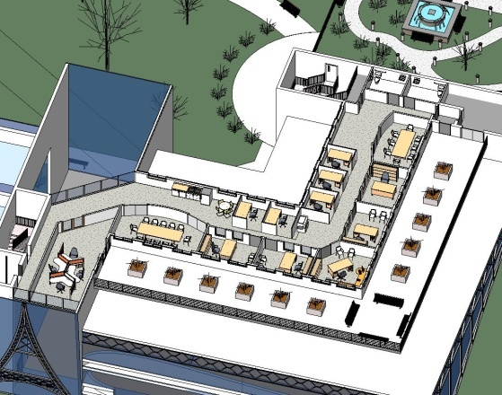
Local Collaboration in the Introductory Studio (2007) – Cont’d
Evaluating Representational Space During the In-Process Journey as Opposed to the Final Destination

Slide 8
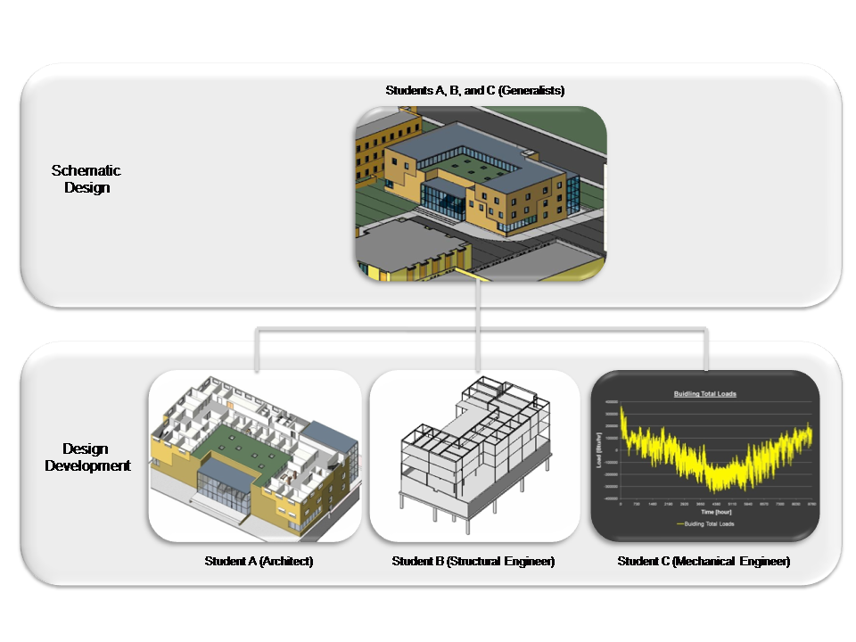
Local Collaboration in the Terminal Studio (2007)
Students A, B, and C (Generalists)
Schematic
Design
Design
Development
Student A (Architect)
Student B (Structural Engineer)
Student C (Mechanical Engineer)

Slide 9
Distance Collaborations Between Architecture and Engineering Students (2008)

Slide 10
Potential Future Collaborations (2009)
Legend
Architectural design
Landscape architecture
Construction management
Construction documentation
Structural engineering
Mechanical engineering
University of Nebraska-Lincoln
Montana State University
University of Wyoming

Slide 11
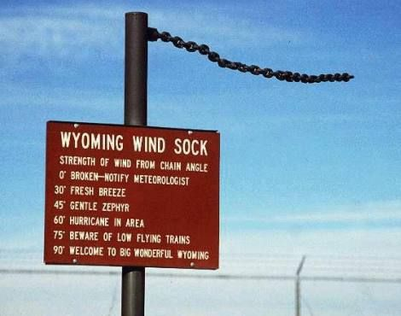
Thank you for your attention
References
ABET, “Criteria for Accrediting Engineering Programs”, Baltimore, MD: ABET, Inc., 2007a, 6.
ABET, “Criteria for Accrediting Engineering Programs”, Baltimore, MD: ABET, Inc., 2007b, 9.
AEI Academic Council [AAC], “Draft Commentary”, 2007, 8.
ASCE Committee on Curricula and Accreditation [ASCE CCA], “Commentary on the ABET Accreditation Criteria for Civil and Similarly Named Programs in the Context of the Civil Engineering Body of Knowledge”, 3.4, 2007, 20.

