Slide 1
Company: EcoDomus, Inc. Product: EcoDomus PM
Igor Starkov, President
10-Jan-13
2013 COBie Challenge for Builders
1

Slide 2
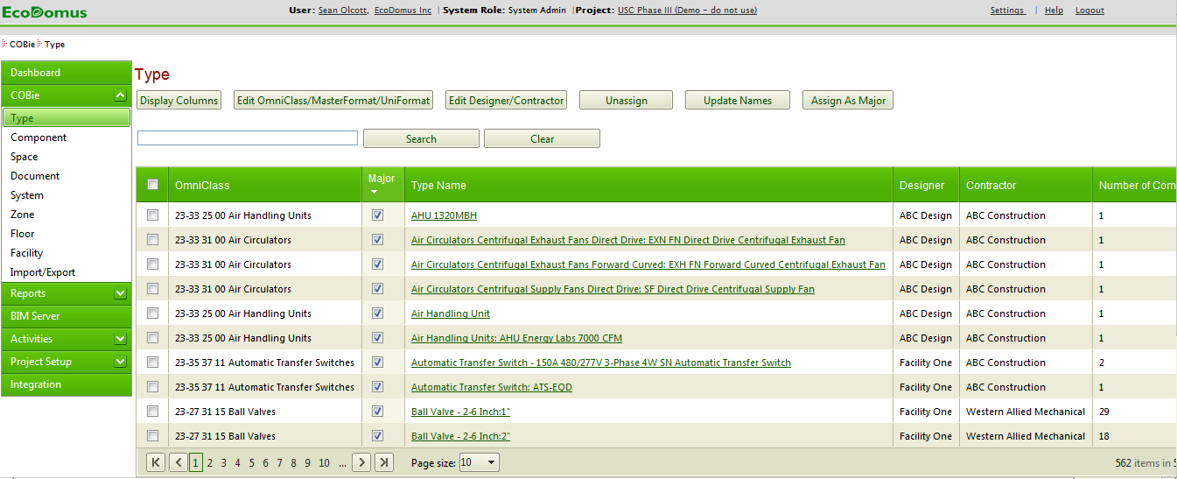
product description
EcoDomus PM ("Project Management") is a software solution dedicated to enabling the usage of Building Information Models (BIM) and Lean processes for managing facility data during new construction, renovation of existing buildings, or just collecting data to create accurate as-builts.
EcoDomus PM allows reducing time and costs of collecting and validating design/construction/commissioning information using COBie.
10-Jan-13
2013 COBie Challenge for Builders
2

Slide 3
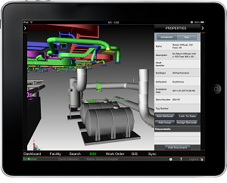
product features
EcoDomus PM provides support for COBie throughout the whole construction project lifecycle both online and off-line, on Tablet PCs (like iPad and Windows 8), laptops and desktops, all having a 3D interface.
With EcoDomus PM you can edit COBie data in a secured online environment in collaborative mode.
EcoDomus PM provides a unique way for extracting and editing COBie data from Autodesk Revit, Bentley AECOsim, Tekla CM, IFCs, and other BIM tools and pushing data back into the model.
EcoDomus PM has built-in Quality Control reports helping analyze and improve quality of BIM data.
10-Jan-13
2013 COBie Challenge for Builders
3

Slide 4
user base
users
user count:
facility count:
public sector:
private sector:
customers
name:
name:
name:
N/A
N/A
N/A
N/A
General Services Administration (GSA)
Kaiser Permanente
University of Southern California
10-Jan-13
2013 COBie Challenge for Builders
4

Slide 5
tested product
product name:
product version:
PC or Cloud:
website:
EcoDomus PM
SaaS
Cloud
www.ecodomus.com
10-Jan-13
2013 COBie Challenge for Builders
5

Slide 6
Builders’ COBie challenge scope
information | COBie.Sheet* | Imported | Exported
spaces and equipment | Space, Type, Component |  | 
space and equipment properties | Attribute |  | 
equipment PM/safety procedures | Job |  | 
equipment safety procedures | Job |  | 
equipment replacement parts | Spare |  | 
pm materials, tools, training | Resource |  | 
spatial zones | Zone |  | 
equipment systems | System |  | 
system operations procedures | Job |  | 
suppliers, manufacturers, etc… | Contact |  | 
handover documents | Document |  | 
* and supporting COBie sheets as required per standard.
10-Jan-13
2013 COBie Challenge for Builders
6

Slide 7
configuration
Please see the accompanying documentation
10-Jan-13
2013 COBie Challenge for Builders
7

Slide 8
process
Please see the accompanying documentation
10-Jan-13
2013 COBie Challenge for Builders
8

Slide 9
COBie savings – single project
building type
floors
total SF
equipment count
Education Facility
4 levels (3 floors and basement)
62,500 sq.ft.
5,920
“back of napkin” savings:
in data capture from upstream
in capture in construction workflow
in production of handover data set
other, etc…
Total $ construction office savings
expected savings from not having to recreate design data & streamlined workflow:
Time for each manual record entry (in hours) * | 0.008
Time for establishing lookup link (hrs) | 0.004
Time required to enter all records and establish links (hrs) | 4410.29
Data verification time (assume 15% of total labor) | 661.54
Cost of labor per hour | $30
Labor experience level (good=1, bad>1) | 1.00
Total cost of manual COBie Excel file production | $152,155
Cost Savings due to using EcoDomus PM | $132,371
Cost Ratio (EcoDomus/Semi-Manual Process) | 21%
10-Jan-13
2013 COBie Challenge for Builders
9

Slide 10
COBie savings – facility portfolio
building types
number of buildings
total SF
equipment count
Office/educational/athletic/CUPs
200
14MSF
Tens of thousands
“back of napkin” savings:
in data capture from upstream
in capture in construction workflow
in production of handover data set
other, etc…
Total $ construction office savings
expected savings: millions of dollars
10-Jan-13
2013 COBie Challenge for Builders
10

Slide 11
contacts
COBie support
name:
phone:
email:
web:
marketing POC
name:
phone:
email:
Philip DeMottie
(516) 361-4436
pdemottie@ecodomus.com
www.ecodomus.com
Igor Starkov
(571) 277-6617
igor@ecodomus.com
10-Jan-13
2013 COBie Challenge for Builders
11

