Slide 1
Quicx developed by Chinook Systems Inc.
David Wampler, Software Manager
Wanda Lenkewich, Owner
07-Jan-14
2014 buidlingSMART Challenge
1

Slide 2
Lifecycle Application
Design
Construction
Quality
Drawings
Specifications
Documents
Design Review
Submittals
RFI’s
Change Docs
Inspections
Punchlist
Commissioning
Equipment
Systems
Deliverables Tracking
Checklists
Functional Tests
Issues Log
Closeout
O&M’s
Training
Warranty
Spare Parts
Project Mgmt
Field Reports
Meetings
Transmittals
Contacts
Companies
Places
Contracts
Users / Roles
Customization
Notifications
Quicx has continually enhanced the management, delivery, and preservation of mission critical facility data and documentation since its introduction into the marketplace in the 1990’s.
Quicx is a full featured lifecycle enterprise application offered by licenses or as a web-based service.
It leverages resources and eliminates time consuming steps while achieving consistent, high quality, integrated design, construction, commissioning and operational deliverables.
With COBie compliancy and BIM integration, Quicx provides the ability to consolidate all facility data into one central application. For more information please visit www.Quicx.net
Design
Construction
Quality
Drawings
Specifications
Documents
Design Review
Submittals
RFI’s
Change Docs
Inspections
Punchlist
Commissioning
Equipment
Systems
Deliverables Tracking
Checklists
Functional Tests
Issues Log
Closeout
O&M’s
Training
Warranty
Spare Parts
Project Mgmt
Field Reports
Meetings
Transmittals
Contacts
Companies
Places
Contracts
Users / Roles
Customization
Notifications
07-Jan-14
2014 buidlingSMART Challenge
2

Slide 3
product features
Mobile Application with Offline Access
Cloud Based
DoD Compliant and CAC enabled
Automated Notifications
Granular, Role Based Permissions
Progress Tracking and Multi-Project Metric Reporting
Drawing and Specification Revision Management
Pre-Functional and QC Checklists
Functional Performance Tests
Meeting Manager
Issues and Punchlist Tracking
Design & Submittal Review
Construction Management
Closeout and Transition Management
Complete Facilities Document and Data Library
Maintenance Management Integration
Energy Management Integration
07-Jan-14
2014 buidlingSMART Challenge
3

Slide 4
user base
users
user count:
facility count:
public sector:
private sector:
1,459 users
291 Projects
(80%) Pentagon, Laboratory, Healthcare
(20%) Healthcare, Office, Other
07-Jan-14
2014 buidlingSMART Challenge
4

Slide 5
tested product
product name:
product version:
PC or Cloud:
website:
Quicx
1.20.1
Cloud
www.quicx.net Info
www.passport2projects.com App
07-Jan-14
2014 buidlingSMART Challenge
5

Slide 6
Builders’ COBie challenge scope
information | COBie.Sheet* | Imported | Exported
spaces and equipment | Space, Type, Component |  | 
space and equipment properties | Attribute |  | 
equipment PM/safety procedures | Job |  | 
equipment safety procedures | Job |  | 
equipment replacement parts | Spare |  | 
pm materials, tools, training | Resource |  | 
spatial zones | Zone |  | 
equipment systems | System |  | 
system operations procedures | Job |  | 
suppliers, manufacturers, etc… | Contact |  | 
handover documents | Document |  | 
* and supporting COBie sheets as required per standard.
07-Jan-14
2014 buidlingSMART Challenge
6

Slide 7
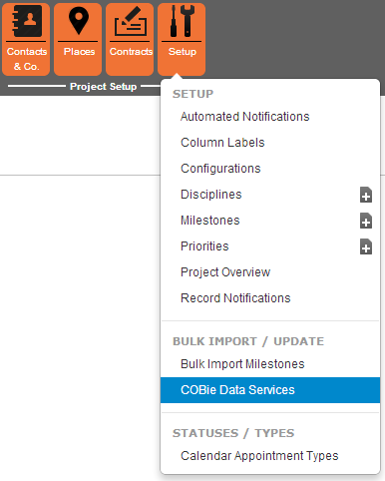
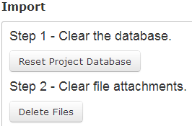
configuration
Select COBie Data Services
Clear Existing Data
07-Jan-14
2014 buidlingSMART Challenge
7

Slide 8
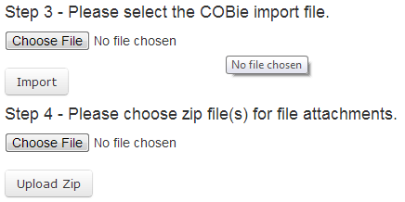
configuration
Point to your COBie File
Point to your COBie docs
07-Jan-14
2014 buidlingSMART Challenge
8

Slide 9
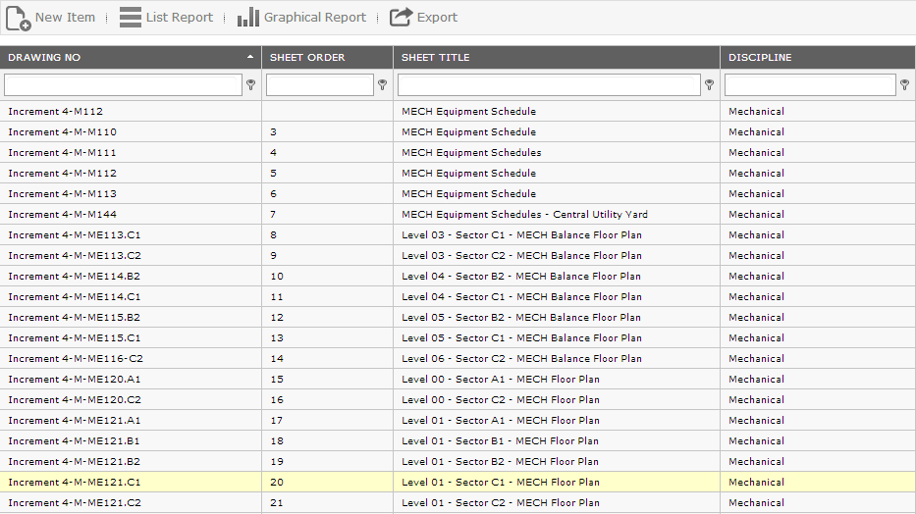
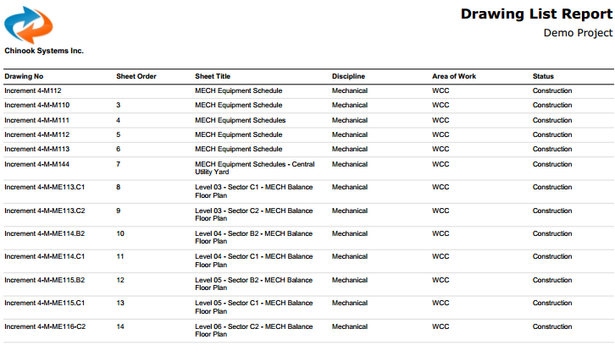
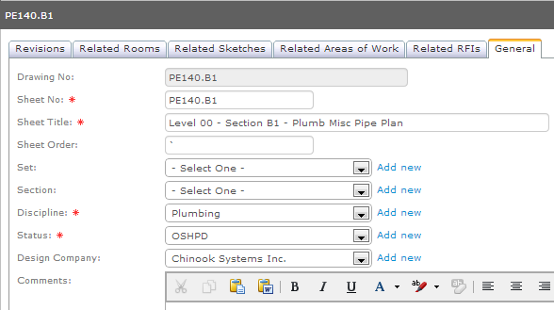
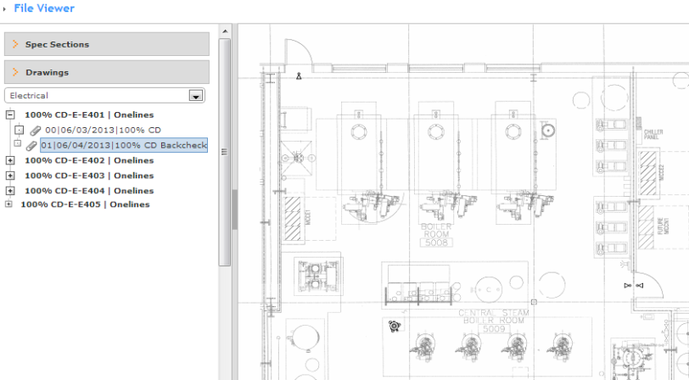
design
Design
Construction
Quality
Commissioning
Closeout
Drawings
Specifications
Documents
Design Review
Submittals
RFI’s
Change Docs
Inspections
Punchlist
Equipment
Checklists
Functional Tests
O&M’s
Training
Warranty
Spare Parts
Issues Log
Project Mgmt
Field Reports
Meetings
Transmittals
Contacts
Companies
Places
Contracts
Users / Roles
Customization
Notifications
Manage contract drawings, add revisions and always have the latest drawing on hand.
Bulk uploading of specification sections linked to equipment types to map respective sections
Manage important docs such as the OPR, BOD, Cx Plan and many more for team review and use.
Perform design review as a team in a database managed format instead of poorly managed spreadsheets.
07-Jan-14
2014 buidlingSMART Challenge
9

Slide 10
Space Attributes
07-Jan-14
2014 buidlingSMART Challenge
10

Slide 11
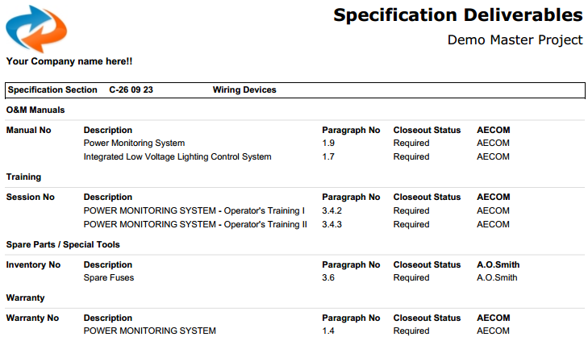
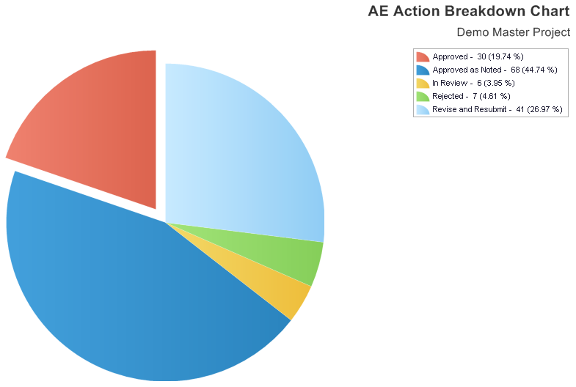
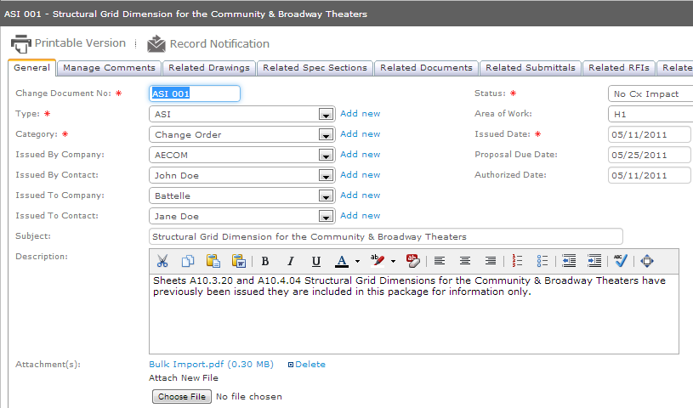
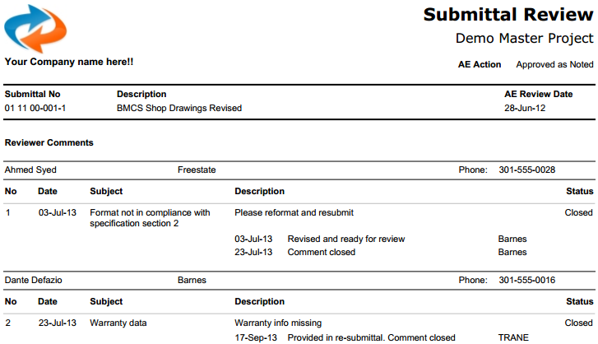
construction
Design
Construction
Quality
Commissioning
Closeout
Drawings
Specifications
Documents
Design Review
Submittals
RFI’s
Change Docs
Inspections
Punchlist
Equipment
Checklists
Functional Tests
O&M’s
Training
Warranty
Spare Parts
Issues Log
Project Mgmt
Field Reports
Meetings
Transmittals
Contacts
Companies
Places
Contracts
Users / Roles
Customization
Notifications
Import and manage the submittal register
Organized submittal packages with approval actions and dates
Perform submittal review online with Automated comment notifications
Cope with numerous RFI’s and Change Orders and keep track of spec and drawing modifications.
07-Jan-14
2014 buidlingSMART Challenge
11

Slide 12
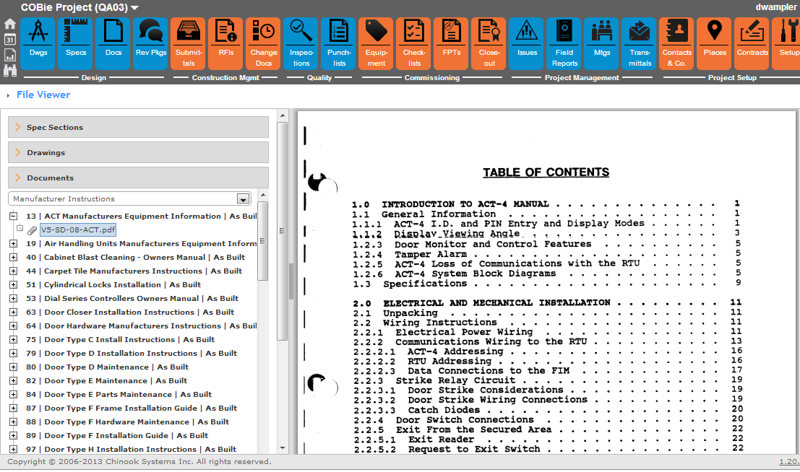
Documents Viewer
07-Jan-14
2014 buidlingSMART Challenge
12

Slide 13
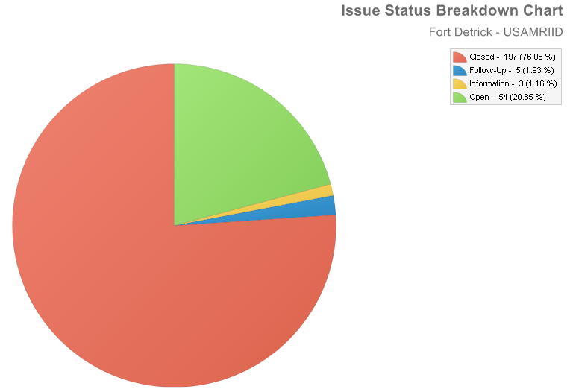
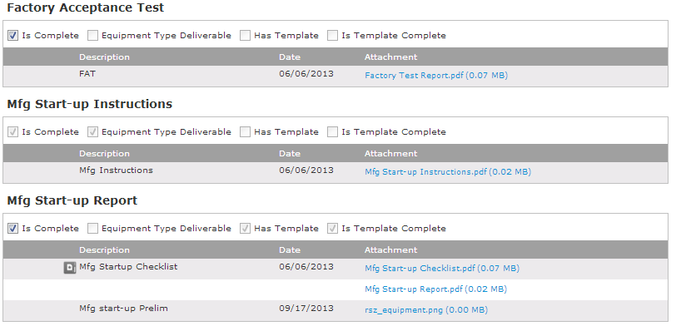
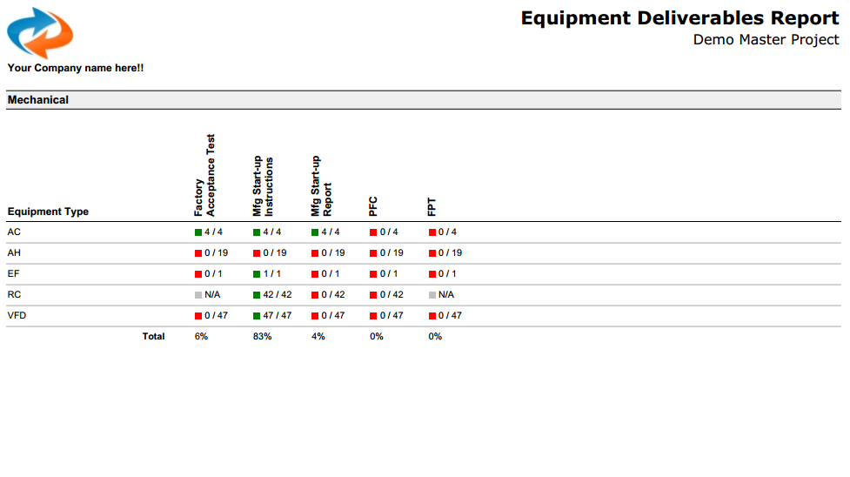
commissioning
Design
Construction
Quality
Commissioning
Closeout
Drawings
Specifications
Documents
Design Review
Submittals
RFI’s
Change Docs
Inspections
Punchlist
Equipment
Checklists
Functional Tests
O&M’s
Training
Warranty
Spare Parts
Issues Log
Project Mgmt
Field Reports
Meetings
Transmittals
Contacts
Companies
Places
Contracts
Users / Roles
Customization
Notifications
Systems
Deliverables Tracking
Cx based on equipment list
Segregate equipment into equipment types and systems.
Capture equipment attributes and space information
Create Checklists in minutes for mobile offline completion
Add equipment of systems to Functional Tests for testing
Issues log automated notifications keep team up to date
07-Jan-14
2014 buidlingSMART Challenge
13

Slide 14
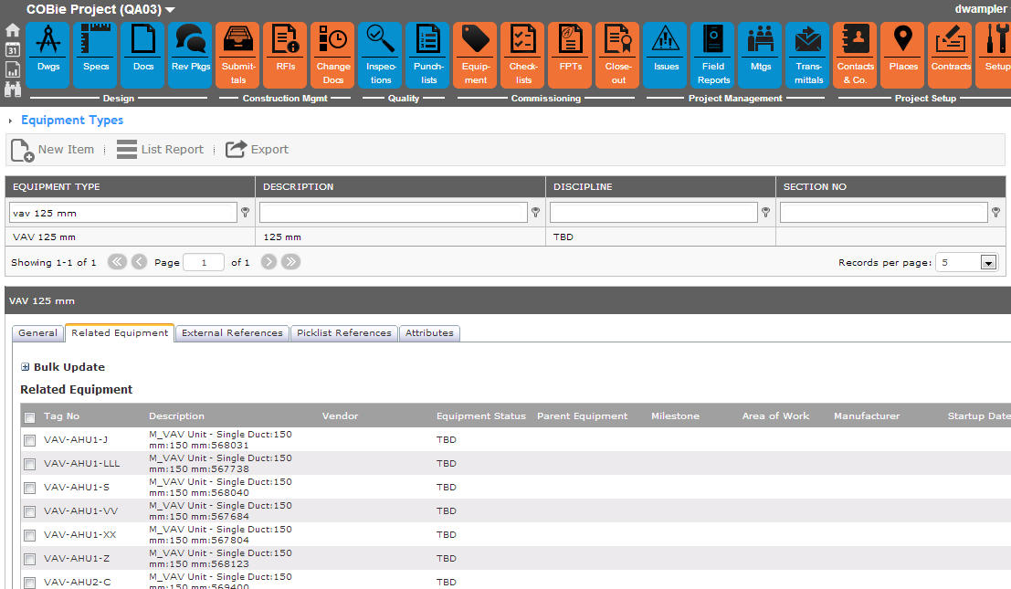
reference mapping
07-Jan-14
2014 buidlingSMART Challenge
14

Slide 15
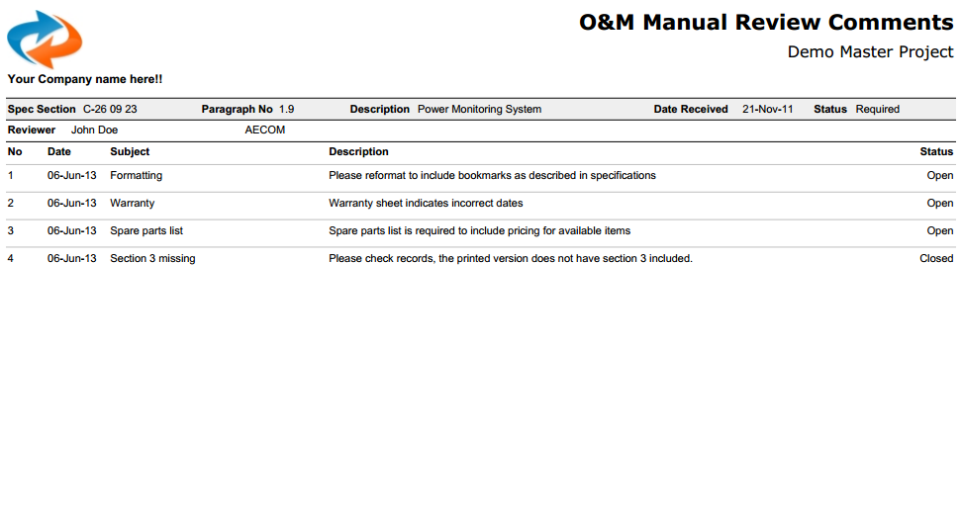
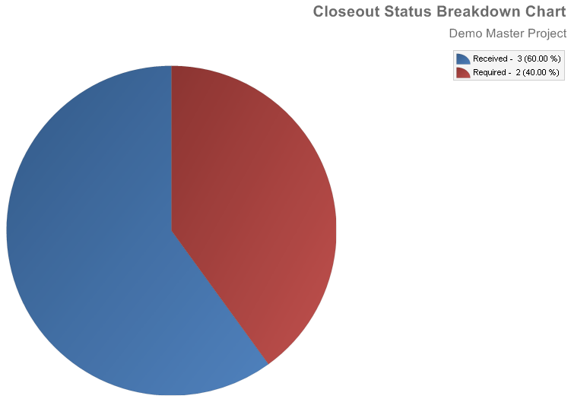
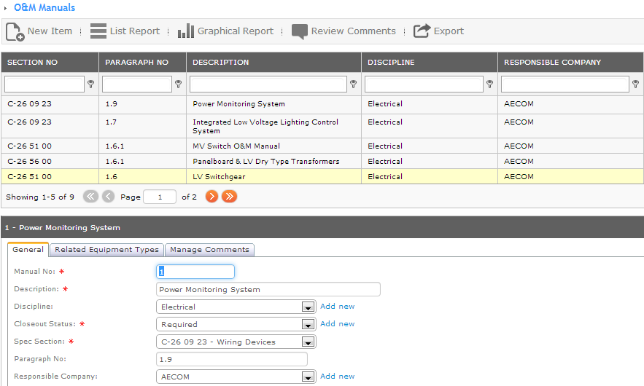
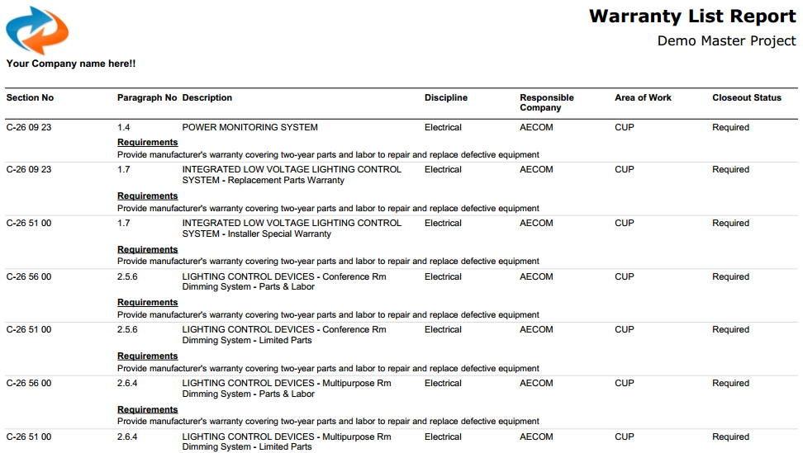
handover
Design
Construction
Quality
Commissioning
Closeout
Drawings
Specifications
Documents
Design Review
Submittals
RFI’s
Change Docs
Inspections
Punchlist
Equipment
Checklists
Functional Tests
O&M’s
Training
Warranty
Spare Parts
Issues Log
Project Mgmt
Field Reports
Meetings
Transmittals
Contacts
Companies
Places
Contracts
Users / Roles
Customization
Notifications
Systems
Deliverables Tracking
Organize and manage all the deliverables for turnover
Track the requirements and status of each closeout deliverable item
Generate reports for use with Contracting and subcontracting team
Perform O&M review within the system
Automated notifications keep the team up to date with updates and progress
07-Jan-14
2014 buidlingSMART Challenge
15

Slide 16
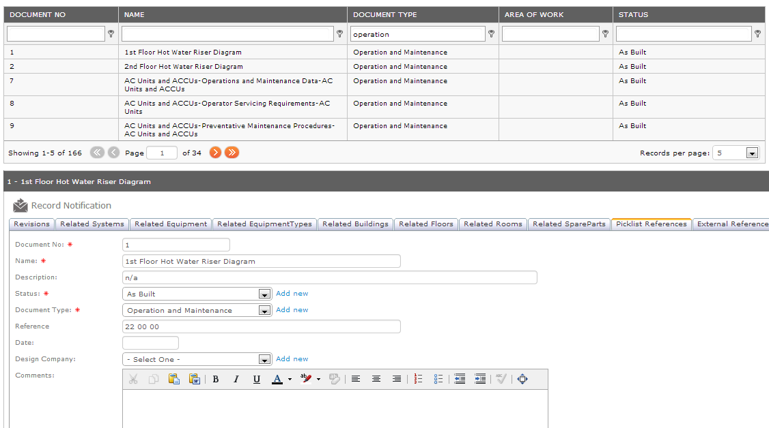
Equipment Relations
07-Jan-14
2014 buidlingSMART Challenge
16

Slide 17
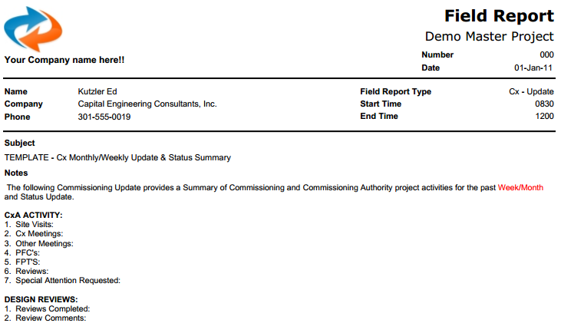
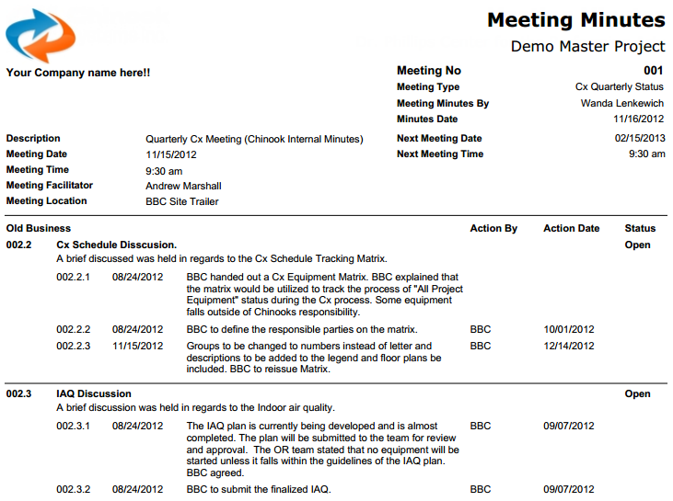
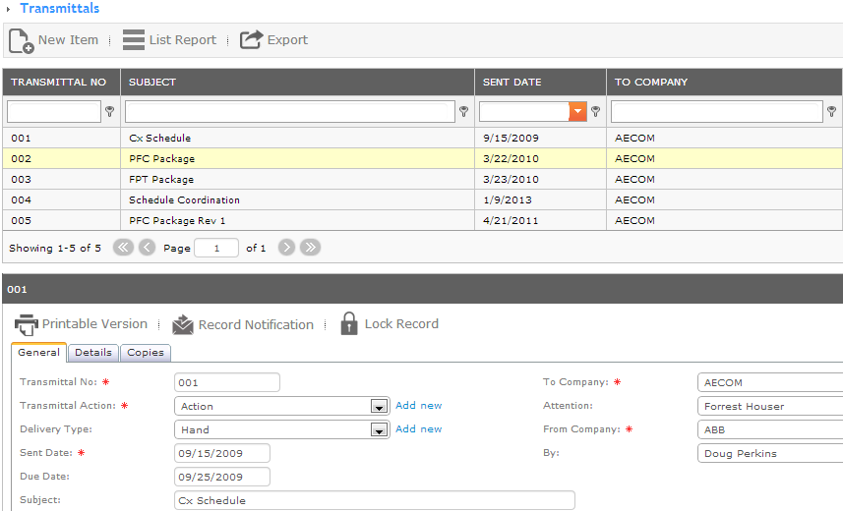
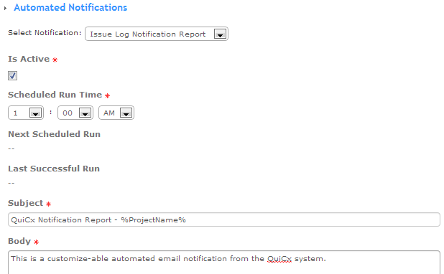
project management
Design
Construction
Quality
Commissioning
Closeout
Drawings
Specifications
Documents
Design Review
Submittals
RFI’s
Change Docs
Inspections
Punchlist
Equipment
Checklists
Functional Tests
O&M’s
Training
Warranty
Spare Parts
Issues Log
Project Mgmt
Field Reports
Meetings
Transmittals
Contacts
Companies
Places
Contracts
Users / Roles
Customization
Notifications
Systems
Deliverables Tracking
07-Jan-14
2014 buidlingSMART Challenge
17

Slide 18
contacts
COBie support
name:
phone:
email:
web:
marketing POC
name:
phone:
email:
David Wampler
703-350-3541
quicx@chinooksystems.com
www.quicx.net
David Wampler
703-350-3541
quicx@chinooksystems.com
07-Jan-14
2014 buidlingSMART Challenge
18

