Slide 1
EcoDomus PM
Data Management
Igor Starkov
President
EcoDomus, Inc.

Slide 2
About EcoDomus
Software and consulting firm with several offices in the U.S. and international partners in Australia, China, Japan, UK and Middle East.
Focus on BIM for Facility Lifecycle Data Management
Pioneers of BIM for FM, COBie integration & industry standards
Some of our clients:
Others
Healthcare
Government
Education

Slide 3
EcoDomus Solutions for Lifecycle BIM
EcoDomus PM™
Data Collection & Validation
EcoDomus FM™
Data Maintenance & Analytics
COBie Management
BIM Data Quality Control
3D As-Built (CAD to BIM)
Commissioning & Handover
Energy Modeling
Field BIM (iPad/Windows8)
BIM for Work Orders
Mobile BIM
Energy Management
BIM/GIS Integration
3D/2D BIM Dashboard
Up-to-date BIM As-Built
DATA
BASE

Slide 4
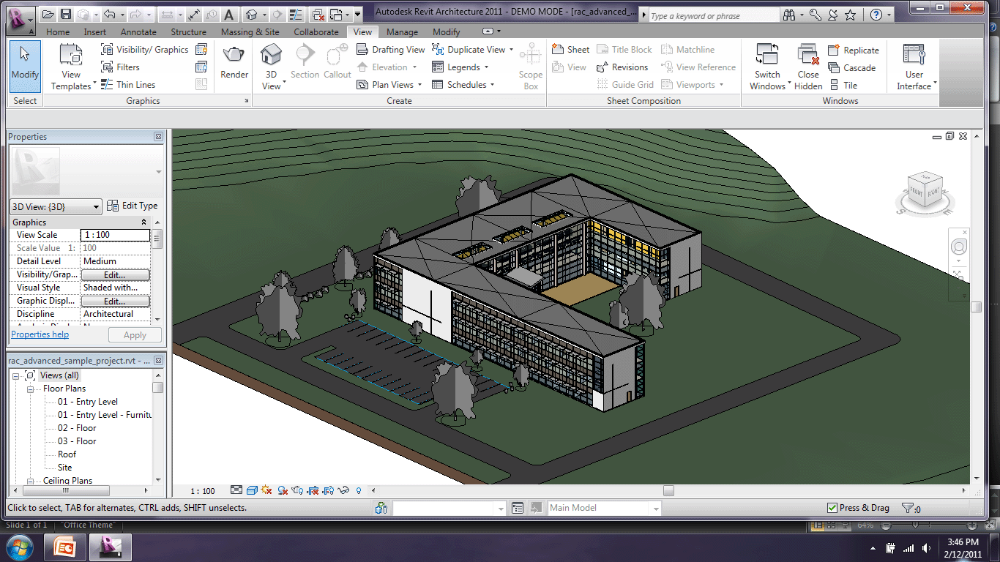
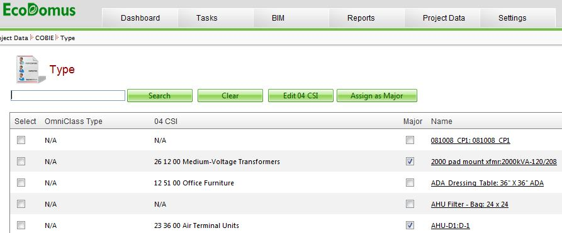
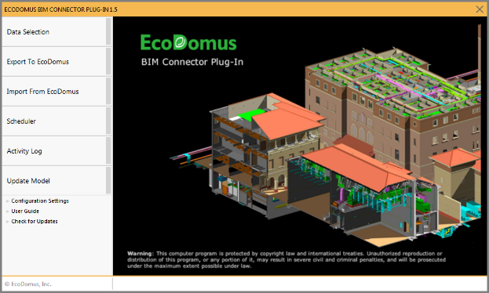
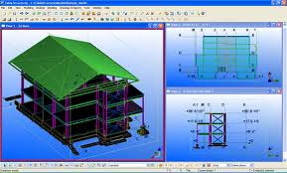
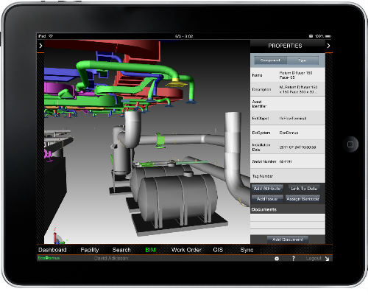
Getting BIM into EcoDomus
Revit
EcoDomus Web
EcoDomus BIM Connector
Tekla, Bentley, ArchiCAD, IFC
EcoDomus Mobile
Original BIM is filtered, data is split from geometry, and data is pushed to the web

Slide 5
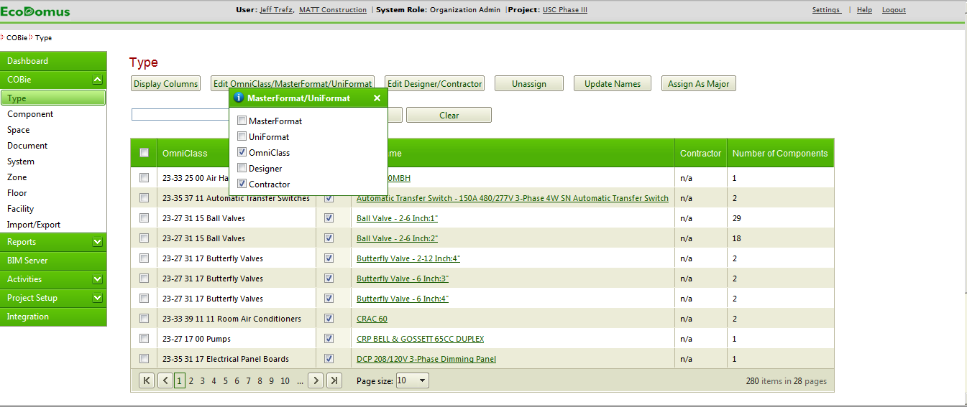
Add COBie Data to Types and Components
Step 1
1. Select “Display Columns”
2. Select “Contractor”
Notes:
To start with some housekeeping:
You will all be muted, but you can log your questions in the right hand pane. We’ll get to them at the end in our Q&A session.
Also, we will be recording this and distributing both the recording and power point afterwards.
We have an hour scheduled, and we’ll cover:
*who we are – individually as presenters and the organizations we represent
*an overview of what BIM and COBie are
*a description of USC’s approach for implementing a integrated lifecycle BIM strategy,
*a demonstration of how they’re using EcoDomus to support that strategy
*and then we’ll get to your questions.

Slide 6
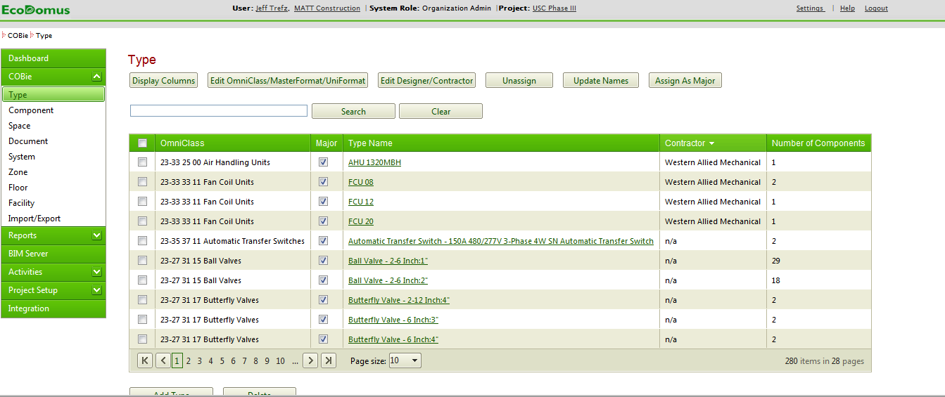
Add COBie Data to Types and Components
Step 2
Click here to sort Type requirements by Contractors
Notes:
To start with some housekeeping:
You will all be muted, but you can log your questions in the right hand pane. We’ll get to them at the end in our Q&A session.
Also, we will be recording this and distributing both the recording and power point afterwards.
We have an hour scheduled, and we’ll cover:
*who we are – individually as presenters and the organizations we represent
*an overview of what BIM and COBie are
*a description of USC’s approach for implementing a integrated lifecycle BIM strategy,
*a demonstration of how they’re using EcoDomus to support that strategy
*and then we’ll get to your questions.

Slide 7
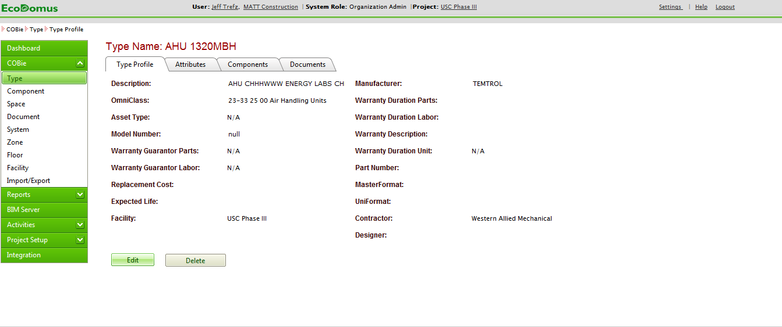
Add COBie Data to Types and Components
Step 3
Notes:
To start with some housekeeping:
You will all be muted, but you can log your questions in the right hand pane. We’ll get to them at the end in our Q&A session.
Also, we will be recording this and distributing both the recording and power point afterwards.
We have an hour scheduled, and we’ll cover:
*who we are – individually as presenters and the organizations we represent
*an overview of what BIM and COBie are
*a description of USC’s approach for implementing a integrated lifecycle BIM strategy,
*a demonstration of how they’re using EcoDomus to support that strategy
*and then we’ll get to your questions.

Slide 8
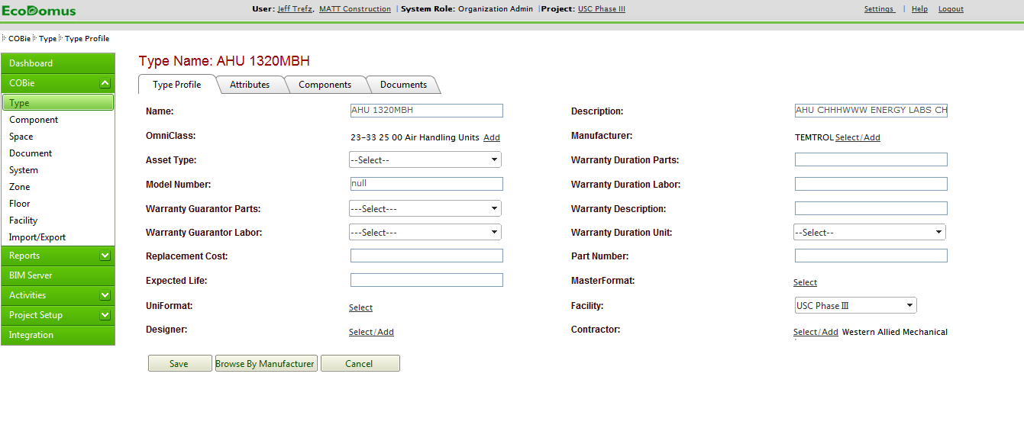
Add COBie Data to Types and Components
Step 4
Edit extended Attributes here
Review and edit Components within Type
Upload Documents by Type
Edit open fields in Type profile for standard COBie data
Notes:
To start with some housekeeping:
You will all be muted, but you can log your questions in the right hand pane. We’ll get to them at the end in our Q&A session.
Also, we will be recording this and distributing both the recording and power point afterwards.
We have an hour scheduled, and we’ll cover:
*who we are – individually as presenters and the organizations we represent
*an overview of what BIM and COBie are
*a description of USC’s approach for implementing a integrated lifecycle BIM strategy,
*a demonstration of how they’re using EcoDomus to support that strategy
*and then we’ll get to your questions.

Slide 9
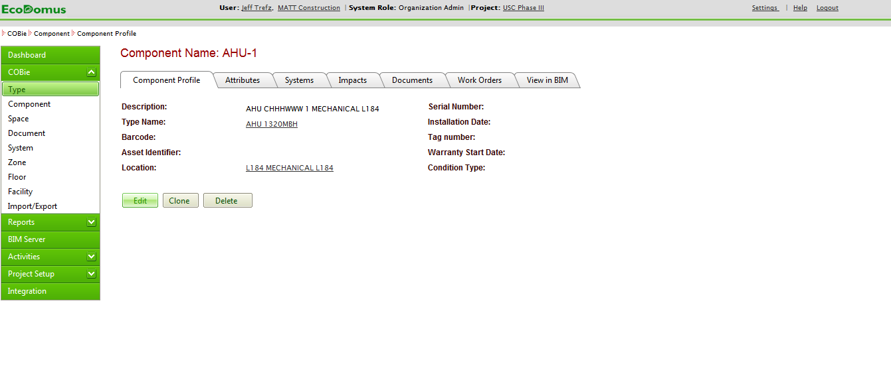
Add COBie Data to Types and Components
Step 5
Find Components from COBie tab or through associated Types
View Component in BIM
Notes:
To start with some housekeeping:
You will all be muted, but you can log your questions in the right hand pane. We’ll get to them at the end in our Q&A session.
Also, we will be recording this and distributing both the recording and power point afterwards.
We have an hour scheduled, and we’ll cover:
*who we are – individually as presenters and the organizations we represent
*an overview of what BIM and COBie are
*a description of USC’s approach for implementing a integrated lifecycle BIM strategy,
*a demonstration of how they’re using EcoDomus to support that strategy
*and then we’ll get to your questions.

Slide 10
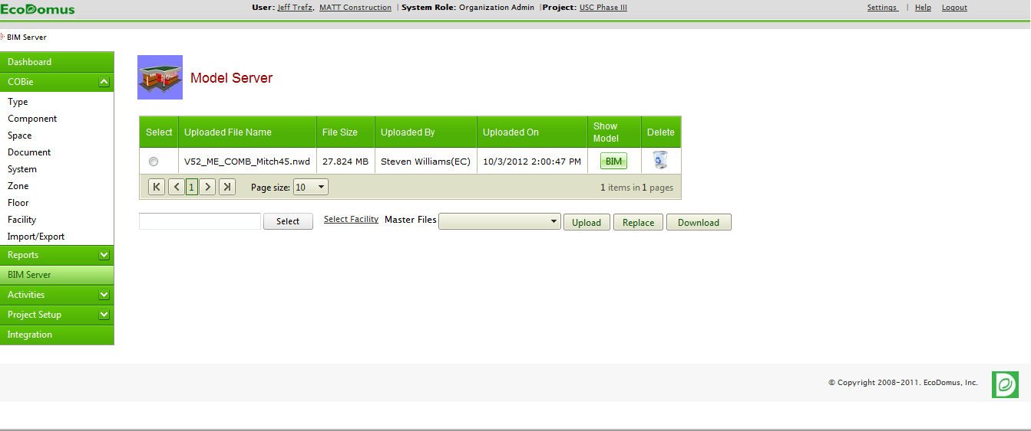
Add Data and Docs to Model
Step 1
2. Select “BIM”
1. Select “BIM Server”
Notes:
To start with some housekeeping:
You will all be muted, but you can log your questions in the right hand pane. We’ll get to them at the end in our Q&A session.
Also, we will be recording this and distributing both the recording and power point afterwards.
We have an hour scheduled, and we’ll cover:
*who we are – individually as presenters and the organizations we represent
*an overview of what BIM and COBie are
*a description of USC’s approach for implementing a integrated lifecycle BIM strategy,
*a demonstration of how they’re using EcoDomus to support that strategy
*and then we’ll get to your questions.

Slide 11
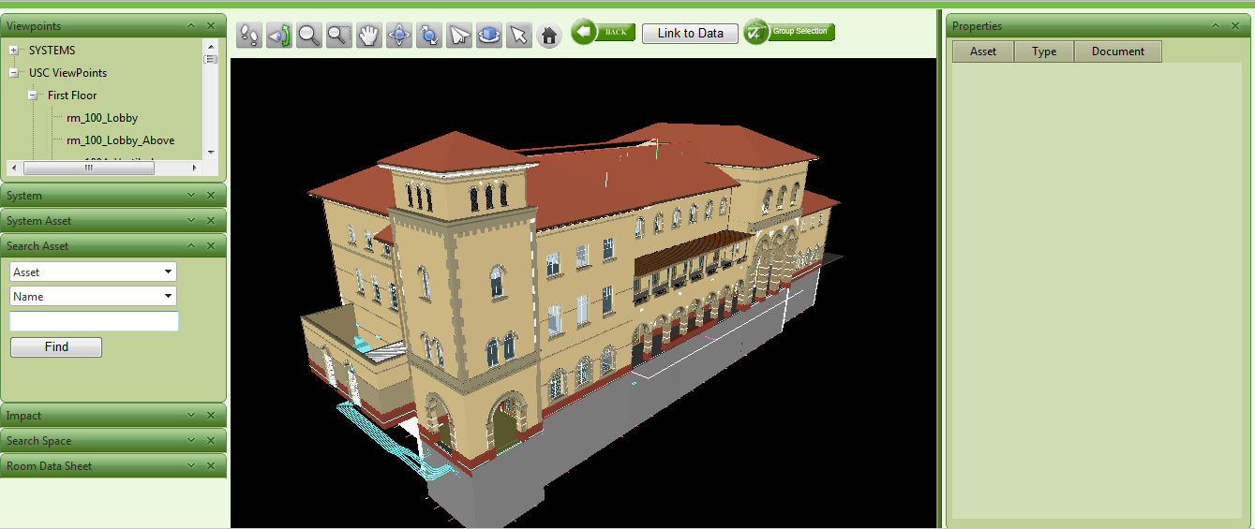
Add Data and Docs to Model
Step 2
Search for Component by Viewpoint (e.g. Room, Equipment, or System)
Or, Search “Asset/Type” and select
Notes:
To start with some housekeeping:
You will all be muted, but you can log your questions in the right hand pane. We’ll get to them at the end in our Q&A session.
Also, we will be recording this and distributing both the recording and power point afterwards.
We have an hour scheduled, and we’ll cover:
*who we are – individually as presenters and the organizations we represent
*an overview of what BIM and COBie are
*a description of USC’s approach for implementing a integrated lifecycle BIM strategy,
*a demonstration of how they’re using EcoDomus to support that strategy
*and then we’ll get to your questions.

Slide 12
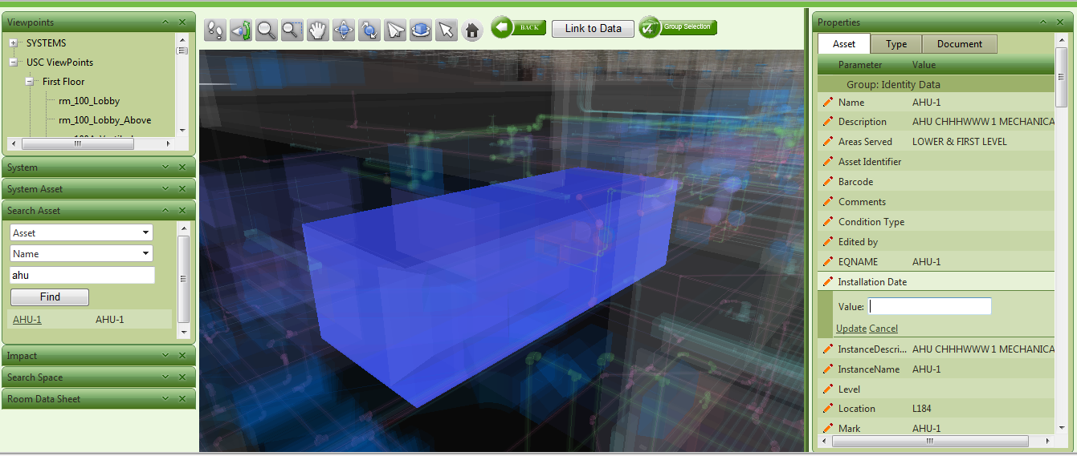
Add Data and Docs to Model
Step 3
Add/Edit Data by selecting pencil
Notes:
To start with some housekeeping:
You will all be muted, but you can log your questions in the right hand pane. We’ll get to them at the end in our Q&A session.
Also, we will be recording this and distributing both the recording and power point afterwards.
We have an hour scheduled, and we’ll cover:
*who we are – individually as presenters and the organizations we represent
*an overview of what BIM and COBie are
*a description of USC’s approach for implementing a integrated lifecycle BIM strategy,
*a demonstration of how they’re using EcoDomus to support that strategy
*and then we’ll get to your questions.

Slide 13
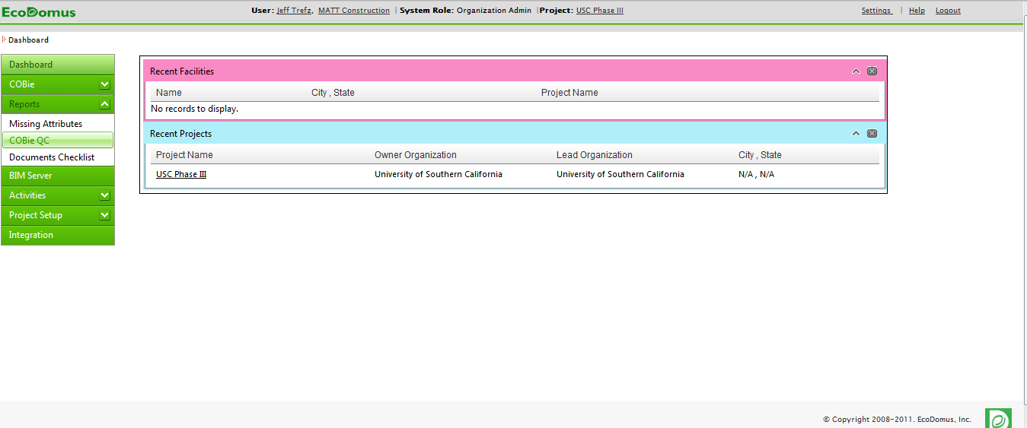
Check Input: COBie standard data
Step 1
Go to Reports drop down menu and select “COBie QC”
Notes:
To start with some housekeeping:
You will all be muted, but you can log your questions in the right hand pane. We’ll get to them at the end in our Q&A session.
Also, we will be recording this and distributing both the recording and power point afterwards.
We have an hour scheduled, and we’ll cover:
*who we are – individually as presenters and the organizations we represent
*an overview of what BIM and COBie are
*a description of USC’s approach for implementing a integrated lifecycle BIM strategy,
*a demonstration of how they’re using EcoDomus to support that strategy
*and then we’ll get to your questions.

Slide 14
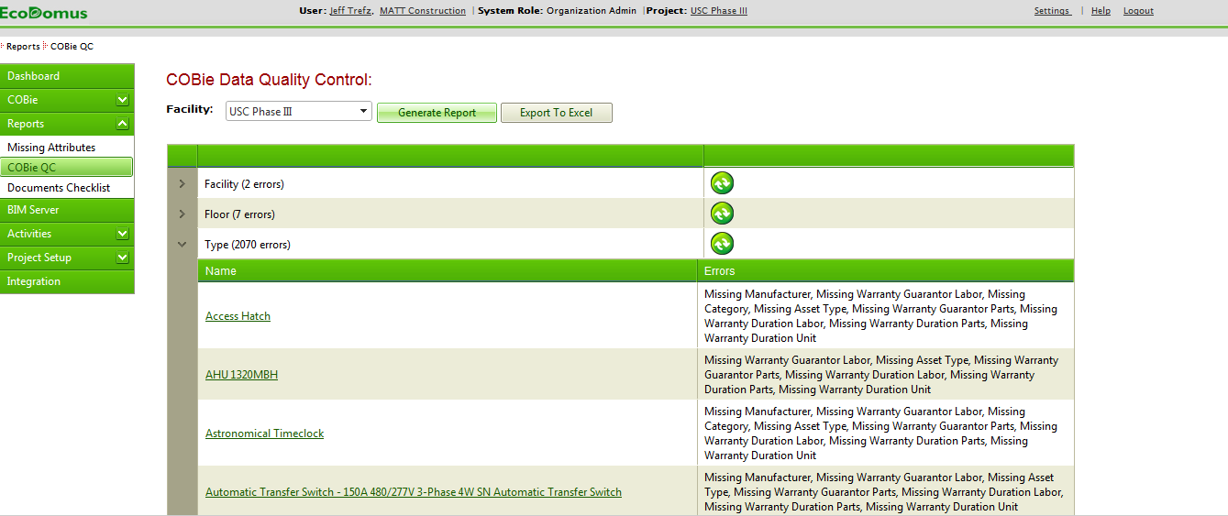
Check Input: COBie standard data
Step 2
Select “Generate Report”
Review missing data by category, select item to add missing data
Notes:
To start with some housekeeping:
You will all be muted, but you can log your questions in the right hand pane. We’ll get to them at the end in our Q&A session.
Also, we will be recording this and distributing both the recording and power point afterwards.
We have an hour scheduled, and we’ll cover:
*who we are – individually as presenters and the organizations we represent
*an overview of what BIM and COBie are
*a description of USC’s approach for implementing a integrated lifecycle BIM strategy,
*a demonstration of how they’re using EcoDomus to support that strategy
*and then we’ll get to your questions.

Slide 15
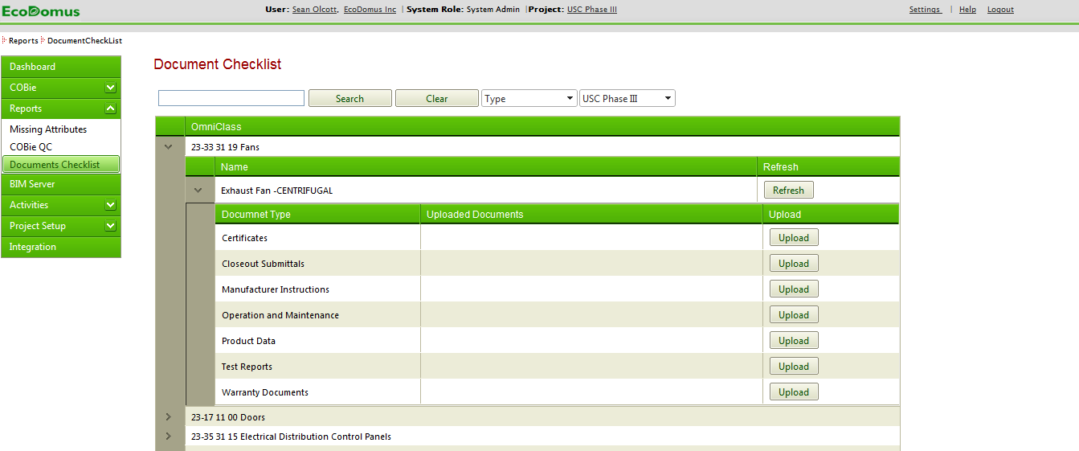
Check Input: Documents
Step 3
2. Select by category (eg Type, Component)
1. Select “Documents Checklist”
3. Upload missing documents
Notes:
To start with some housekeeping:
You will all be muted, but you can log your questions in the right hand pane. We’ll get to them at the end in our Q&A session.
Also, we will be recording this and distributing both the recording and power point afterwards.
We have an hour scheduled, and we’ll cover:
*who we are – individually as presenters and the organizations we represent
*an overview of what BIM and COBie are
*a description of USC’s approach for implementing a integrated lifecycle BIM strategy,
*a demonstration of how they’re using EcoDomus to support that strategy
*and then we’ll get to your questions.

Slide 16
Thank You!
Igor Starkov
571-277-6617
Reston, VA
igor@ecodomus.com

