Slide 1
S413
Navisworks: Managing Collision Detection & Construction Sequencing
Andy Thoma
Technical Specialist: Civil Engineering
Athoma@Microdesk.com

Slide 2
WHO WE ARE: Autodesk Software Partner – PSP Google Training Partner ESRI Training and Development Partner AEC Consultants and Software Developers WHAT WE DO: Autodesk Software Sales Revit | Navisworks | AutoCAD | Civil 3D & More Autodesk Training – ATC and Custom Implementation Training Services Google Training – Google Earth and Sketch-Up Training Classes BIM, LEED, GIS and FM Consulting – Training, Business Process Engineering, and Custom Application Development IT Support Helpdesk – for Autodesk, ESRI, Google and general IT related inquiries
MASSACHUSETTS | NEW HAMPSHIRE | NEW YORK | NEW JERSEY | CONNITECUT | PHILADELPHIA | WASHINGTON, DC | CALIFORNIA

Slide 3
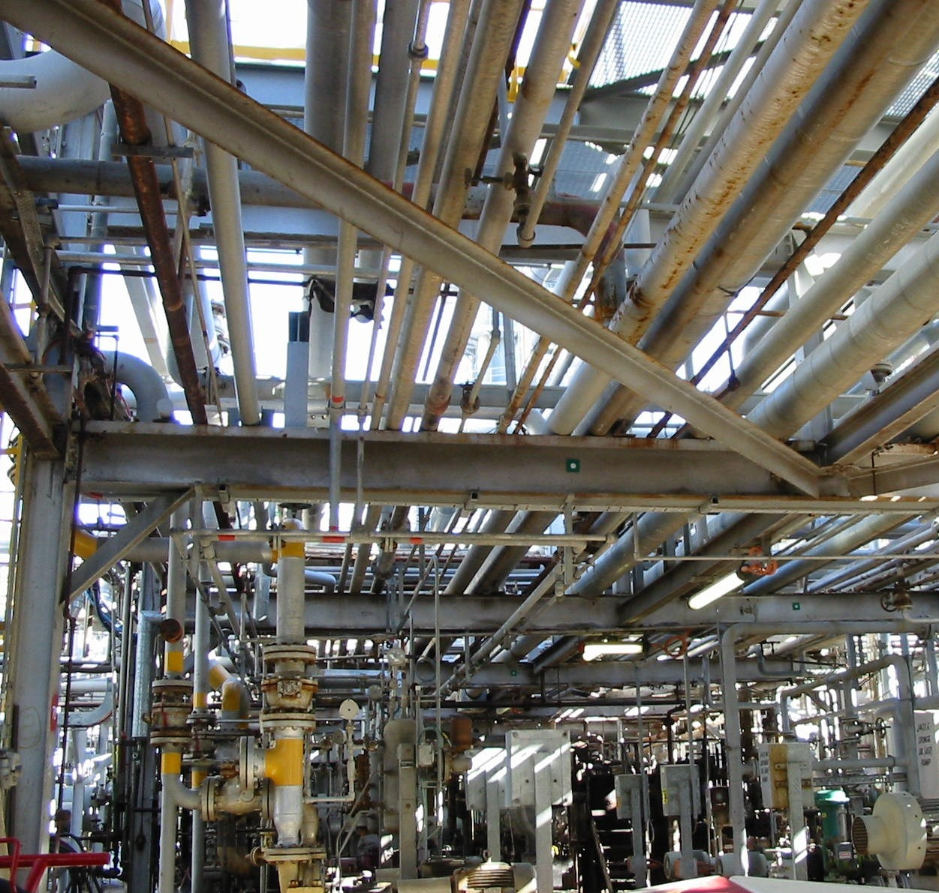
Clash Detection
Notes:
Manage target user
AEC firms that need to Integrate various formats and perform Clash detection between elements, analysis time verse process (4d process planning), animate presentations, create presentations based on design models

Slide 4
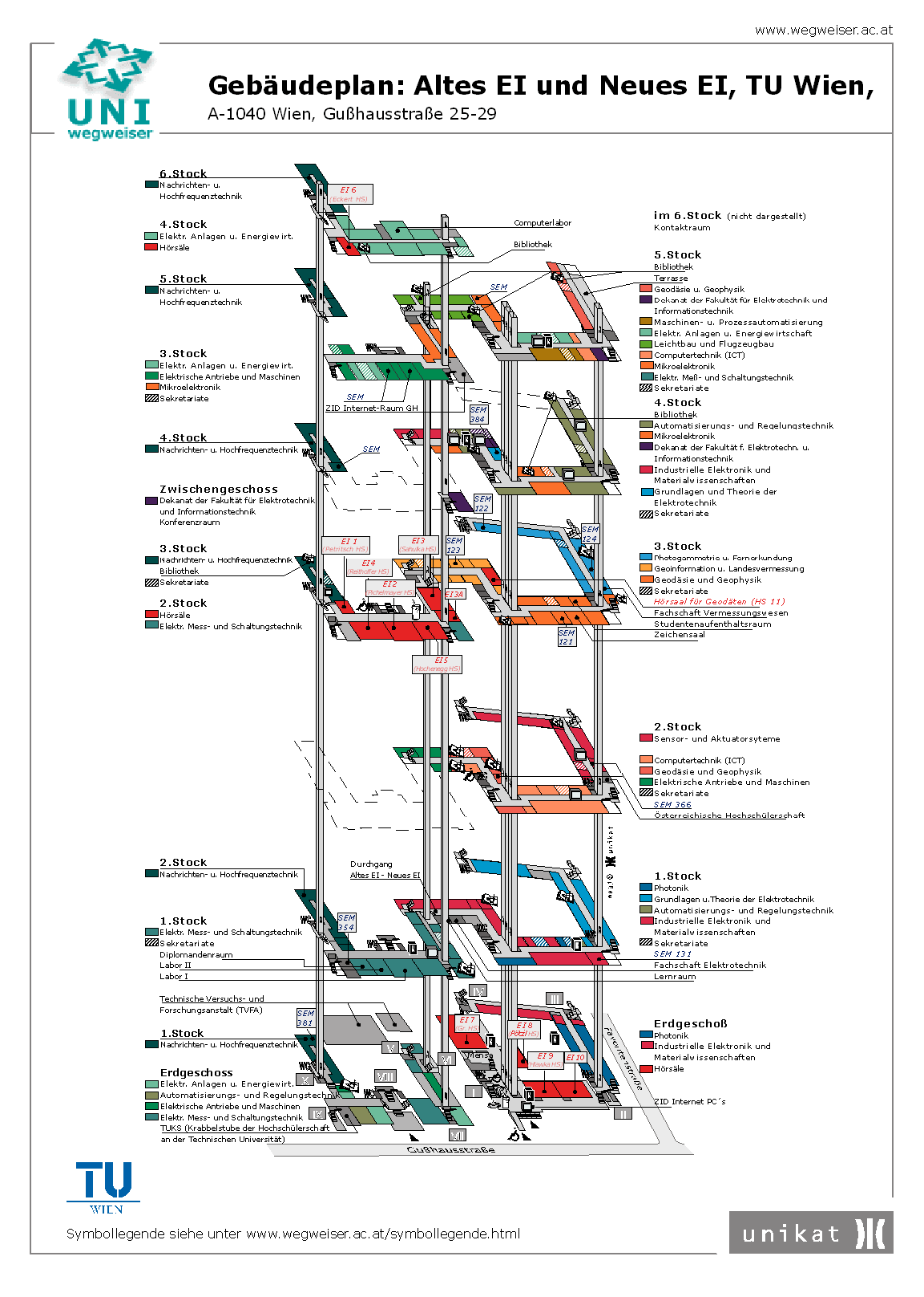
Lost in Translation
Notes:
Manage target user
AEC firms that need to Integrate various formats and perform Clash detection between elements, analysis time verse process (4d process planning), animate presentations, create presentations based on design models

Slide 5
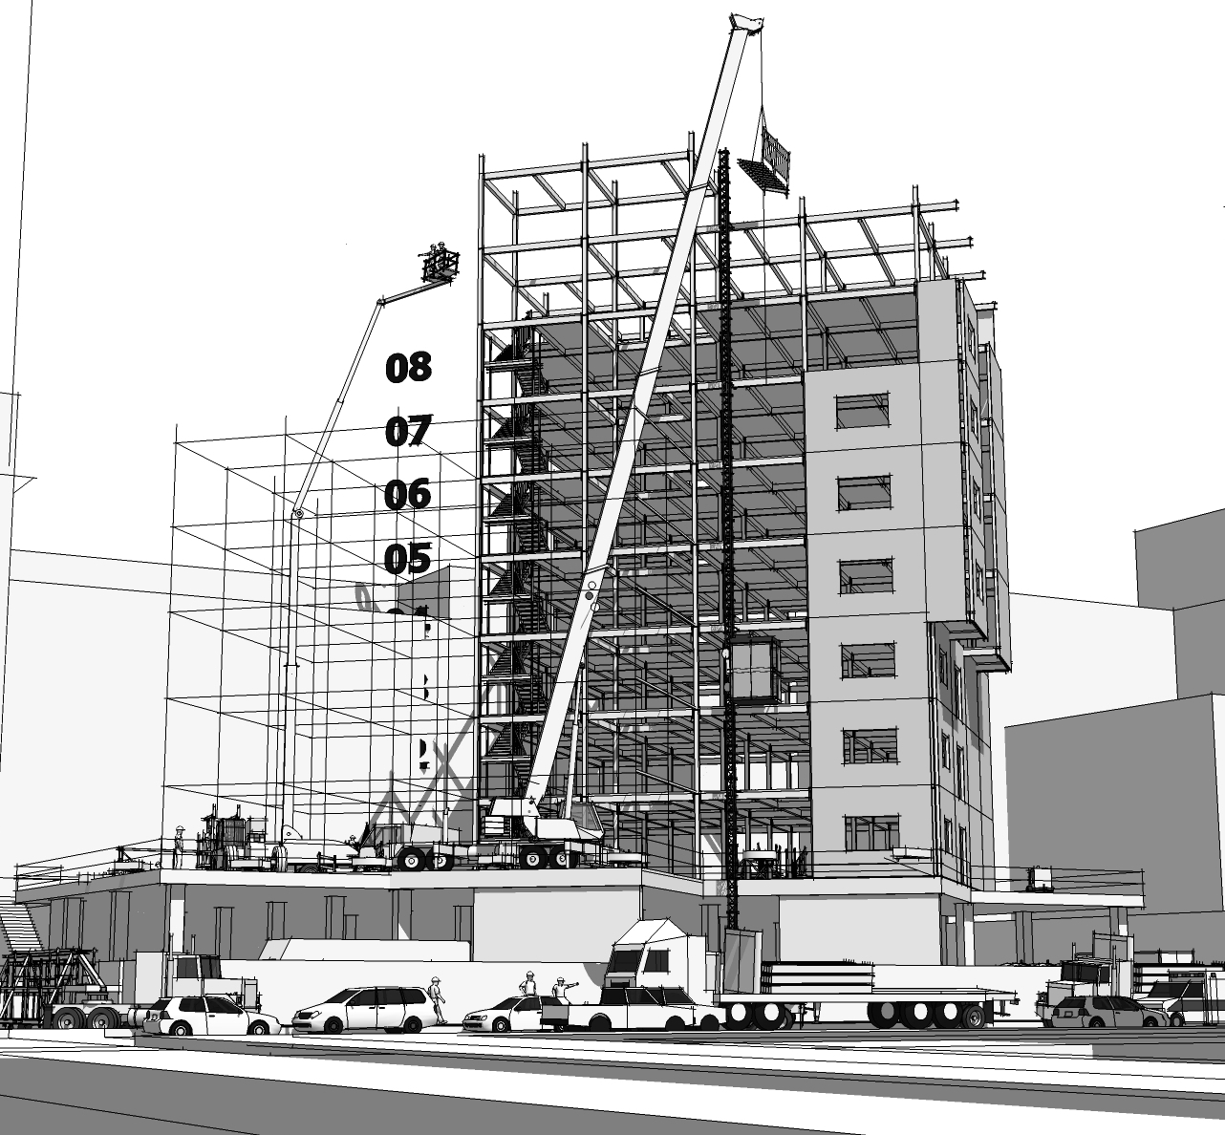
Construction Sequencing
Notes:
Manage target user
AEC firms that need to Integrate various formats and perform Clash detection between elements, analysis time verse process (4d process planning), animate presentations, create presentations based on design models

Slide 6
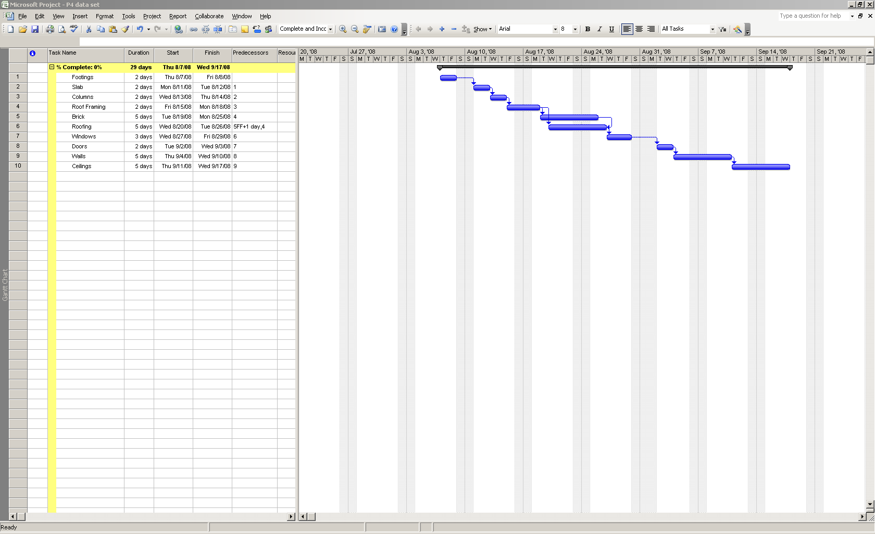
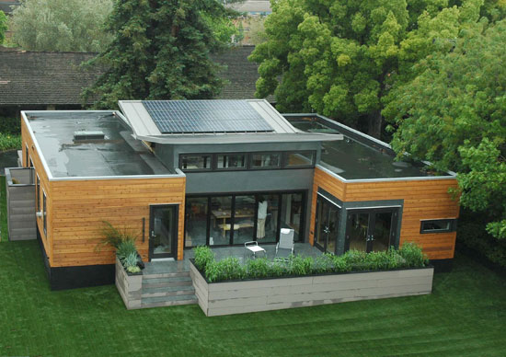
Process Planning

Slide 7
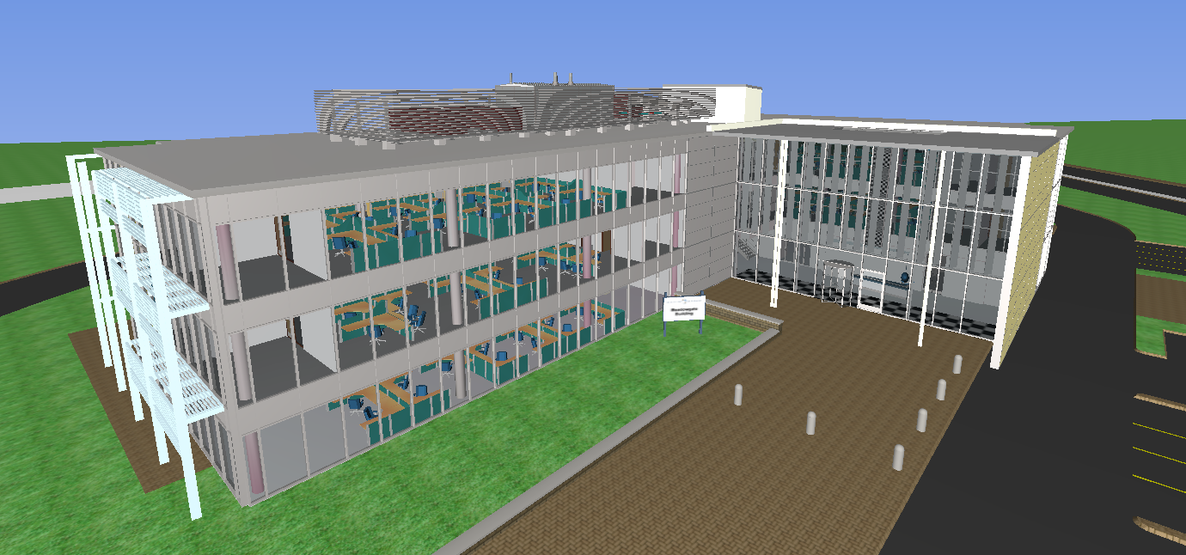
Collaborative Model

Slide 8
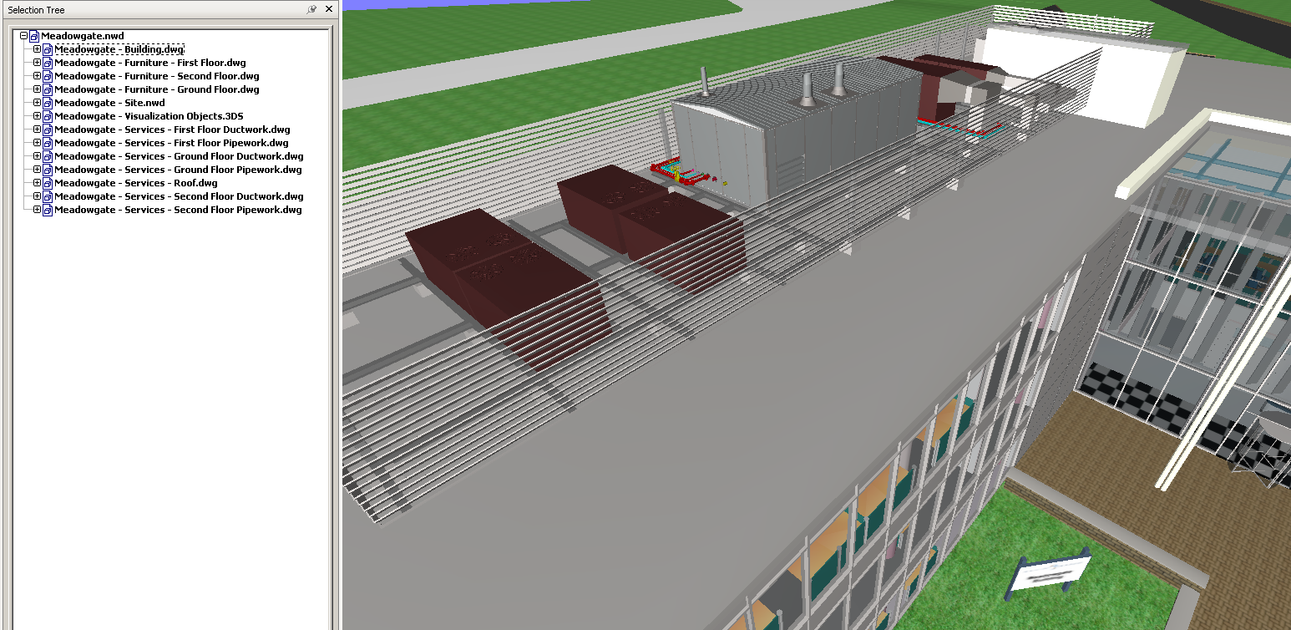
Collaborate How?

Slide 9
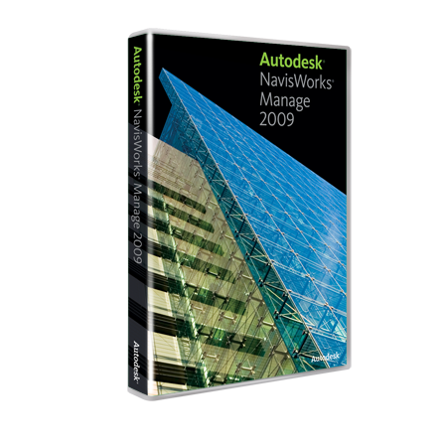
NavisWorks
Manage Design
Visualize Project
Present Model
Simulate Ideas
Detect Problems

Slide 10
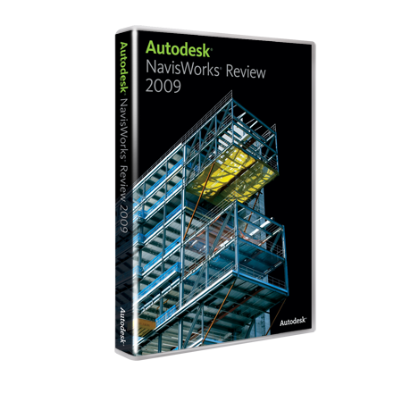
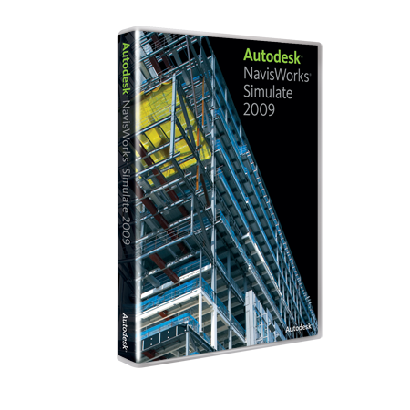
Product Family
Review
Simulate
Manage
Freedom

Slide 11
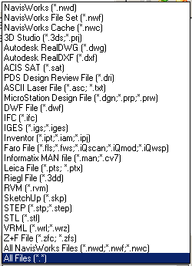
Manage Design
Open, Convert, Attach, Export
Multiple CAD formats
Streamlined Cohesion
.NWD
.NWF

Slide 12
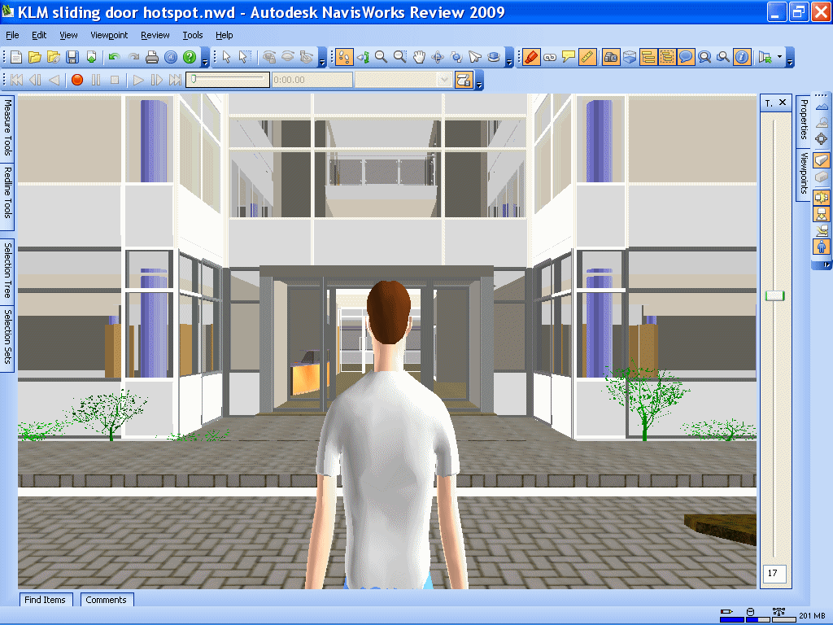
Visualize Project

Slide 13
Present Ideas

Slide 14
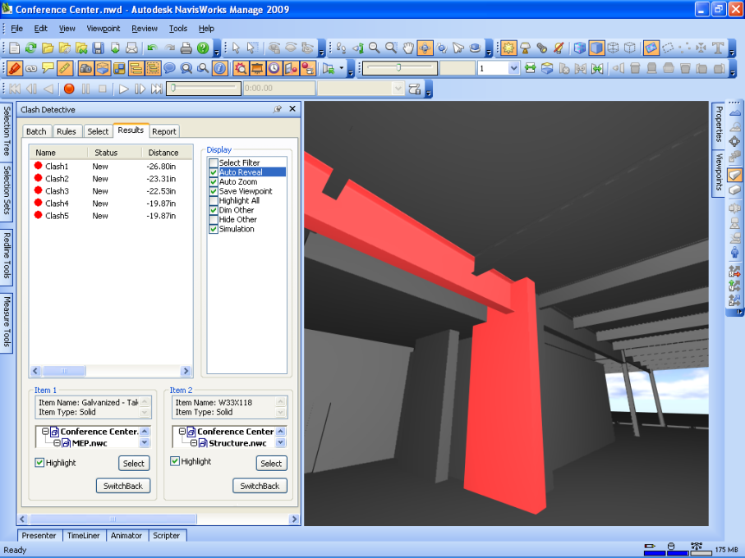
Detect Problems
Conflict Reduction
Visualization
Resolution

Slide 15
Clash Detection

Slide 16
Tolerance

Slide 17
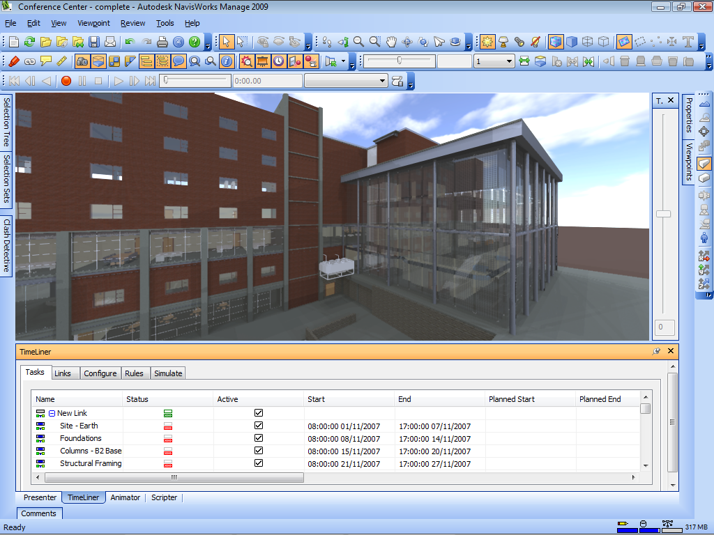
Simulate Ideas
Time Lining
Construction Planning
Progress Assessment

Slide 18
Visualize the Sequence

Slide 19
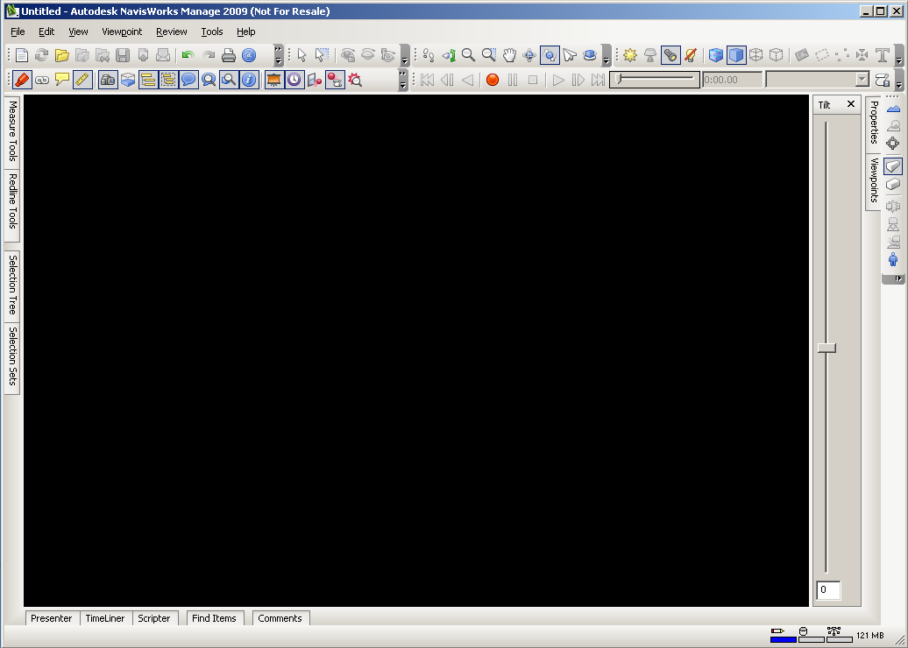
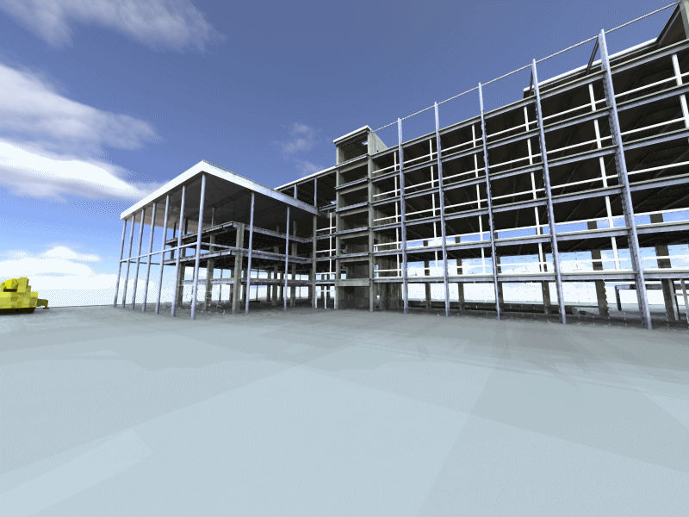
Create a Process

Slide 20
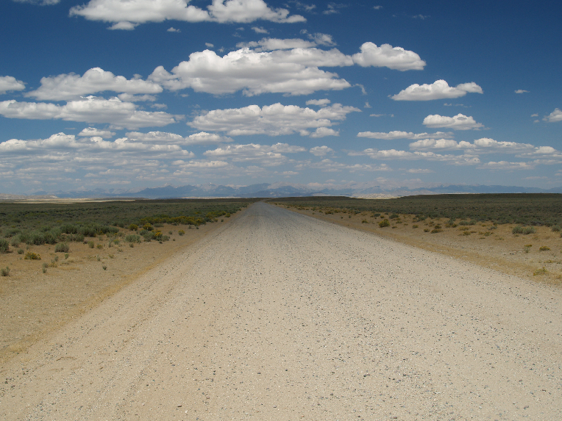
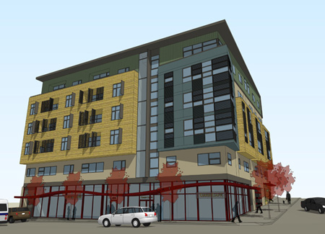
The Idea …
Think and Visualize in 3D
Create in 3D

Slide 21
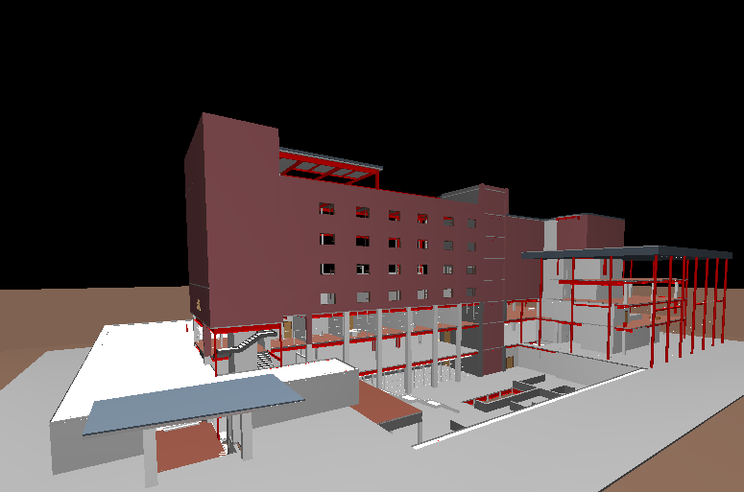
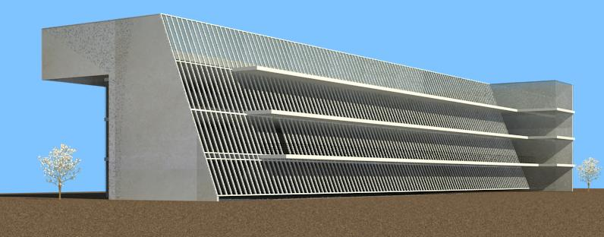
Collaborate

Slide 22
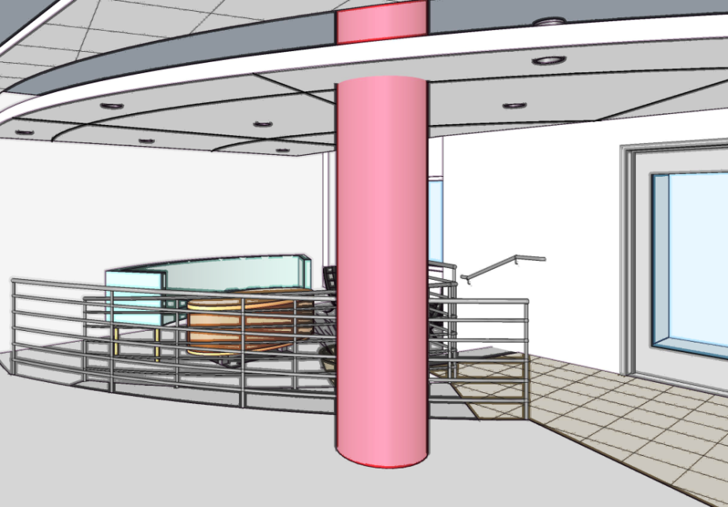
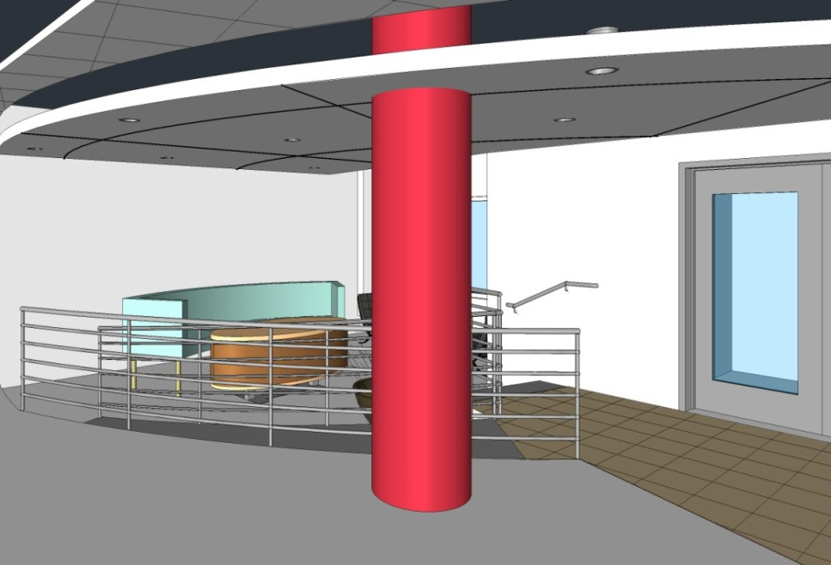
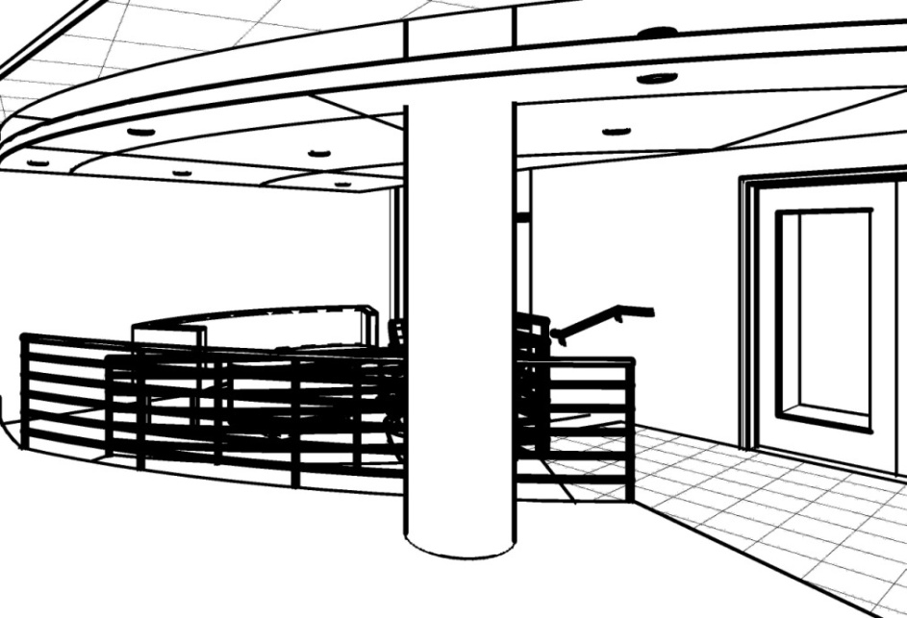
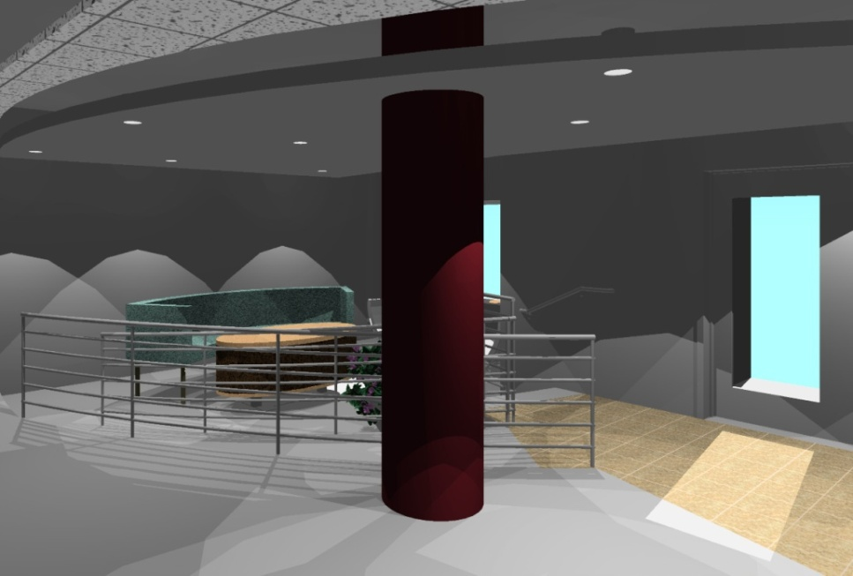
Present

Slide 23
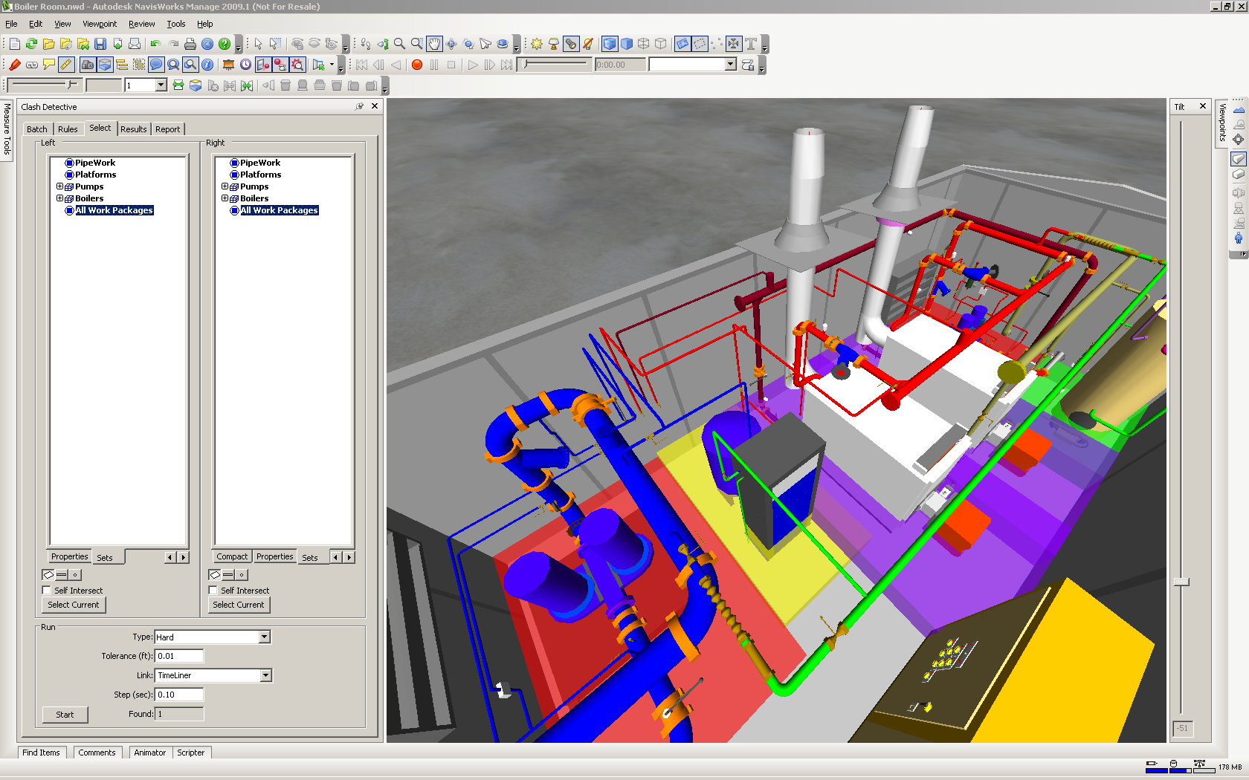
Look for Problems

Slide 24
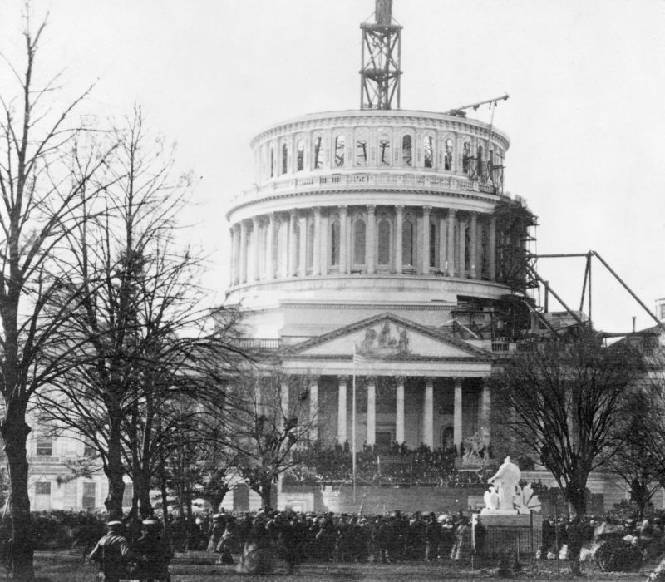
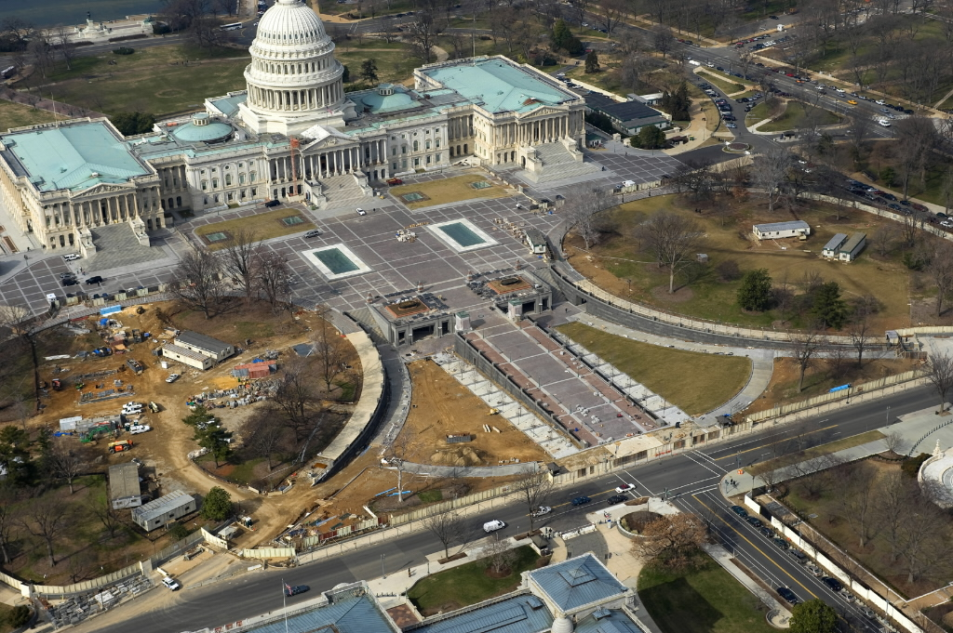
Create Order

Slide 25
Questions?
www.Microdesk.com
1-800-336-3375
Athoma@Microdesk.com

