Slide 1
EastCoast CAD/CAM IFC COBie Plus (via Fabrication for AutoCAD MEP)
David E. Quigley, Chief Operating Officer
Keith Brown, MEP Consulting Engineer
10-Jan-13
2013 HVAC information exchange Demo
1

Slide 2
product description
MEP Design to Fabrication:
Based on Open Standards and an Open Architecture, EastCoast CAD/CAM provides users with a seamless, Version 2 National BIM Standard Compliant workflow taking an engineered model, extending and preparing it with real manufacturer content and fabrication detail for manufacturing, installation and now, with relevant COBie functionality, taking the original design all of the way through to Facilities Management without redrawing and automating the process of O&M manual creation .
10-Jan-13
2013 HVAC information exchange Demo
2

Slide 3
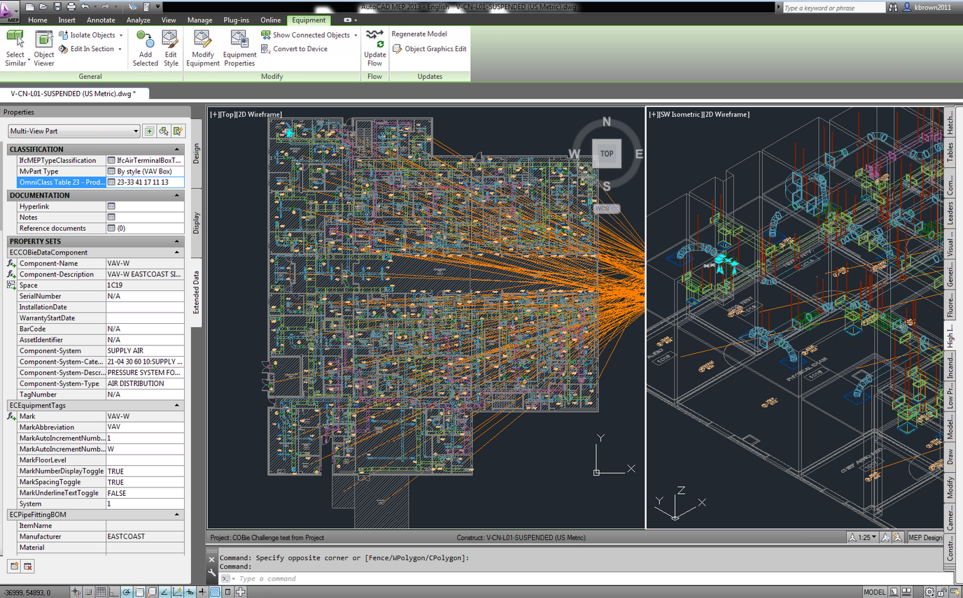
product features
MEP Design to Fabrication provides contractors and engineers the much sought after ability to take engineering design drawings created on engineering oriented platforms, such as Revit MEP, and easily convert them to sheet metal, piping and plumbing detail drawings. The result of which can be used for coordination, fabrication, and installation. Generic system layouts are automatically converted to real manufacturer parts, geometry and specifications, according to your specific requirements. This patented process removes the need to completely redraw the engineer’s design, and saves contractors time and money on every project.
Bringing interoperability to disparate design platforms
Eliminating redundant redrawing processes
Automating the MEP Design to Fabrication workflow for profound productivity efficiencies
Delivering COBie data as required in the Version 2 National BIM Standard
10-Jan-13
2013 HVAC information exchange Demo
3

Slide 4
user base
> 1,000
as a software publisher this is n/a
as a software publisher this is n/a
as a software publisher this is n/a
UMEC San Diego (EMCOR) CA
Dee Cramer MI
Postler and Jaekle NY
users
user count:
facility count:
public sector:
private sector:
customers
10-Jan-13
2013 HVAC information exchange Demo
4

Slide 5
tested product
product:
Revit MEP 2013
AutoCAD MEP 2013
Fabrication for AutoCAD MEP Version 5.1
IFC COBie Plus
PC-based
www.eccadcam.com
10-Jan-13
2013 HVAC information exchange Demo
5

Slide 6
HVACie demo scope
information | associated IFC entities | Imported | Exported
spaces | ifcSpace |  | 
space properties | property sets |  | 
equipment | type and instance objects |  | 
equipment properties | property sets |  | 
equipment connections | connections |  | 
assemblies | type and instance objects |  | 
systems | ifcSystem |  | 
system properties | property sets |  | 
10-Jan-13
2013 HVAC information exchange Demo
6

Slide 7
HVACie export to COBie
information | COBie.Sheet* | Exported
spaces | Space, Type | 
space properties | Attribute | 
equipment | Type, Component | 
equipment properties | Attribute | 
equipment connections | Connections | 
assemblies | Assemblies | 
systems | System | 
system properties | Attribute | 
* and supporting COBie sheets as required per standard.
10-Jan-13
2013 HVAC information exchange Demo
7

Slide 8
configuration
Apply Spaces and Zones to the Model – Use standard AutoCAD MEP tools to apply spaces and zones to your model
Attach Cobie Data Property Sets – COBie data is attached to the objects in the model by applying the following property sets
ECCOBieDataSpaces and ECSpaceObjects – These property sets contain all relevant space related properties. Objects are intelligent and will know what space they live in
ECCOBieDataType and EC ComponentData – These property sets contain all relevant equipment related properties. Type data is common across multiple instances of the same object in the model. If you edit the information for one instance each object of the same type will be updated. Component data is unique for every instance.
ECEquipmentTags and ECAirTerminalObjects – Most likely these tags were applied during the fabrication design process to aid the draftsman in detailing the model for fabrication. Information contained in these property sets is automatically read by the above mentioned Type and Component property sets. Therefore there is no need to input this information specifically for the COBie deliverable. (Keith is this true?)
Classifications – Classifications fields are applied automatically to objects but the correct classification will need to be manually selected
Review and update the COBie Data – Much of the data in the above mentioned property sets will be automatically filled in during the process of creating your construction documentation (detailed drawings). However some of the data is not relevant to the detailer and will need to be filled out specifically for the COBie handover
Build and review your schedules – By building COBie schedules you can quickly and easily ensure that all relevant data has been filled out.
Update your data as necessary - If the data has not been filled out properly then you can use the schedules to jump to the specific Type or Component and update the data via the property palette
Apply Contact Information for the project – Use the IFCResourceAssign command to apply all relevant contact information to your model
IFC Options – Optionally you can further customize your COBie deliverable and tell the system exactly which property sets and which properties within each set you would like exported to COBie. Information contained on the facilities tab is also setup in this file.
10-Jan-13
2013 HVAC information exchange Demo
8

Slide 9
process
Export to IFC - Use the AutoCAD MEP IfcExport command to export to Industry Foundation Class (IFC) format.
IFC COBie Plus - Once the file is exported, use the Fabrication for AutoCAD MEP IFC COBie Plus command on the file to reduce the data to only what is needed for COBie. IFCExport takes the IFC file and creates a duplicate with all of the information in it that is needed.
BIM Server - You are now ready to run the BIMServer Satellite tool to import the IFC file and then export it as an XML file.
View the COBie Data - You can now open the XML file in a spreadsheet application, such as Microsoft Excel.
10-Jan-13
2013 HVAC information exchange Demo
9
Notes:
Apply Spaces and Zones to the Model – Use standard AutoCAD MEP tools to apply spaces and zones to your model
Attach Cobie Data Property Sets – COBie data is attached to the objects in the model by applying the following property sets
ECCOBieDataSpaces and ECSpaceObjects – These property sets contain all relevant space related properties. Objects are intelligent and will know what space they live in
ECCOBieDataType and EC ComponentData – These property sets contain all relevant equipment related properties. Type data is common across multiple instances of the same object in the model. If you edit the information for one instance each object of the same type will be updated. Component data is unique for every instance.
ECEquipmentTags and ECAirTerminalObjects – Most likely these tags were applied during the fabrication design process to aid the draftsman in detailing the model for fabrication. Information contained in these property sets is automatically read by the above mentioned Type and Component property sets. Therefore there is no need to input this information specifically for the COBie deliverable. (Keith is this true?)
Classifications – Classifications fields are applied automatically to objects but the correct classification will need to be manually selected
Review and update the COBie Data – Much of the data in the above mentioned property sets will be automatically filled in during the process of creating your construction documentation (detailed drawings). However some of the data is not relevant to the detailer and will need to be filled out specifically for the COBie handover
Build and review your schedules – By building COBie schedules you can quickly and easily ensure that all relevant data has been filled out.
Update your data as necessary - If the data has not been filled out properly then you can use the schedules to jump to the specific Type or Component and update the data via the property palette
Apply Contact Information for the project – Use the IFCResourceAssign command to apply all relevant contact information to your model
IFC Options – Optionally you can further customize your COBie deliverable and tell the system exactly which property sets and which properties within each set you would like exported to COBie. Information contained on the facilities tab is also setup in this file.
Export to IFC - Use the AutoCAD MEP IfcExport command to export to Industry Foundation Class (IFC) format.
IFC COBie Plus - Once the file is exported, use the Fabrication for AutoCAD MEP IFC COBie Plus command on the file to reduce the data to only what is needed for COBie. IFCExport takes the IFC file and creates a duplicate with all of the information in it that is needed.
BIM Server - You are now ready to run the BIMServer Satellite tool to.import the IFC file and then export it as an XML file.
View the COBie Data - You can now open the XML file in a spreadsheet application, such as Microsoft Excel.

Slide 10
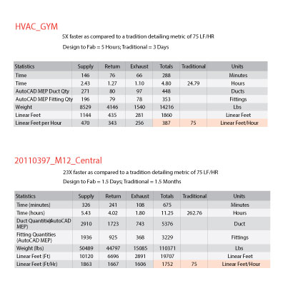
HVACie savings – single project
10-Jan-13
2013 HVAC information exchange Demo
10

Slide 11
contacts
COBie support
name:
phone:
email:
web:
marketing POC
name:
phone:
email:
Keith Brown
800-334-2977
support@eccadcam.com
www.eccadcam.com
David E. Quigley
603-490-2558
dave.quigley@eccadcam.com
10-Jan-13
2013 HVAC information exchange Demo
11

