Slide 1
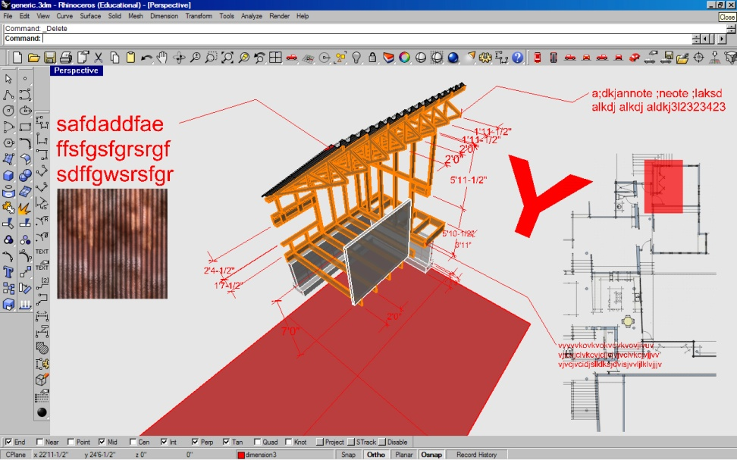
BIM: Constructing Opportunities at Montana State University CHRISTOPHER LIVINGSTON AIA Assistant Professor Montana State University
Construction Document Prototype, Spring 2008, Student: Casey Walker

Slide 2
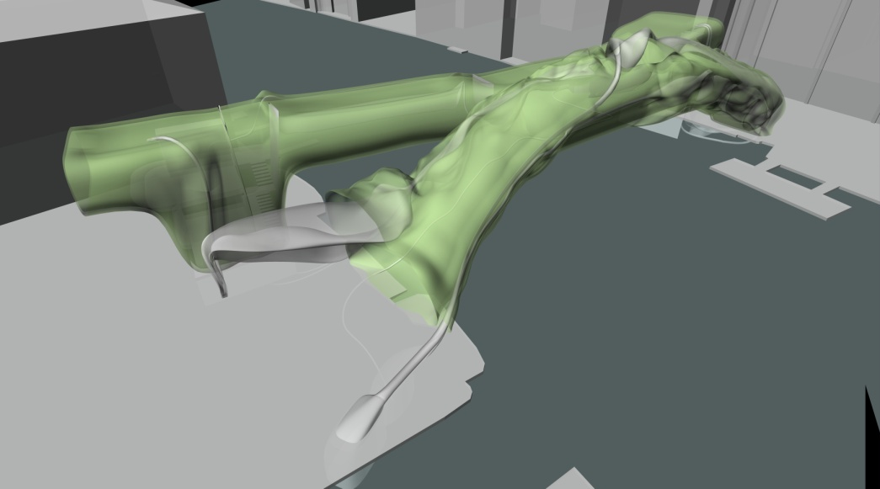
Connecticut General Insurance Building, Skidmore Owings & Merrill, 1957
Venice Bridge Museum Competition, 2006 Student: Tim Sanford

Slide 3
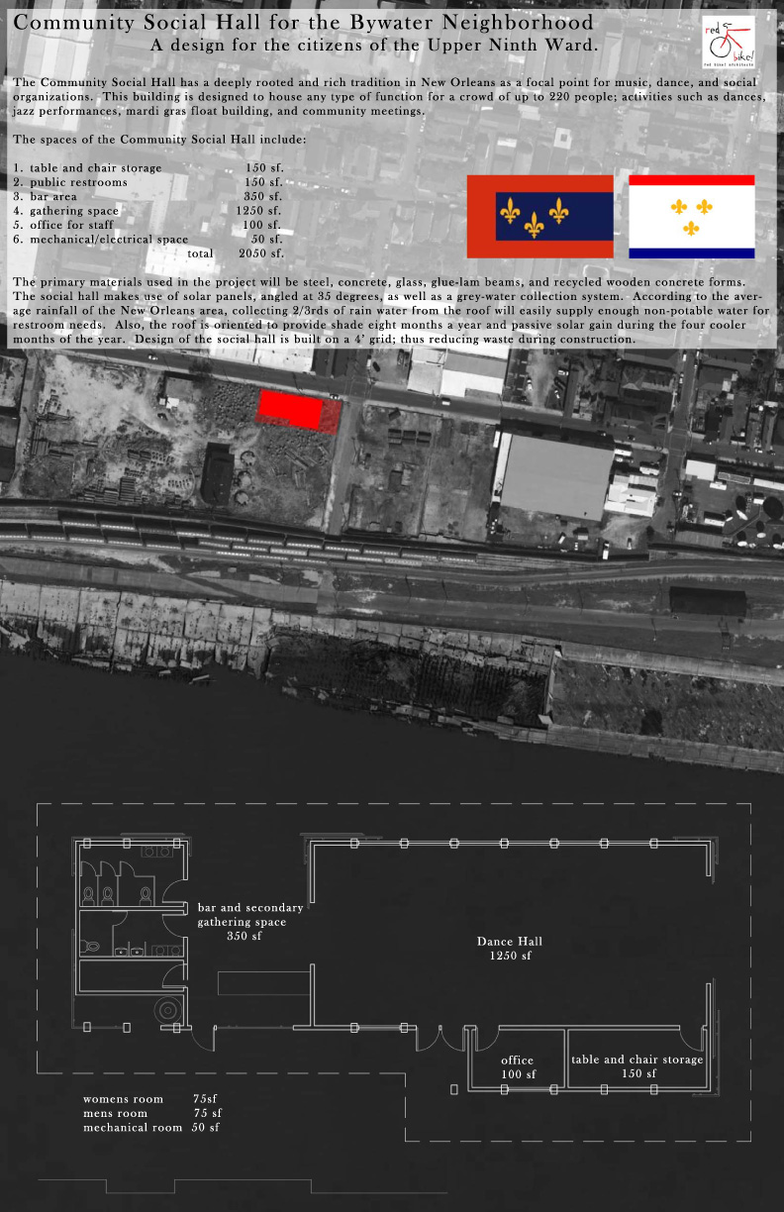
Arch 440, Schematic Design, Student: Kelly Fulton

Slide 4
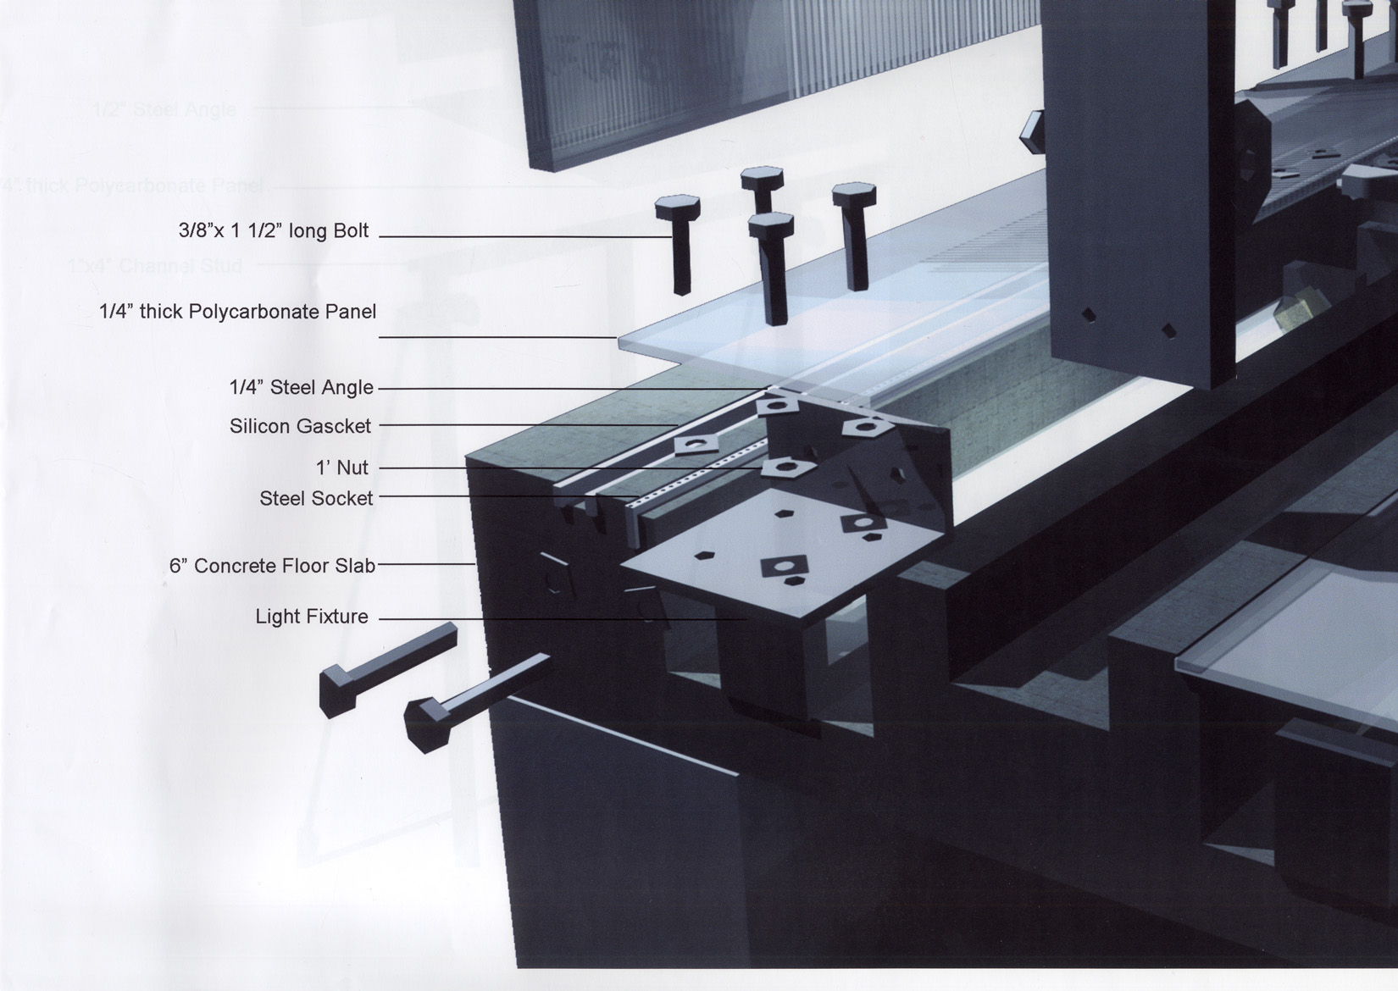
Arch 440, Detail drawing, Student: Daisuke Sadamori

Slide 5
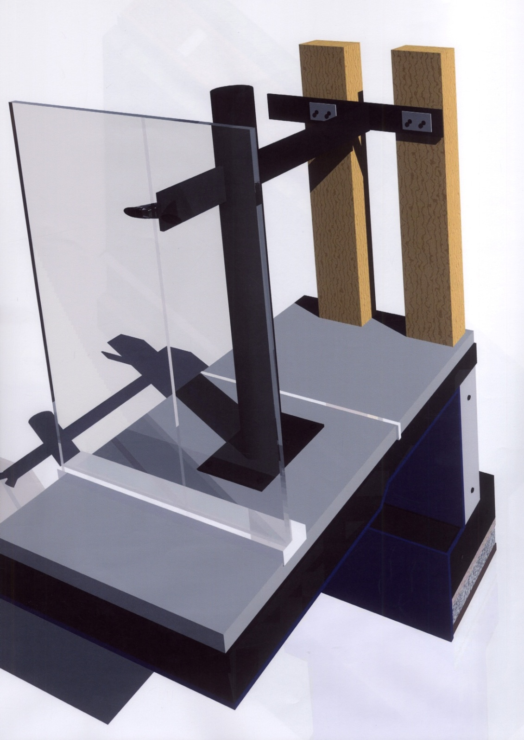
Arch 440, Detail drawing, Student: Sarah Berwald

Slide 6
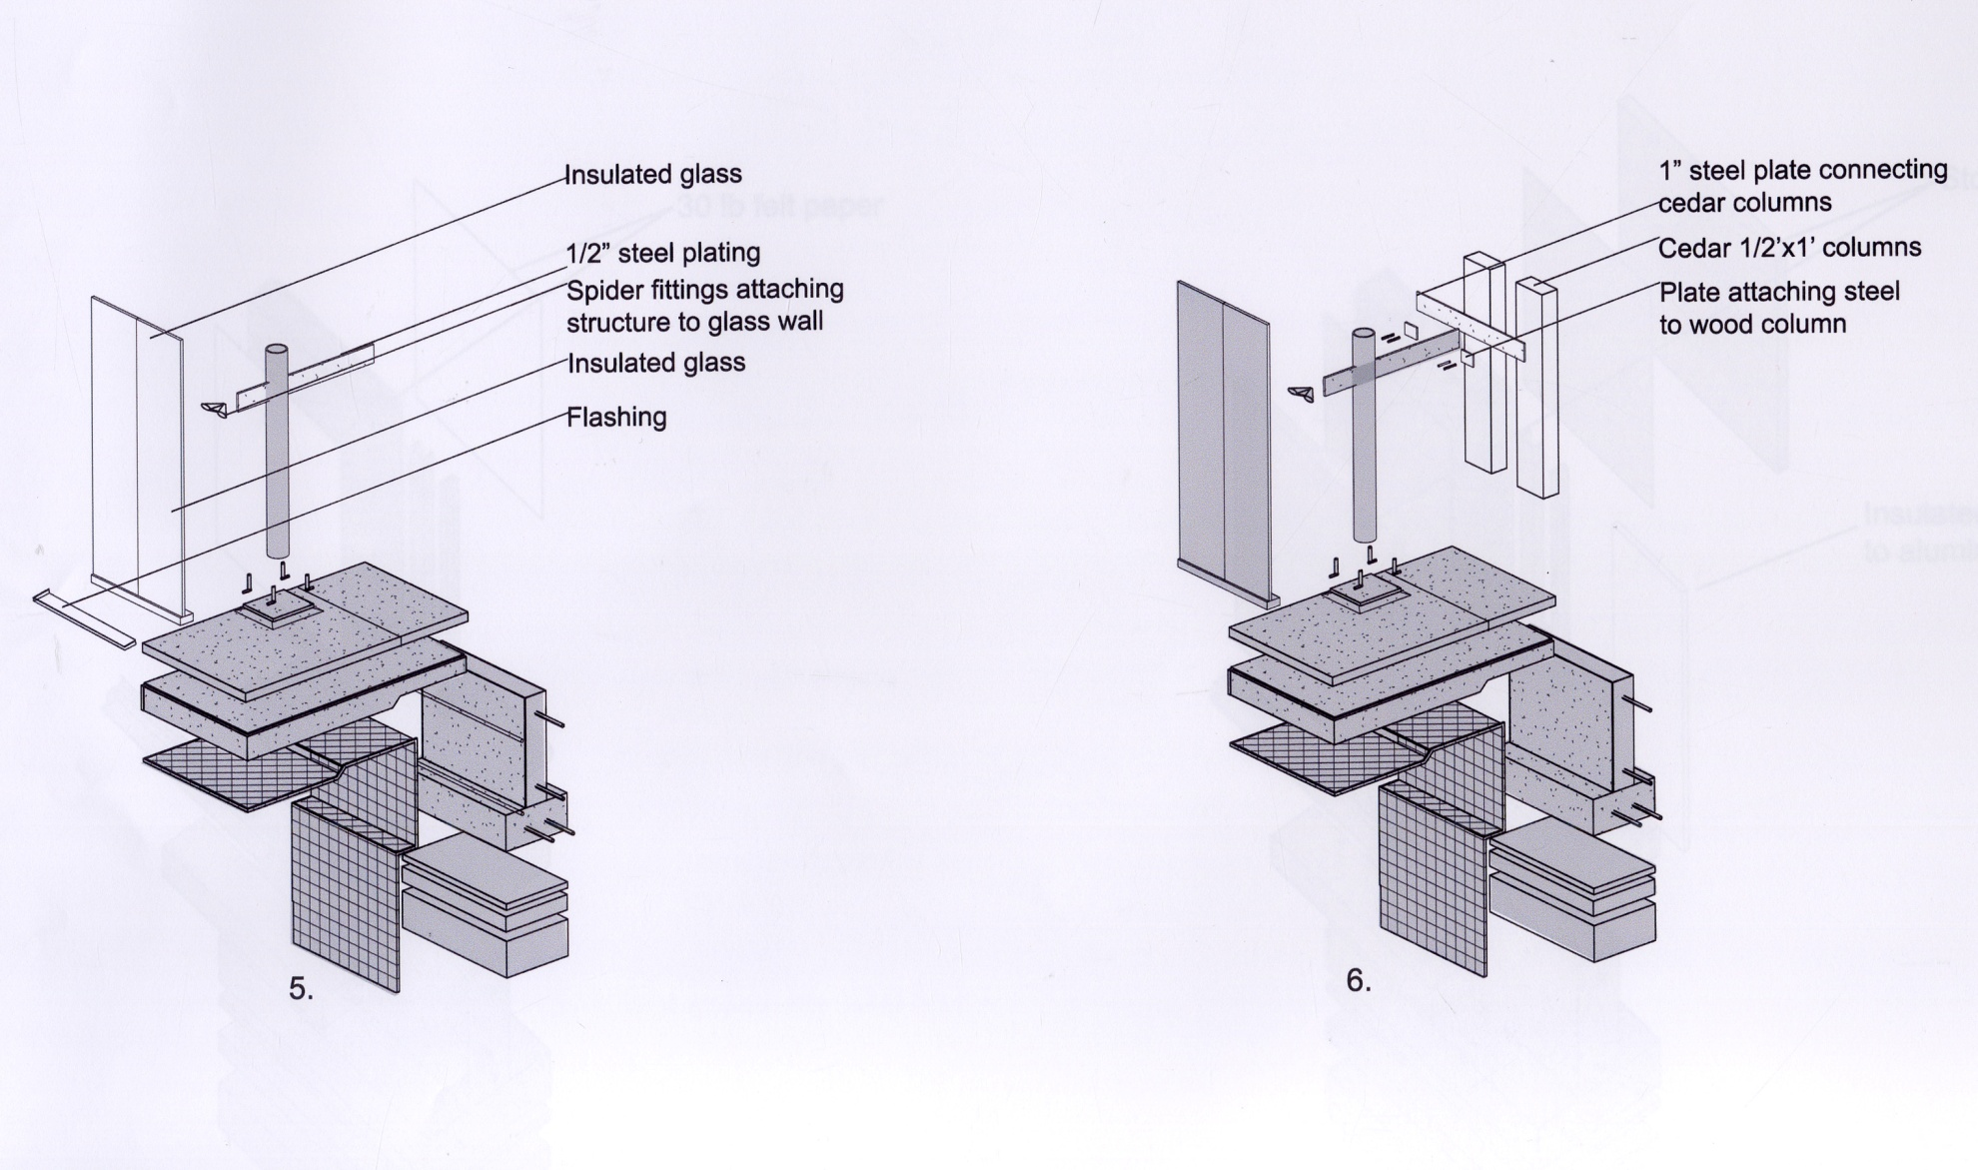
Arch 440, Detail drawing, Student: Sarah Berwald

Slide 7
Arch 440, Detail drawing, Student: Jeffrey Ernst

Slide 8
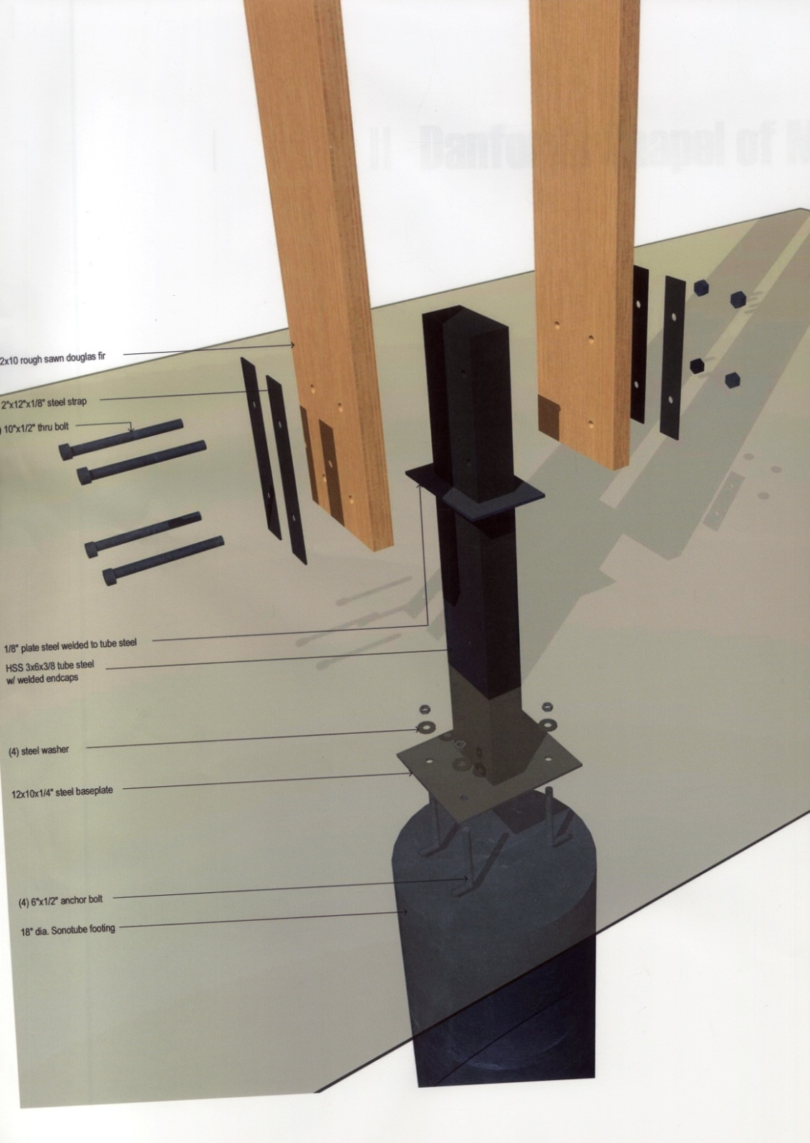
Arch 440, Detail drawing, Student: Marit Leuth

Slide 9
Arch 440, Cover sheet, Final document set, Student: Kelly Fulton

Slide 10
Arch 440, Plan sheet, Final document set, Student: Kelly Fulton

Slide 11
Arch 440, Elevations sheet, Final document set, Student: Kelly Fulton

Slide 12
Arch 440, Sections sheet, Final document set, Student: Kelly Fulton

Slide 13
Arch 440, Wall sections sheet, Final document set, Student: Kelly Fulton

Slide 14
Arch 440, Detail sheet, Final document set, Student: Kelly Fulton

Slide 15
Arch 440, Detail sheet, Final document set, Student: Kelly Fulton

Slide 16
Arch 440, BIM structural system drawing, Student: Chad Schreiner

Slide 17
Arch 440, BIM MEP system drawing, Student: Chad Schreiner

Slide 18
Arch 440, BIM Enclosure system drawing, Student: Chad Schreiner

Slide 19
Arch 440, BIM Interior system drawing, Student: Chad Schreiner

Slide 20
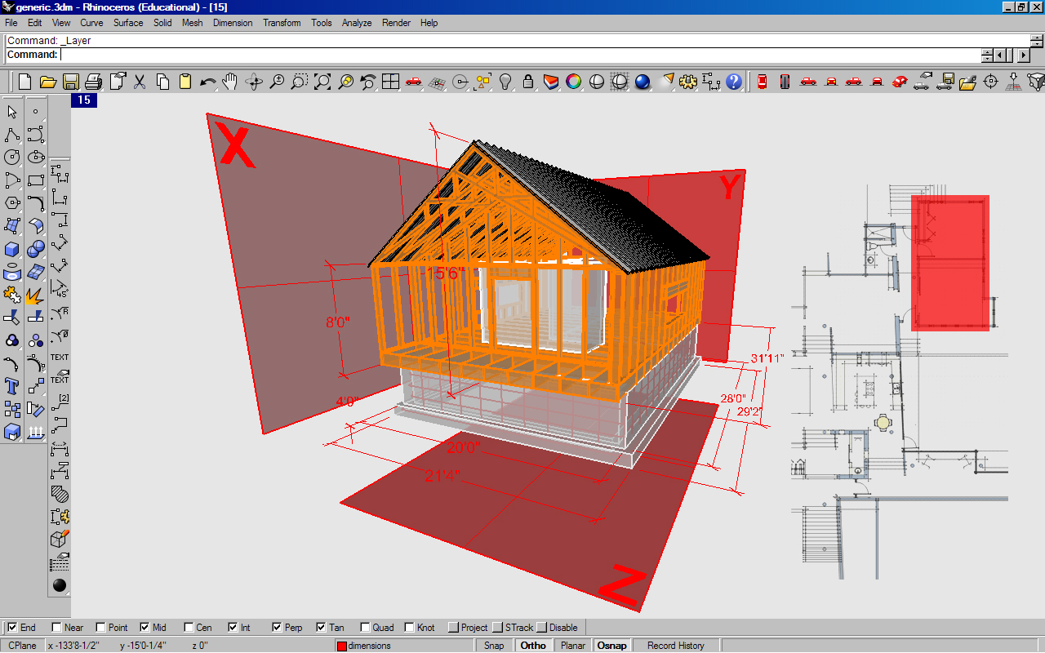
Construction Document Prototype, Student: Casey Walker

Slide 21
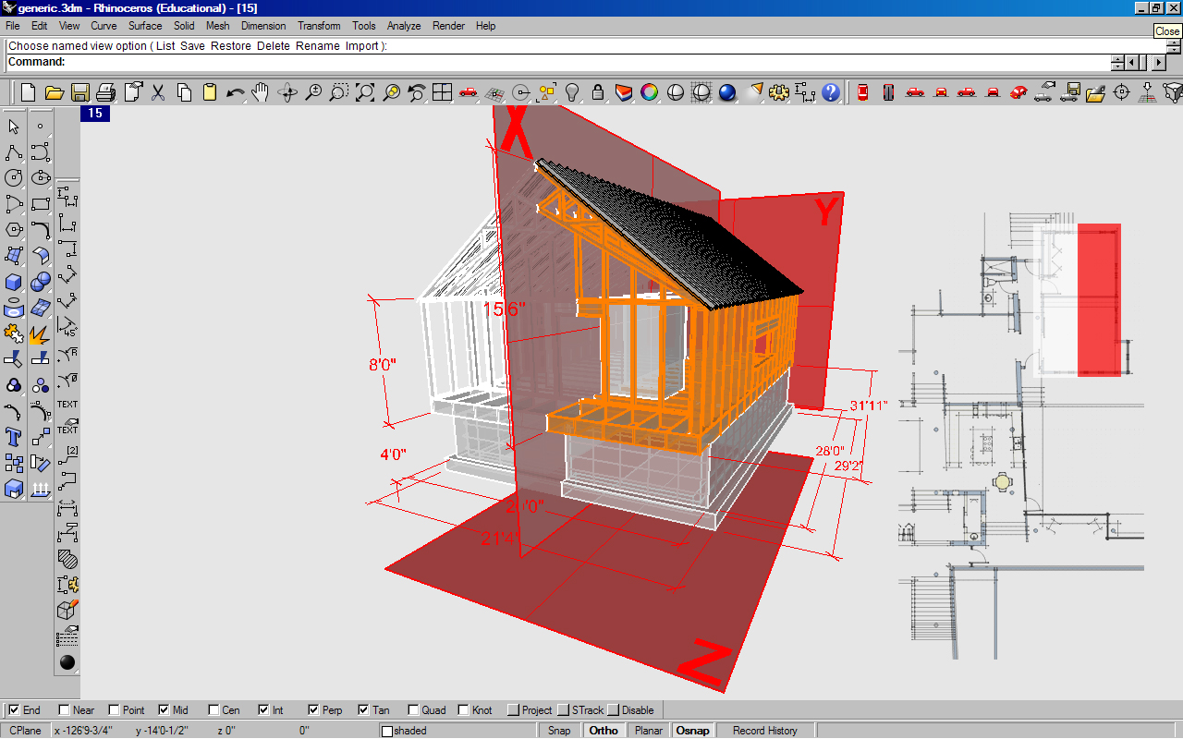

Slide 22
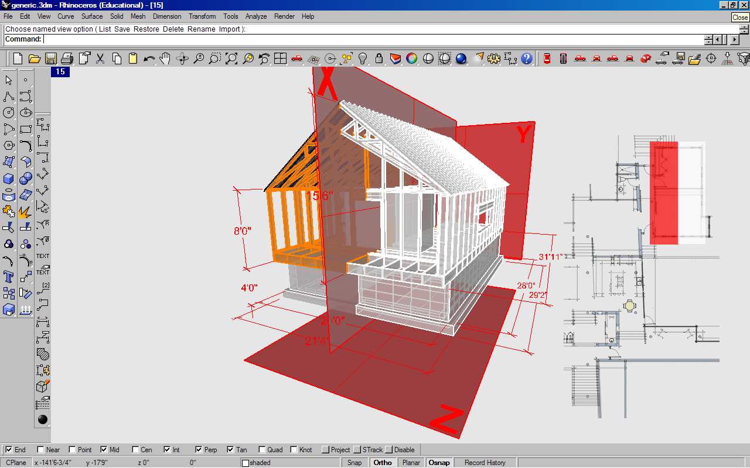

Slide 23
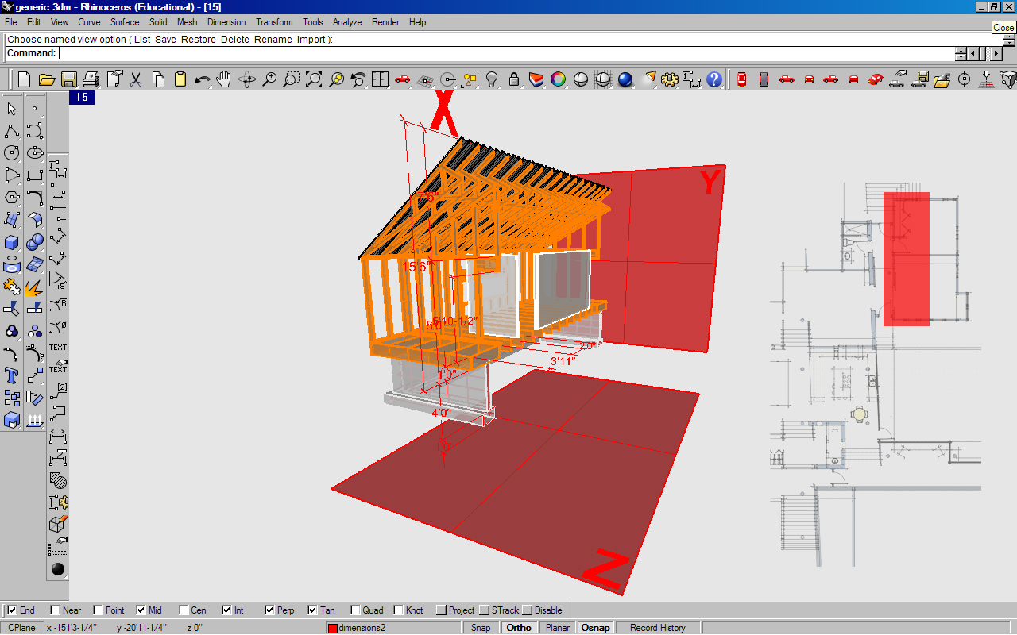

Slide 24
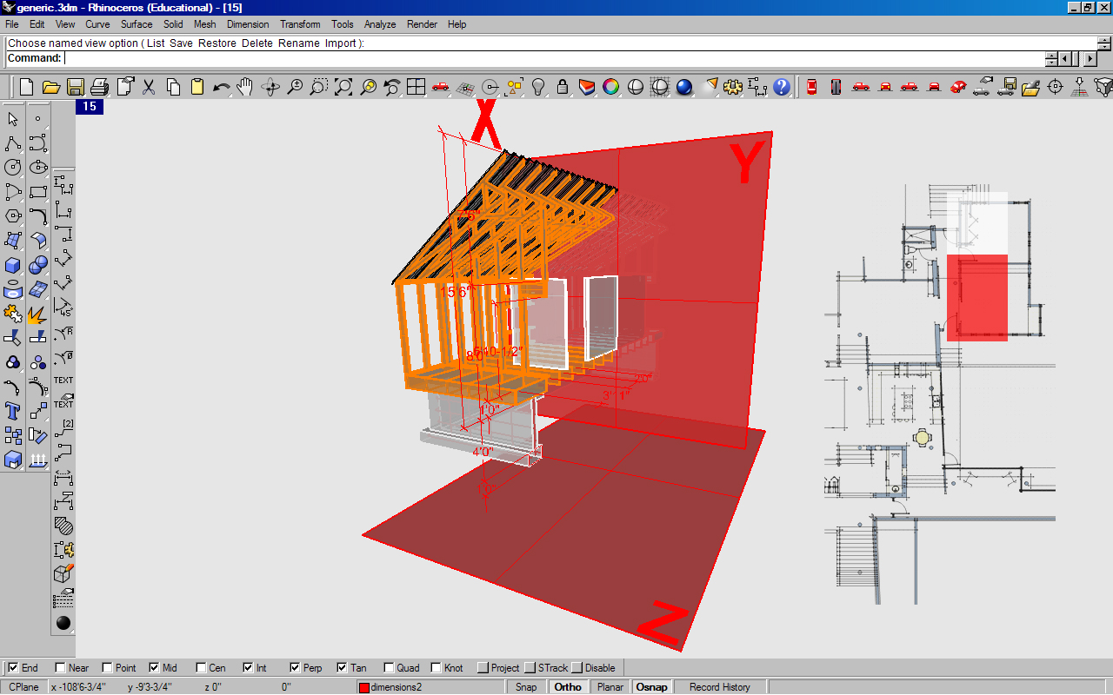

Slide 25
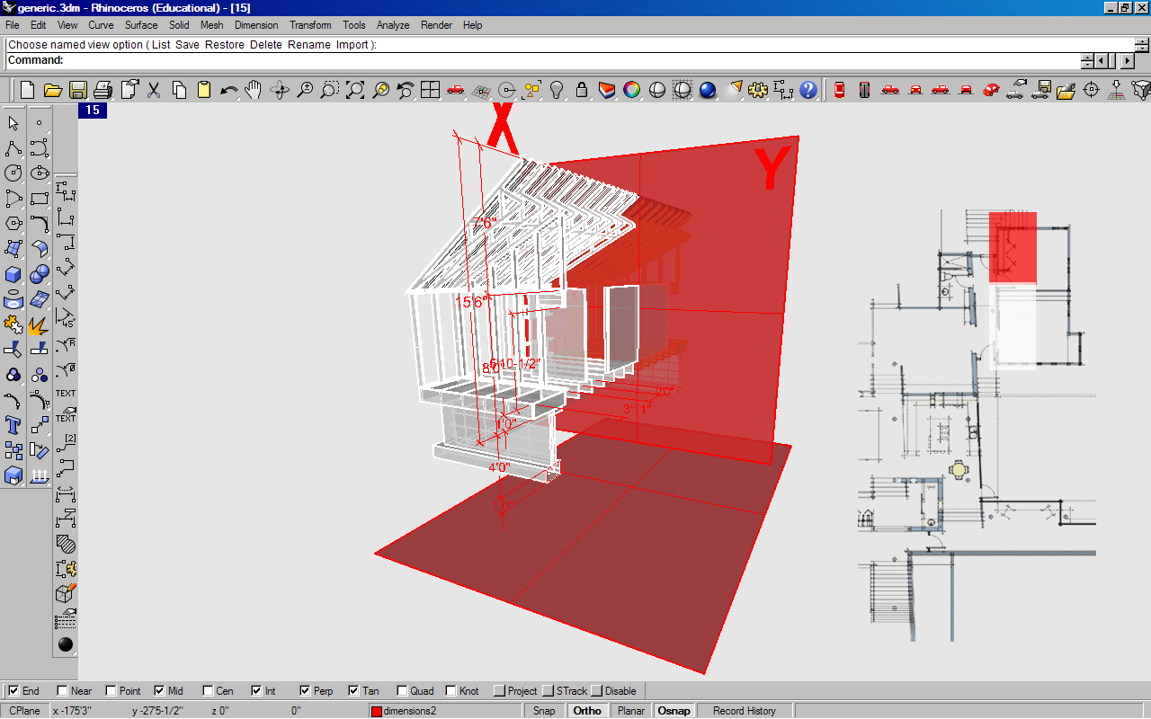

Slide 26
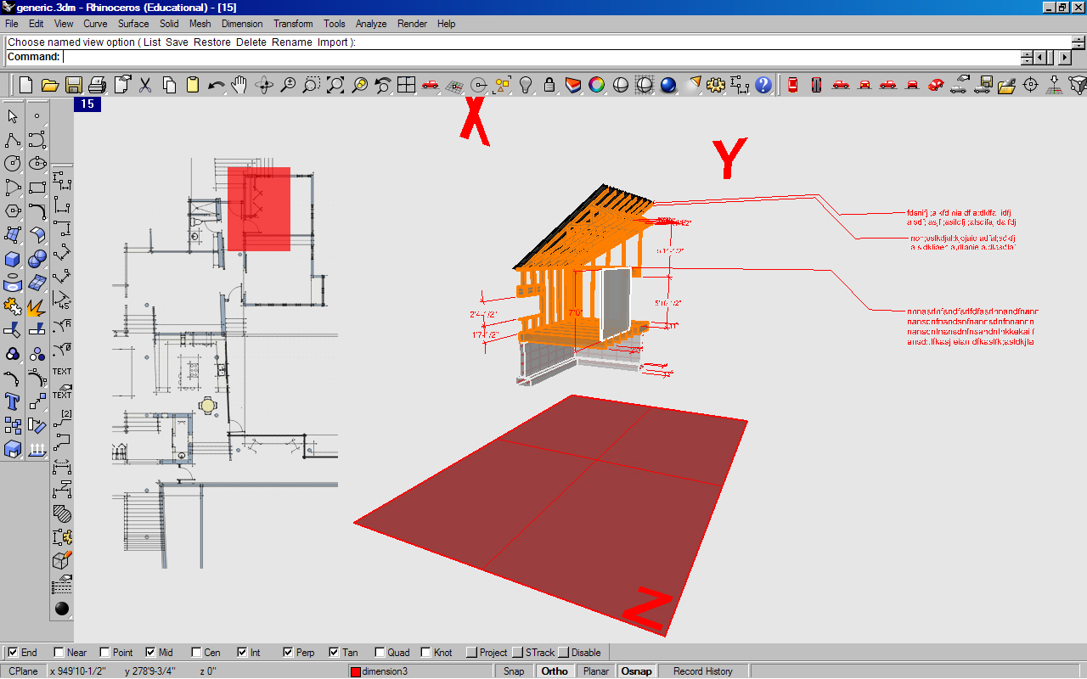

Slide 28
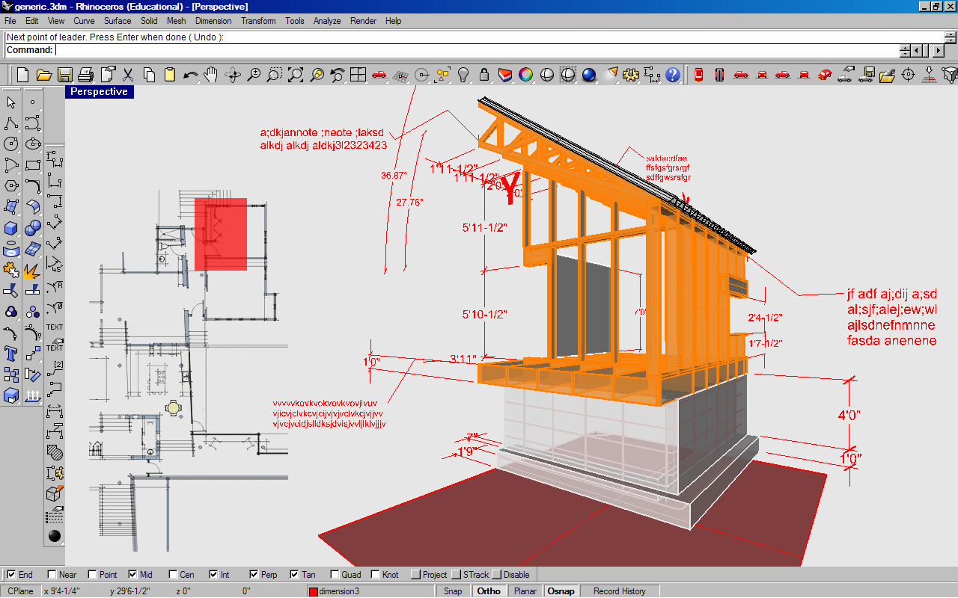

Slide 29
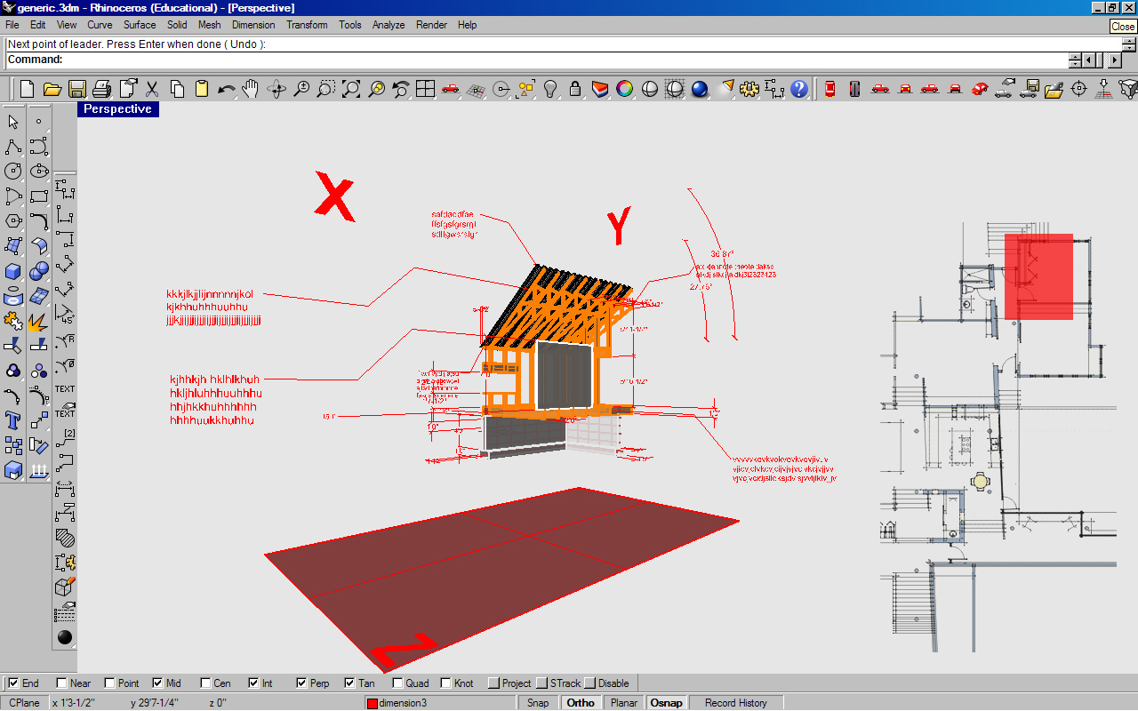

Slide 30
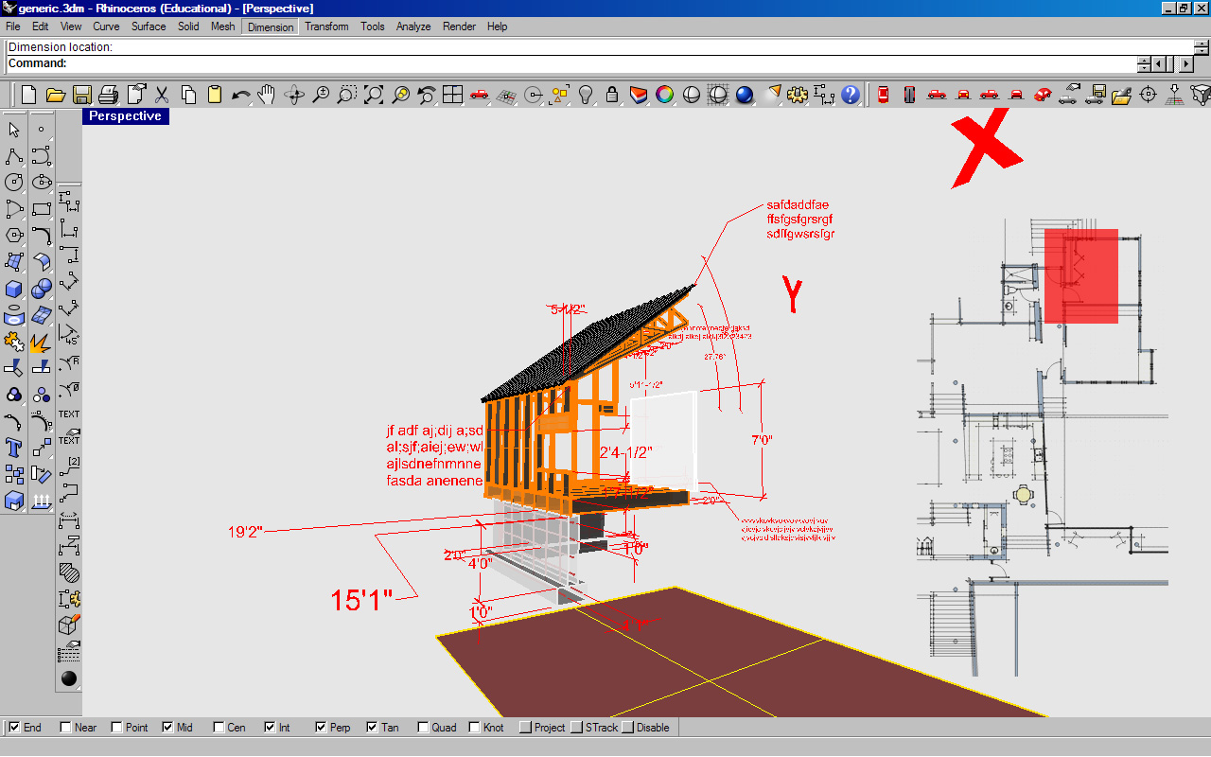

Slide 31
Interactive Work Environment Prototype, spring 2008 Student: Casey Walker

