Slide 1
Asite Solutions Adoddle Navigator
Devendra Gera, Technical Director
Jignesh Mistri, BIM Specialist
Company
logo
07-Jan-14
2014 buidlingSMART Challenge
1

Slide 2
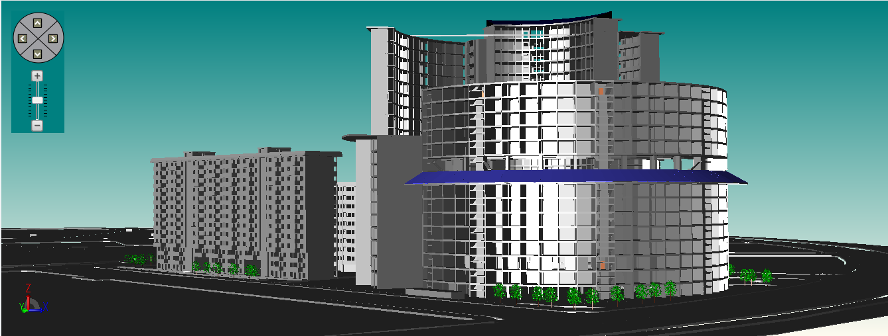
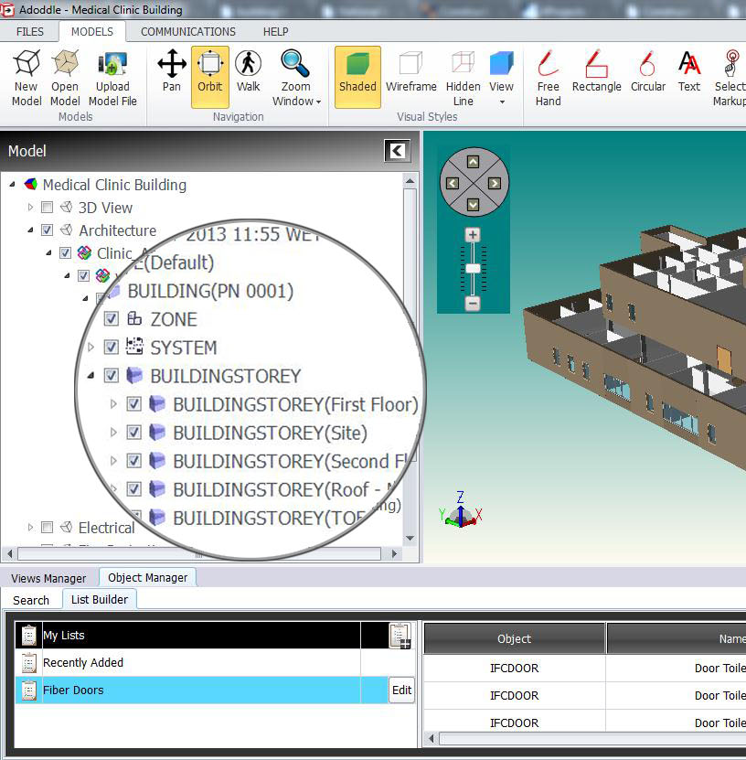
product description
Store and integrate multiple documents, model files and worksets from different project partners - different design tools into one central model
Collaborative approach to modelling makes easier to work with distributed teams, disparate systems and procurement processes.
Connect your commercial data directly to your designs
Bring visibility and control to shared Information Models
Reduce errors from designing in isolation by working in the context of the overall model
Reduce the risk of on-site problems with early design review and tracking of resultant actions
Immediately review the design progression during development and track critical decision making
View and walk through the overall project model and access the rich data without expensive software
Search various object, its revisions, association documents within all AEC disciplines.
Associate plans, specs, and emails to the model in an open and extensible way
07-Jan-14
2014 buidlingSMART Challenge
2

Slide 3
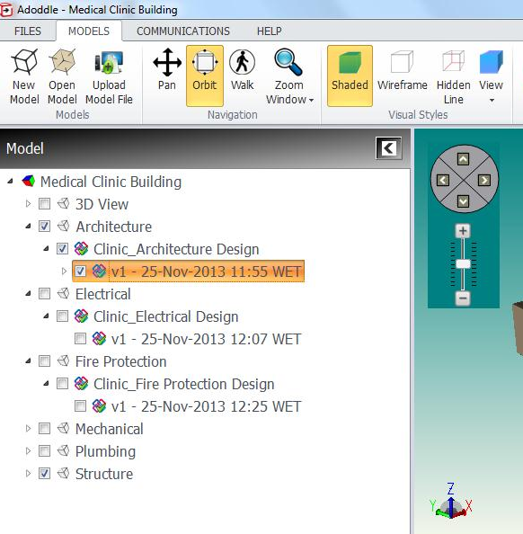
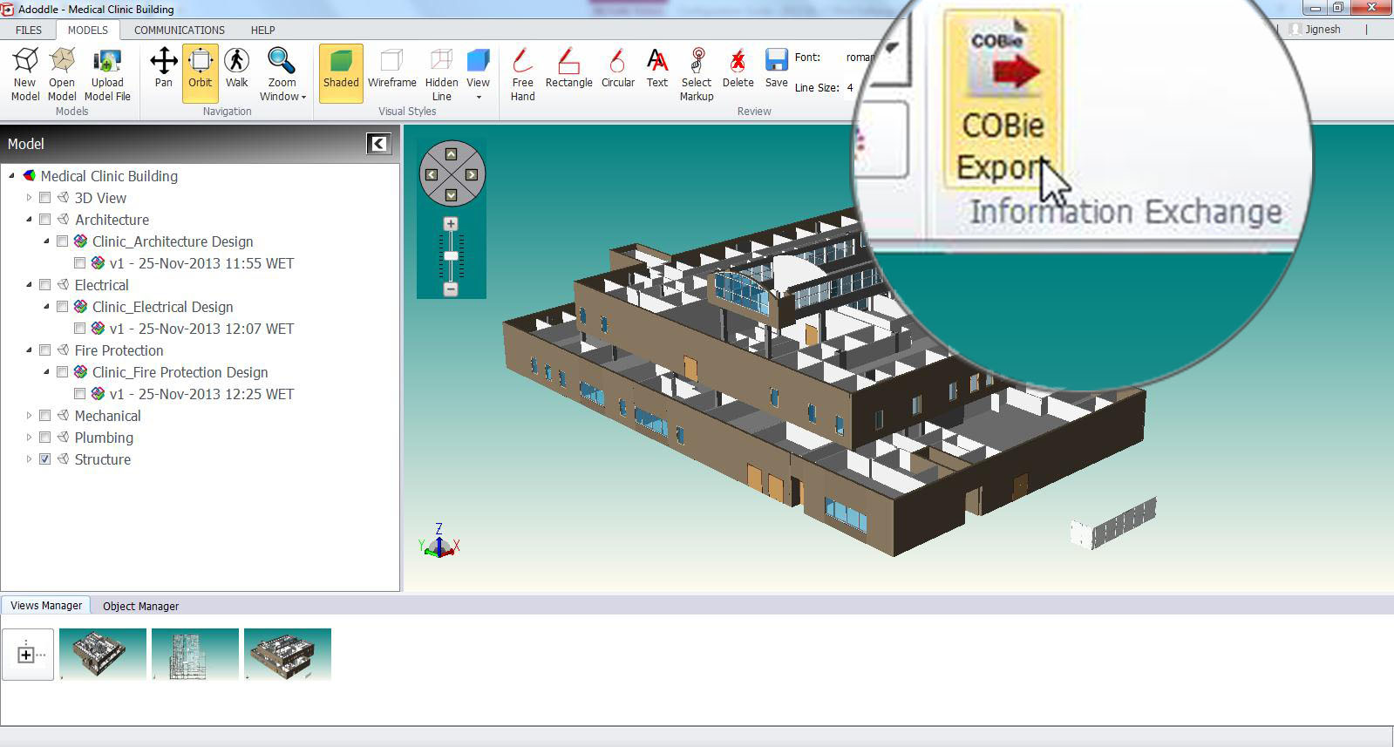
product features
Maintain a clear audit trail by tracking version control and updates to the model
Generates a Revision report (Delta Report) to show the differences between model files revisions uploaded by different users.
Show revision of each object within the latest and existing file revision.
View overall properties/attributes of object in object Detail. Prepare list of various component as per requirement.
View Revision history and Access history to check the file uploading and revision status
Export COBie report at Model level as well as workset level.
Import/Export discipline wise COBie data at workset level to update the model data and model objects to satisfy the different construction stage requirement.
Collaboratively review and mark-up model files in the integrated 3D viewer
Associate views, schedules, and mark-ups with workflows and track actions across your team
Integrate document control and construction management with your BIM coordination process
07-Jan-14
2014 buidlingSMART Challenge
3

Slide 4
user base
users
user count:
facility count:
public sector:
private sector:
customers
name:
name:
name:
109000
8125
30 %
70%
Laing O’Rourke, UK
Environment Agency, UK
Transport for London
07-Jan-14
2014 buidlingSMART Challenge
4

Slide 5
tested product
product name:
product version:
PC or Cloud:
website:
Adoddle Navigator
17.0
Cloud
www.asite.com
07-Jan-14
2014 buidlingSMART Challenge
5

Slide 6
Builders’ COBie challenge scope
information | COBie.Sheet* | Imported | Exported
spaces and equipment | Space, Type**, Component** |  | 
space and equipment properties | Attribute |  | 
equipment PM/safety procedures | Job |  | 
equipment safety procedures | Job |  | 
equipment replacement parts | Spare |  | 
pm materials, tools, training | Resource |  | 
spatial zones | Zone |  | 
equipment systems | System |  | 
system operations procedures | Job |  | 
suppliers, manufacturers, etc… | Contact |  | 
handover documents | Document |  | 
* and supporting COBie sheets as required per standard. ** Import of only Type and Component sheet supported
07-Jan-14
2014 buidlingSMART Challenge
6

Slide 7
configuration
COBie Export
Model Level COBie export
(Publish Model file from Adoddle Navigator)
Workset Level COBie Data Import
(Publish Model file by using Adoddle Revit Plug in)
Workset Level COBie export
Update COBie Data
COBie export
(Publish Model file from Window Explorer)
Click here to Download Configuration Guide
07-Jan-14
2014 buidlingSMART Challenge
7

Slide 8
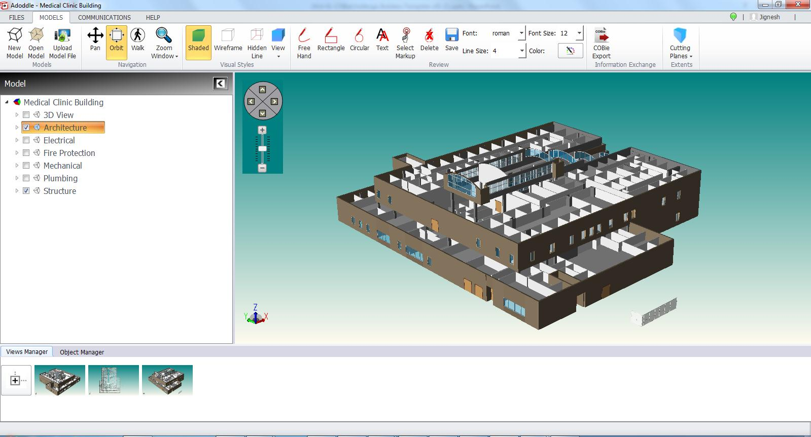
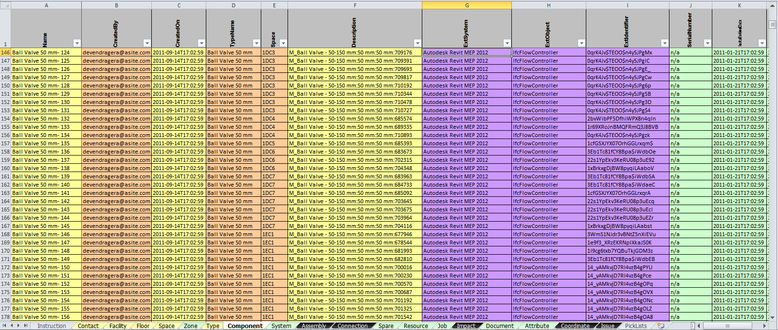
process
COBie Export
for whole Model
Export COBie Data at Model Level
07-Jan-14
2014 buidlingSMART Challenge
8

Slide 9
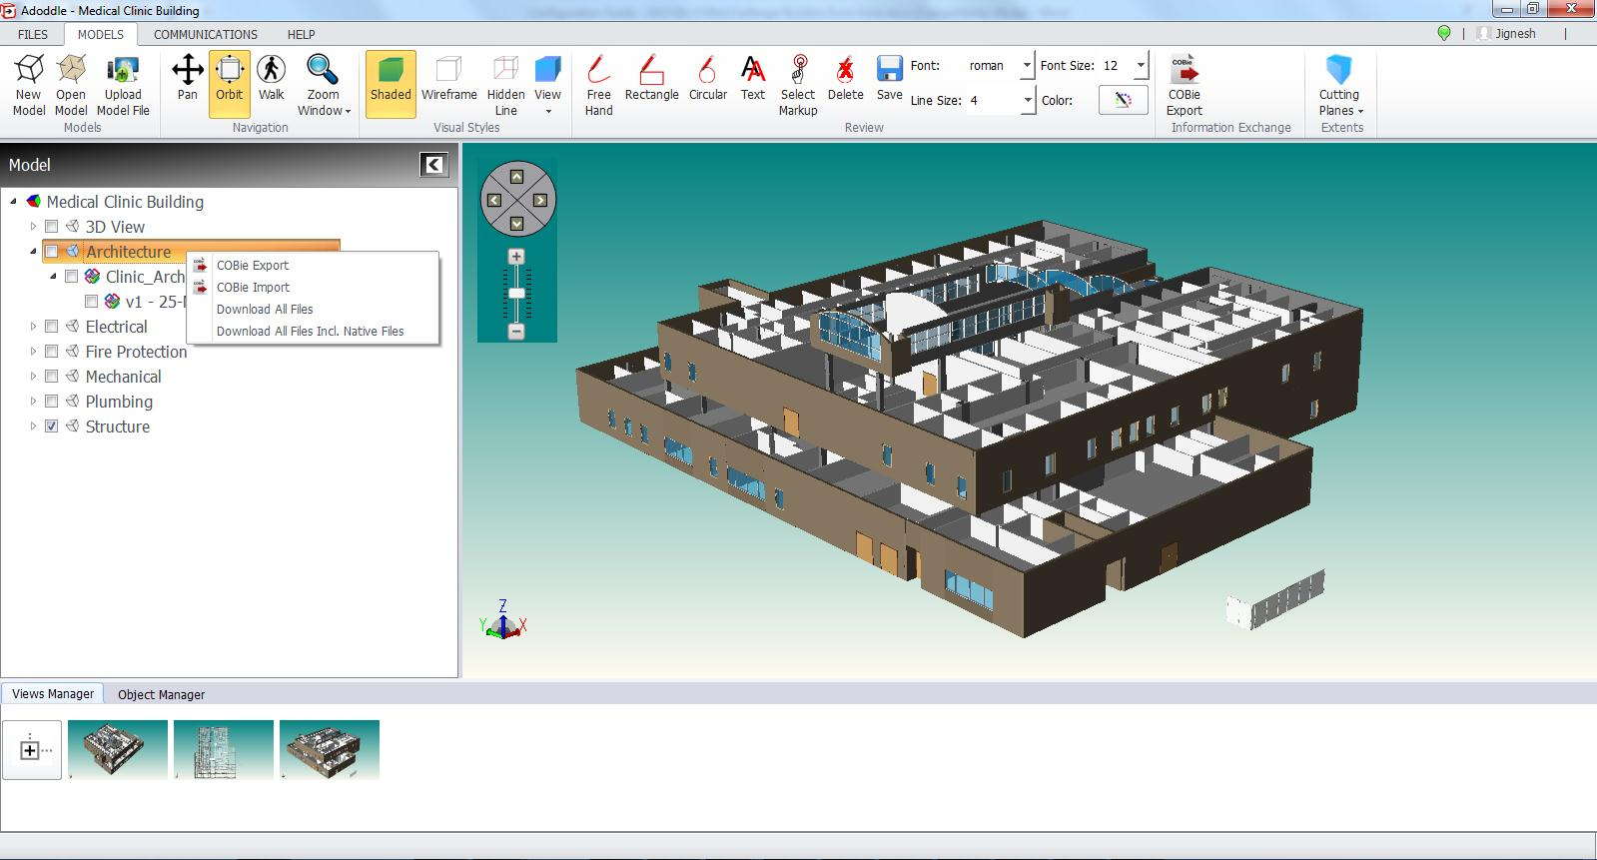
process
COBie Export
for a single workset
Export/Import COBie Data at Workset level
COBie Import
for a single workset
07-Jan-14
2014 buidlingSMART Challenge
9

Slide 10
COBie savings – single project
building type : Clinic
Floors : 3 Floors
total SF : 52500GSF
equipment count: 5071
size of “typical” single project
you wish to highlight for potential customers
“back of napkin” savings:
in data capture from upstream : $63388(5071*0.25Hour*$50)
in capture in construction workflow : $126775(5071*2Times*0.25Hour*$50)
(Average two changes per equipment)
in production of handover data set : $63388 (5071*0.25Hour*$50)
Total $ construction office savings ~ Approx. $253550
07-Jan-14
2014 buidlingSMART Challenge
10

Slide 11
contacts
COBie support
name:
phone:
email:
web:
Marketing POC
name:
phone:
email:
Devendra Gera
+44 7779 355 806
dgera@asite.com
www.asite.com
Tracey Saunders
+44 (0) 207 749 7880
tsaunders@asite.com
07-Jan-14
2014 buidlingSMART Challenge
11

