Slide 1
GRAPHISOFT SE ArchiCAD
Ákos Rechtorisz, Product Manager, Interoperability (IFC)
Monte Chapin, Business Process Leader
07-Jan-14
2014 buidlingSMART Challenge
1

Slide 2
product features
support of all IFC2x3 file versions: .ifc, .ifcxml, .ifczip
support of ‘reference model concept’
detect IFC model changes
collision detection with IFC HVAC models (MEP Modeler)
About ‘Interoperability’ (IFC) –related features:
‘open BIM’ interoperability with other disciplines (structural and MEP)
07-Jan-14
2014 buidlingSMART Challenge
2

Slide 3
product features
MVDs developed within buildingSMART:
IFC2x3 Coordination View
Quantity Take-off add-on view
Space Boundary add-on view
2D Annotation add-on view
IFC2x3 Coordination View (Surface Geometry)
IFC2x3 Basic FM HandOver view (required by COBie2)
About ‘Interoperability’ (IFC) –related features:
‘open BIM’ interoperability with other disciplines (structural and MEP)
Model View Definitions (MVD)
07-Jan-14
2014 buidlingSMART Challenge
3

Slide 4
product features
MVDs developed within buildingSMART
MVDs developed outside of buildingSMART:
Concept Design BIM 2010 required by
GSA (US)
Senate Properties (Finland)
Statsbygg (Norway)
About ‘Interoperability’ (IFC) –related features:
‘open BIM’ interoperability with other disciplines (structural and MEP)
Model View Definitions (MVD)
07-Jan-14
2014 buidlingSMART Challenge
4

Slide 5
product features
IFC Entity Classification
IFC Assignments:
IFC Group
IFC Zone
IFC System
IFC Actor
IFC Occupant
IFC Time Series Schedule
About ‘Interoperability’ (IFC) –related features:
‘open BIM’ interoperability with other disciplines (structural and MEP)
Model View Definitions (MVD)
IFC data and user-interface
07-Jan-14
2014 buidlingSMART Challenge
5

Slide 6
product features
IFC Entity Classification
IFC Assignments
IFC Type Products support of all types
About ‘Interoperability’ (IFC) –related features:
‘open BIM’ interoperability with other disciplines (structural and MEP)
Model View Definitions (MVD)
IFC data and user-interface
07-Jan-14
2014 buidlingSMART Challenge
6

Slide 7
product features
IFC Entity Classification
IFC Assignments
IFC Type Products
IFC Psets and Properties
standard
built-in schemes:
Concept Design BIM 2010
CObie2
custom (new Psets and Properties)
About ‘Interoperability’ (IFC) –related features:
‘open BIM’ interoperability with other disciplines (structural and MEP)
Model View Definitions (MVD)
IFC data and user-interface
07-Jan-14
2014 buidlingSMART Challenge
7

Slide 8
product features
IFC Entity Classification
IFC Assignments
IFC Type Products
IFC Psets and Properties
IFC Classification Reference
built-in classification rules:
OmniClass (Table 11/13/21 and 23)
Uniclass
other local standards
custom (new Classification Reference)
About ‘Interoperability’ (IFC) –related features:
‘open BIM’ interoperability with other disciplines (structural and MEP)
Model View Definitions (MVD)
IFC data and user-interface
07-Jan-14
2014 buidlingSMART Challenge
8

Slide 9
product features
IFC Entity Classification
IFC Assignments
IFC Type Products
IFC Psets and Properties
IFC Classification Reference
Base Quantities: required by
Quantity Take-off add-on view
Concept Design BIM 2010 MVD
COBie2 Documentation
About ‘Interoperability’ (IFC) –related features:
‘open BIM’ interoperability with other disciplines (structural and MEP)
Model View Definitions (MVD)
IFC data and user-interface
07-Jan-14
2014 buidlingSMART Challenge
9

Slide 10
tested product
product name:
product version:
PC or Cloud:
website:
Publically available?
ArchiCAD
17
PC (WIN and MAC)
www.graphisoft.com
Yes

Slide 11
Designers’ COBie challenge scope
information | COBie.Sheet* | Exported
spaces and equipment | Space, Type, Component | 
space and equipment properties | Attribute | 
spatial zones | Zone | 
equipment systems | System | 
* and supporting COBie sheets as required per standard.
07-Jan-14
2014 buidlingSMART Challenge
11

Slide 12
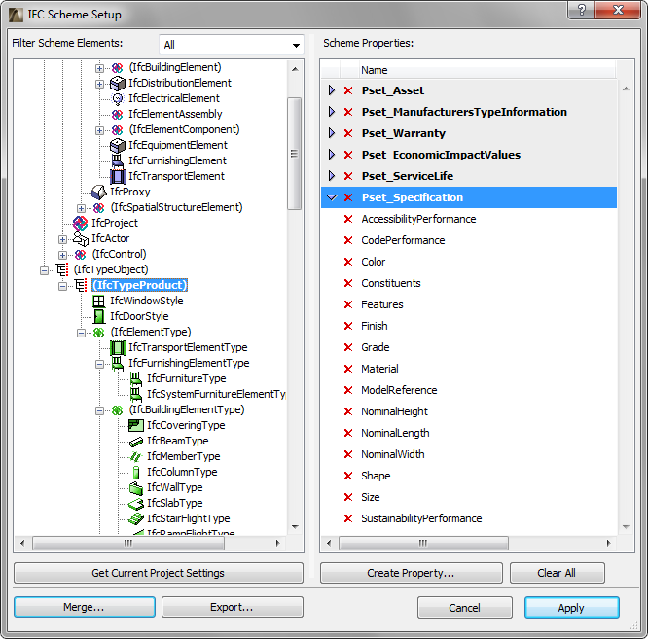
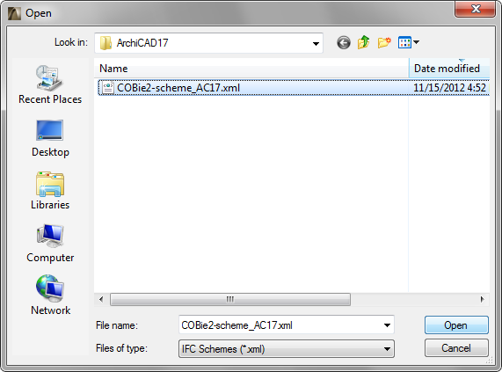
configuration
1. ‘COBie’ scheme
07-Jan-14
2014 buidlingSMART Challenge
12

Slide 13
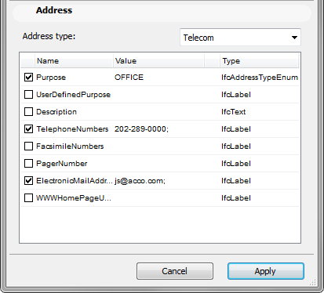
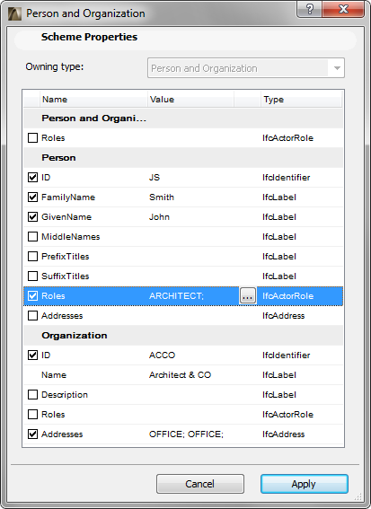
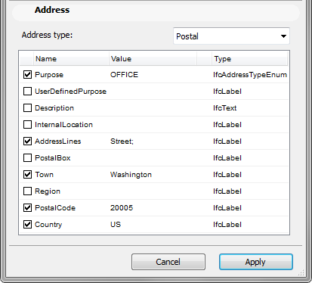
configuration
2. ‘Contact’ configuration
07-Jan-14
2014 buidlingSMART Challenge
13

Slide 14
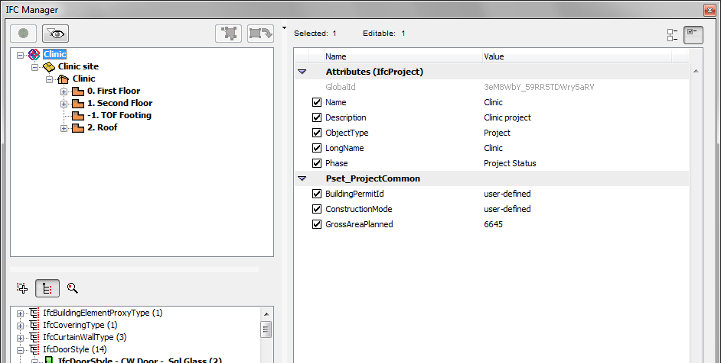
configuration
3. ‘Facility’ configuration
PROJECT
07-Jan-14
2014 buidlingSMART Challenge
14

Slide 15
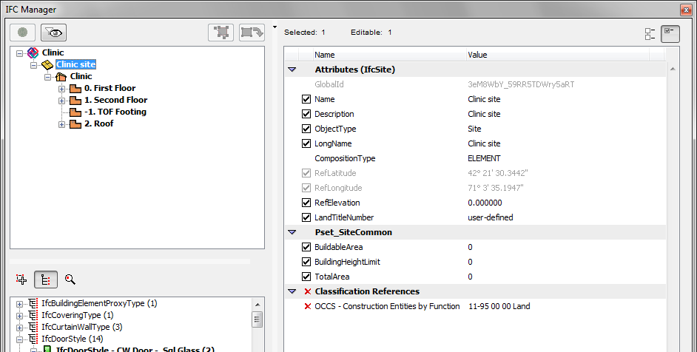
configuration
3. ‘Facility’ configuration
SITE
07-Jan-14
2014 buidlingSMART Challenge
15

Slide 16
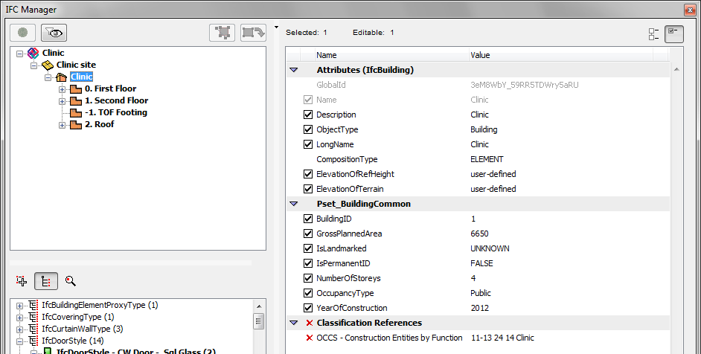
configuration
3. ‘Facility’ configuration
BUILDING
07-Jan-14
2014 buidlingSMART Challenge
16

Slide 17
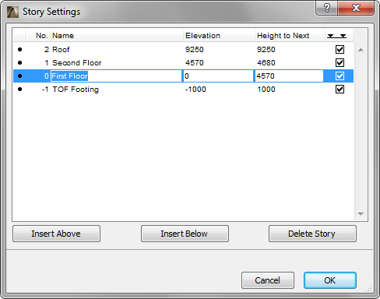
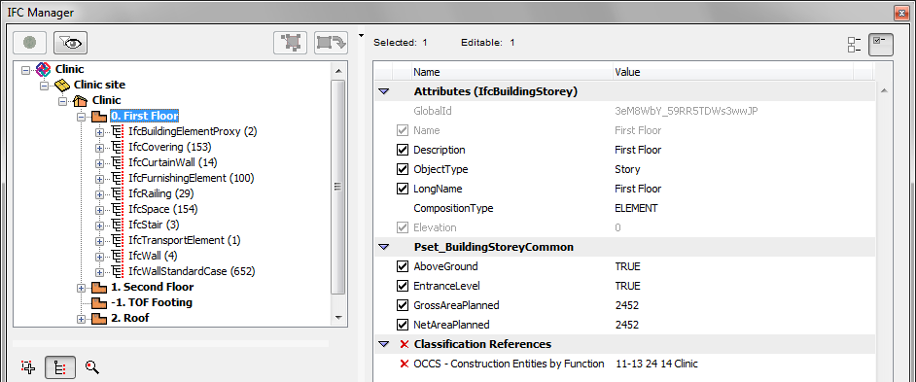
configuration
4. ‘Floor’ configuration
07-Jan-14
2014 buidlingSMART Challenge
17

Slide 18
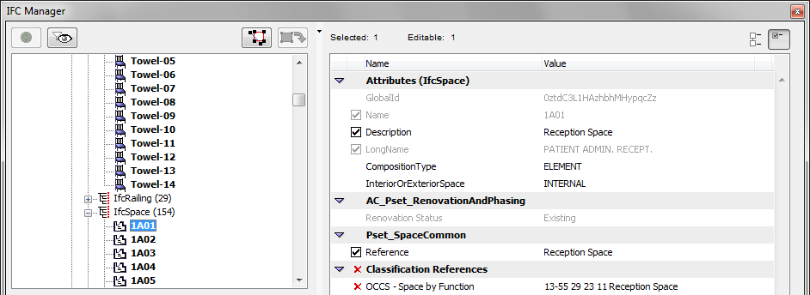
configuration
5. ‘Space’ configuration
07-Jan-14
2014 buidlingSMART Challenge
18

Slide 19
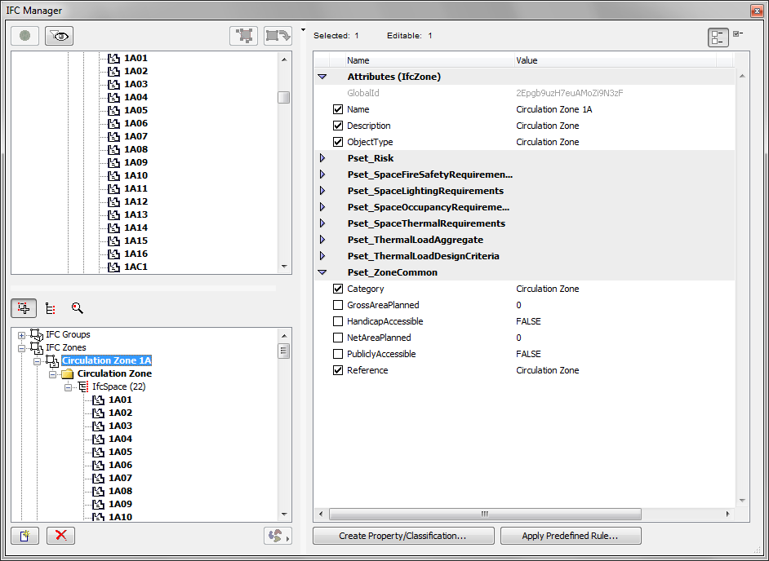
configuration
6. ‘Zone’ configuration
07-Jan-14
2014 buidlingSMART Challenge
19

Slide 20
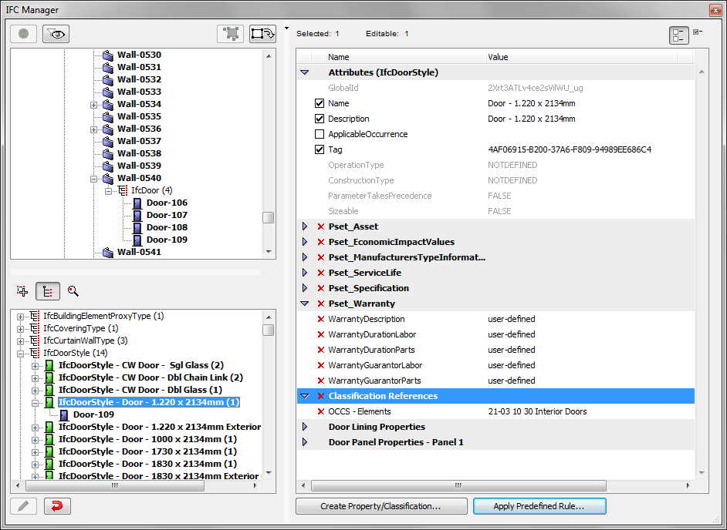
configuration
7. ‘Type’ configuration
07-Jan-14
2014 buidlingSMART Challenge
20

Slide 21
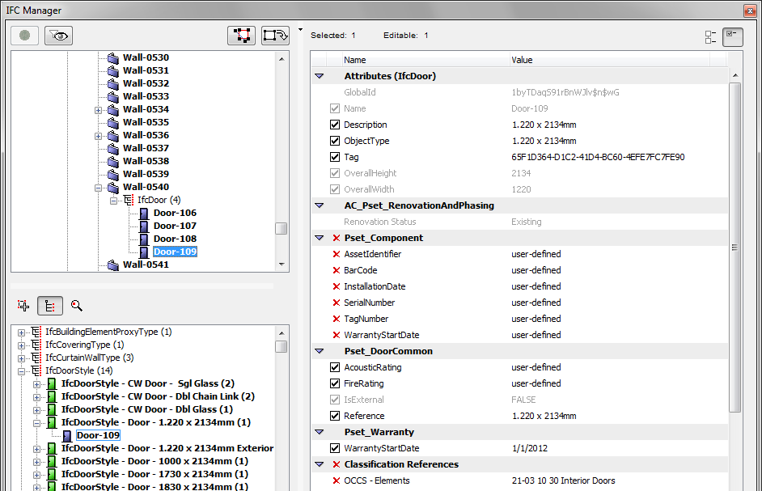
configuration
8. ‘Component’ configuration
07-Jan-14
2014 buidlingSMART Challenge
21

Slide 22
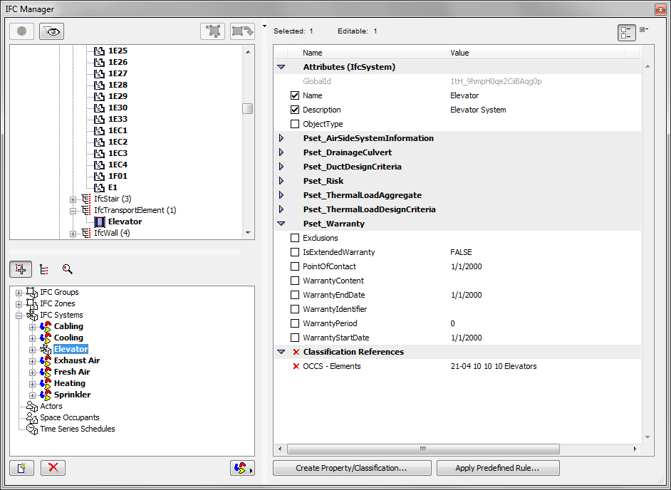
configuration
9. ‘System’ configuration
07-Jan-14
2014 buidlingSMART Challenge
22

Slide 23
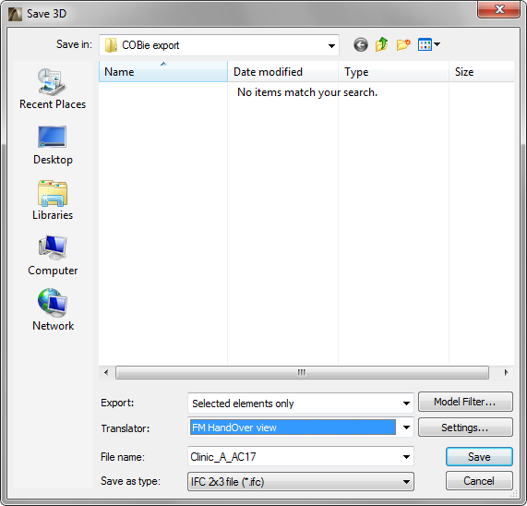
process
One step: Save project as IFC
‘one-click’ export
07-Jan-14
2014 buidlingSMART Challenge
23

Slide 24
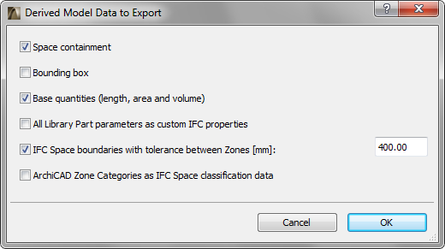
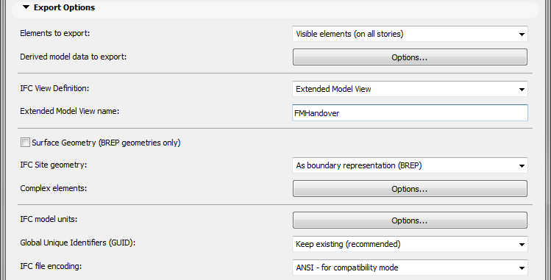
process
Predefined IFC export settings (‘Translator’) for COBie
07-Jan-14
2014 buidlingSMART Challenge
24

